Slide 1
The Treaty of Versailles

Slide 2
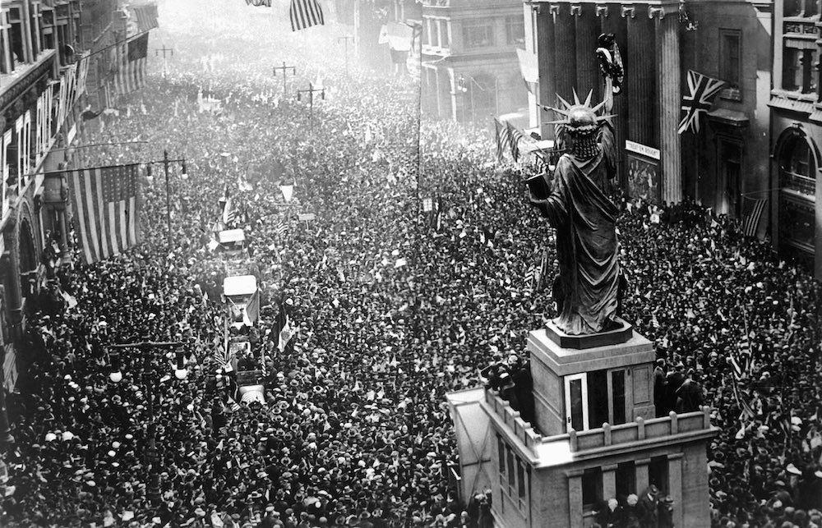
Armistice
War officially ends on November 11, 1918
Kaiser had been informed that the military situation for Germany was hopeless in September – had a truce issued to the Allied Powers
German people had grown tired of the war
British blockade had done its job – Germany was in a bad economic situation
Only military men (non-officers) felt the war could be won – no real ground had been given up

Slide 3
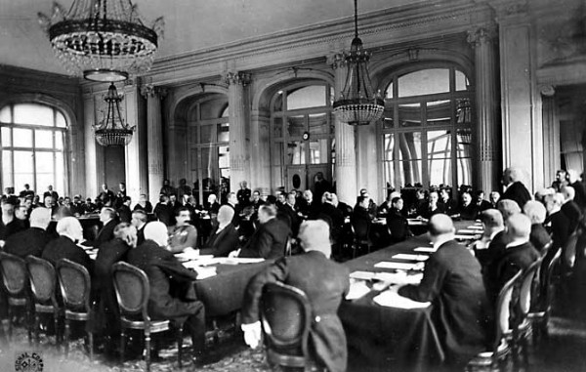
Paris Peace Conference
January 1919 – representatives of 27 Allied nations met in Paris
War was fought for territorial gains & idealistic reasons
Complications soon became obvious – number of secret treaties had been made

Slide 4
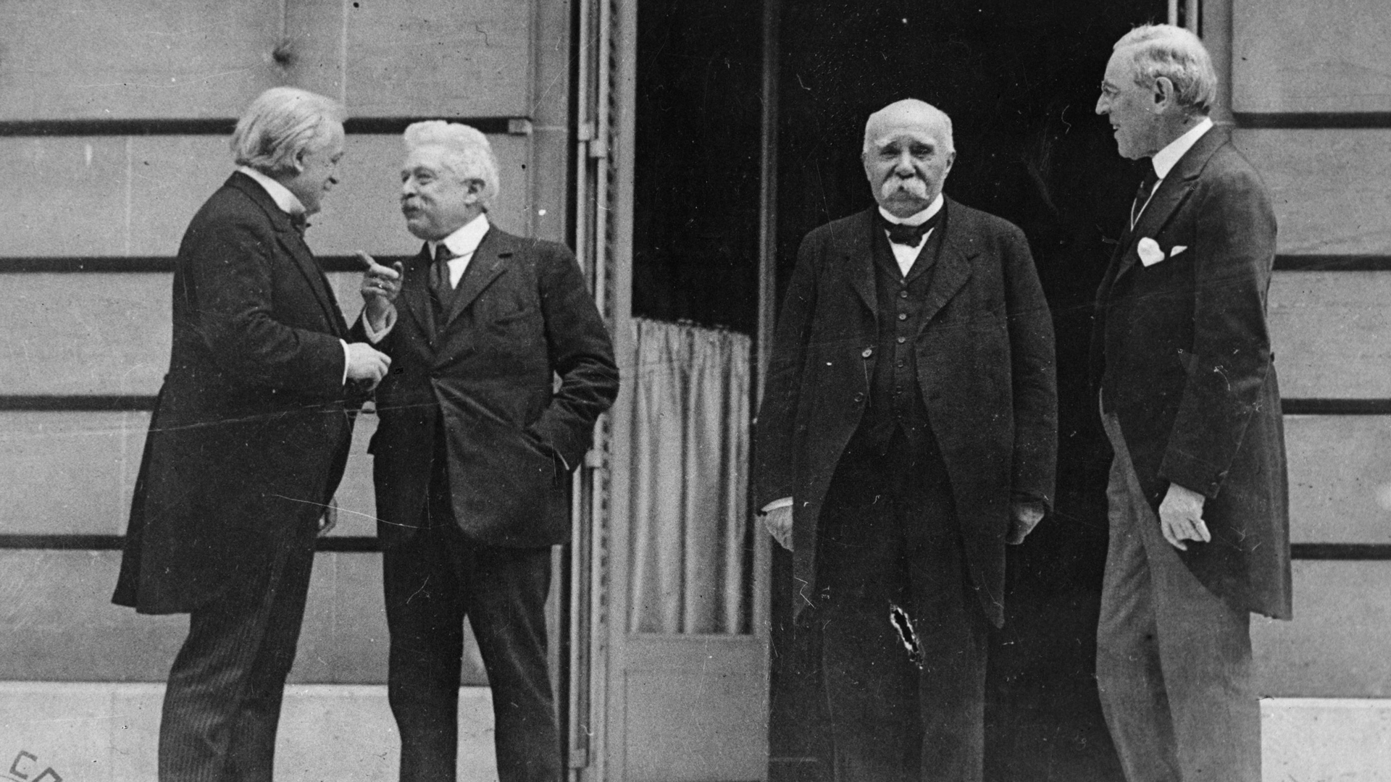
The big four
David Lloyd George – British PM – make Germany pay for the war
Georges Clemenceau – French PM – desired revenge against Germany
Woodrow Wilson – President of USA – Self-determination
Vittorio Orlando – Italian PM – took a backseat to the other three

Slide 5
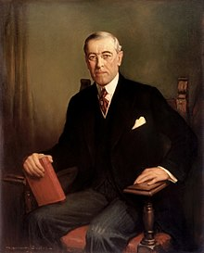
Wilson’s Fourteen Points
Basis for peace settlement that Wilson believed justified the war
Portrayed war as being against absolutism and militarism
Spokesman for new world order based on democracy & international cooperation
Soon realized the other victors were guided by more practical motives

Slide 6
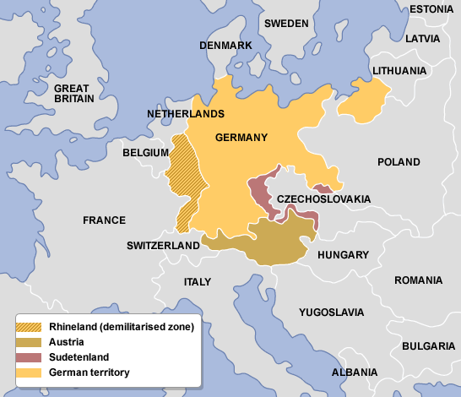
Compromises
Wilson wanted a world organization to prevent future war; Lloyd George and Clemenceau wanted to punish Germany
League of Nations created, but territorial gains allowed
Rhineland buffer zone created & defensive alliance made with US, GB, & France

Slide 7
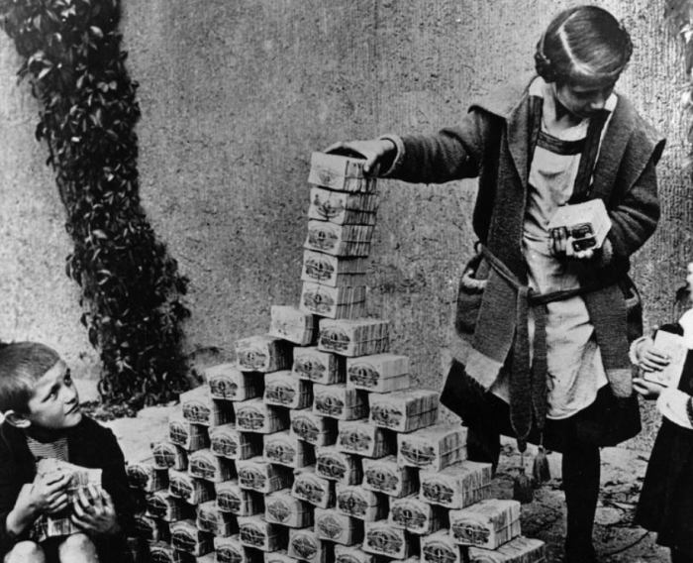
Treaty of Versailles
Germany:
must accept blame for the war – War Guilt Clause
Must pay reparations for all damages
Reduce army to 100,000 men, cut back navy, eliminate air force
Gave Alsace & Lorraine back to France, parts of eastern Germany went to Poland

Slide 8
Legacy
Map of Europe redrawn – Austria-Hungary broken up
New Nations created: Finland, Latvia, Estonia, Lithuania, Poland, Czechoslovakia
Principle of Self-Determination
Ottoman Empire also broken up
Shattered the liberal, rational society that had existed

Slide 9
