Slide 1
The Times They Are A Changin’: The 1960s

Slide 3
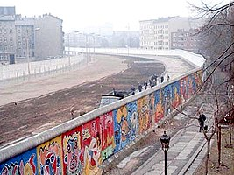
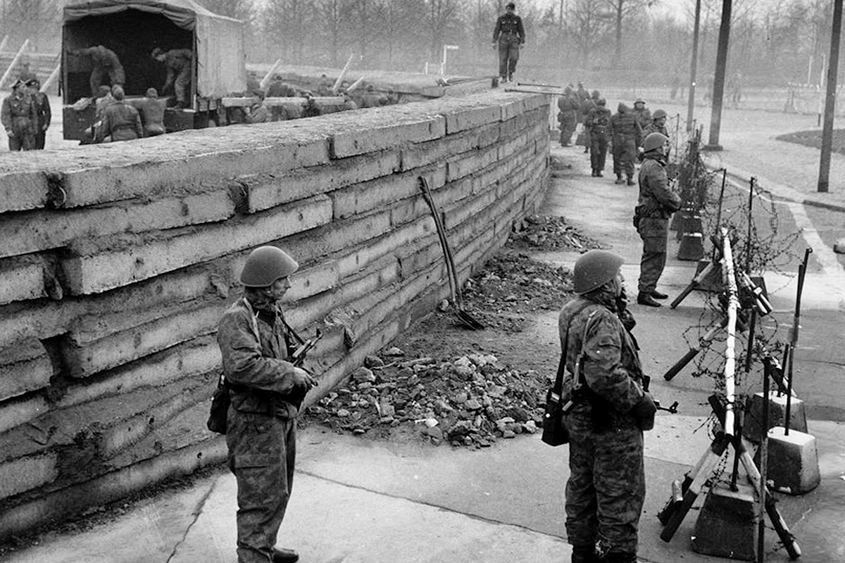
The Berlin Wall (1961 – 1989)

Slide 4
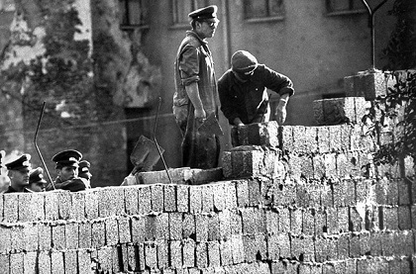
Why was the Wall built?
Short Answer: to keep people in East Germany
Long Answer:
To stop emigration from East Germany to West Germany
WG had been built up by the Marshall Plan – made it a desirable place to live
People fled to WG to escape a brutal regime, scarcity, and to re-unite with family
Weakened the EG economy

Slide 5
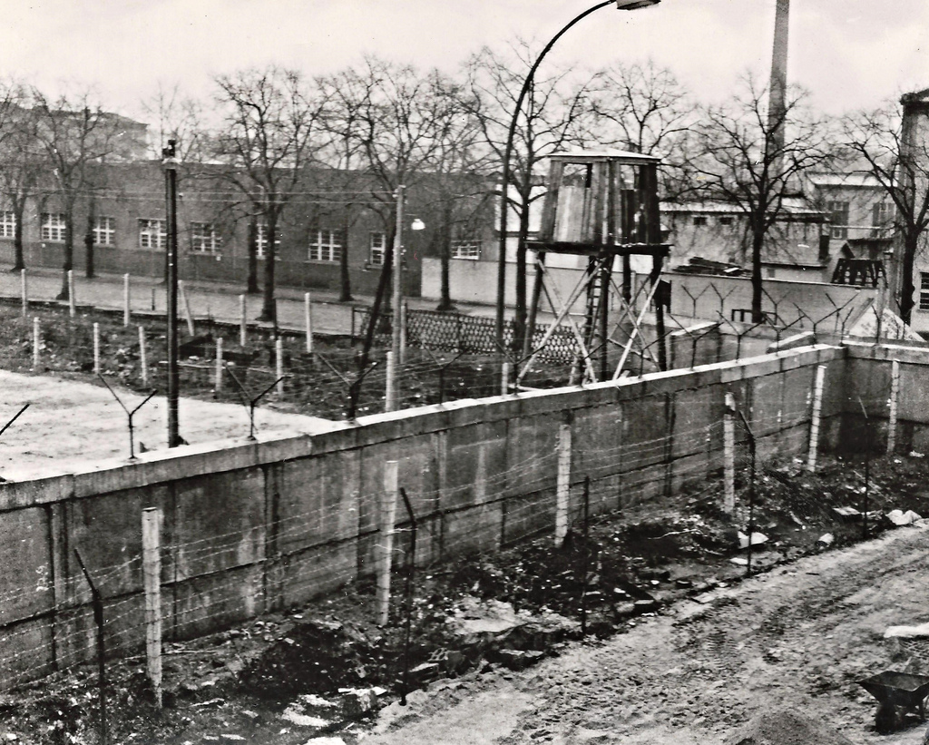
What did it come to symbolize?
It came to represent the difference between western democrats and eastern communists and the way they thought Germany (and the world) should be led.
Became the literal representation of the Iron Curtain
For Germans it became a symbol of national frustration, loss, and hatred

Slide 7
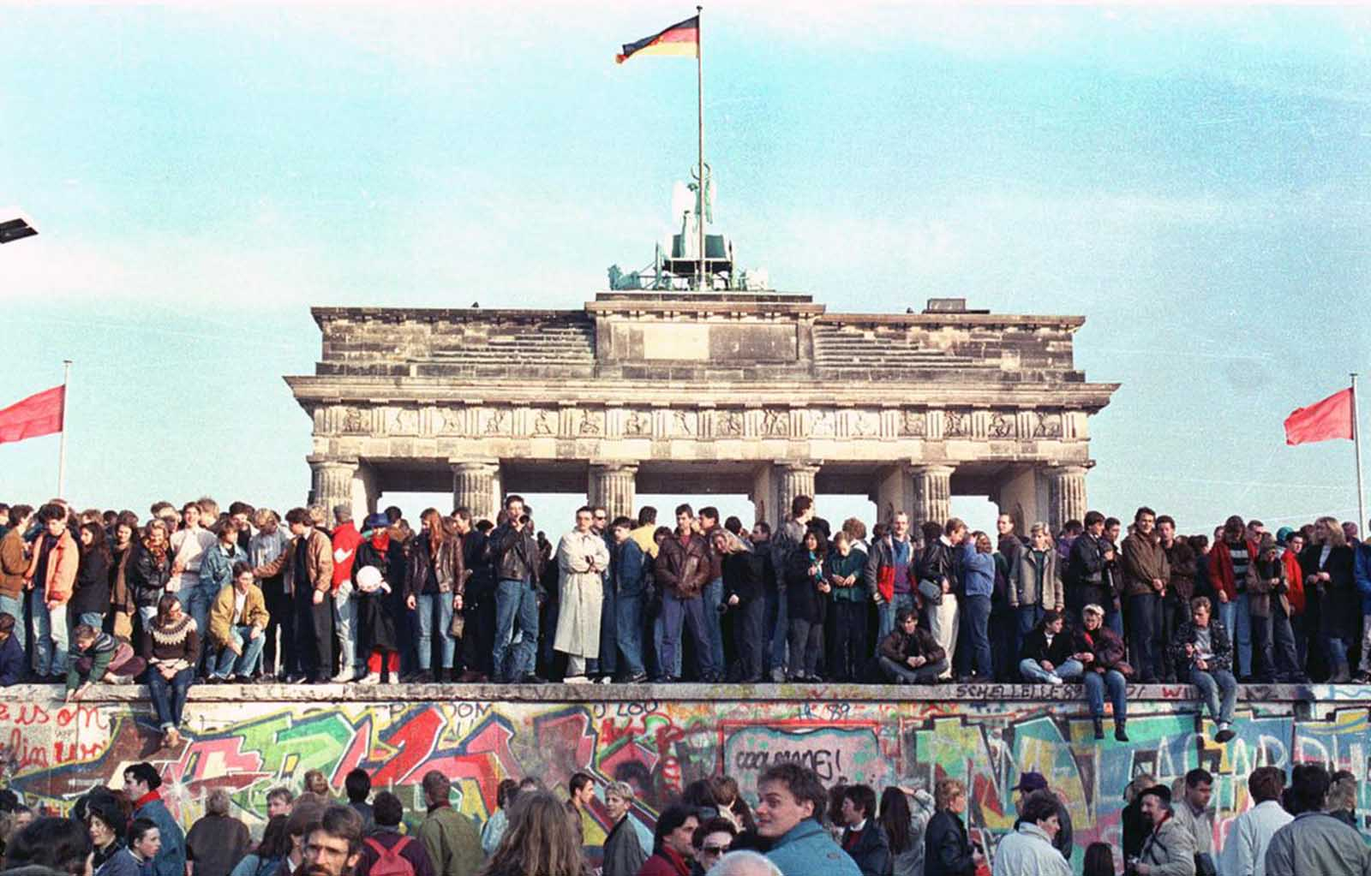
What ultimately led to its demolition?
Communist Bloc had been weakening for a while
EG loses support from Gorbachev
November 9, 1989 – “Permanent relocations can be done through all border checkpoints”
Egermans flock to the border
The wall comes tumbling down

Slide 9
The Vietnam War
(1954 – 1975)

Slide 10
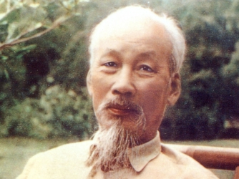
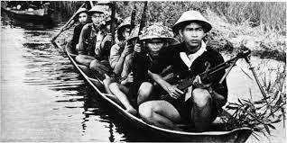
Ho Chi Minh & the Viet Minh
Vietnamese Independence
Guerrilla Warfare
Viet Minh = North Vietnam Army
Viet Cong = South Vietnamese that sympathize with the North
Dien Bien Phu

Slide 11
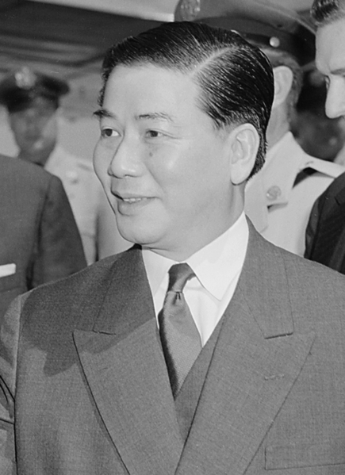
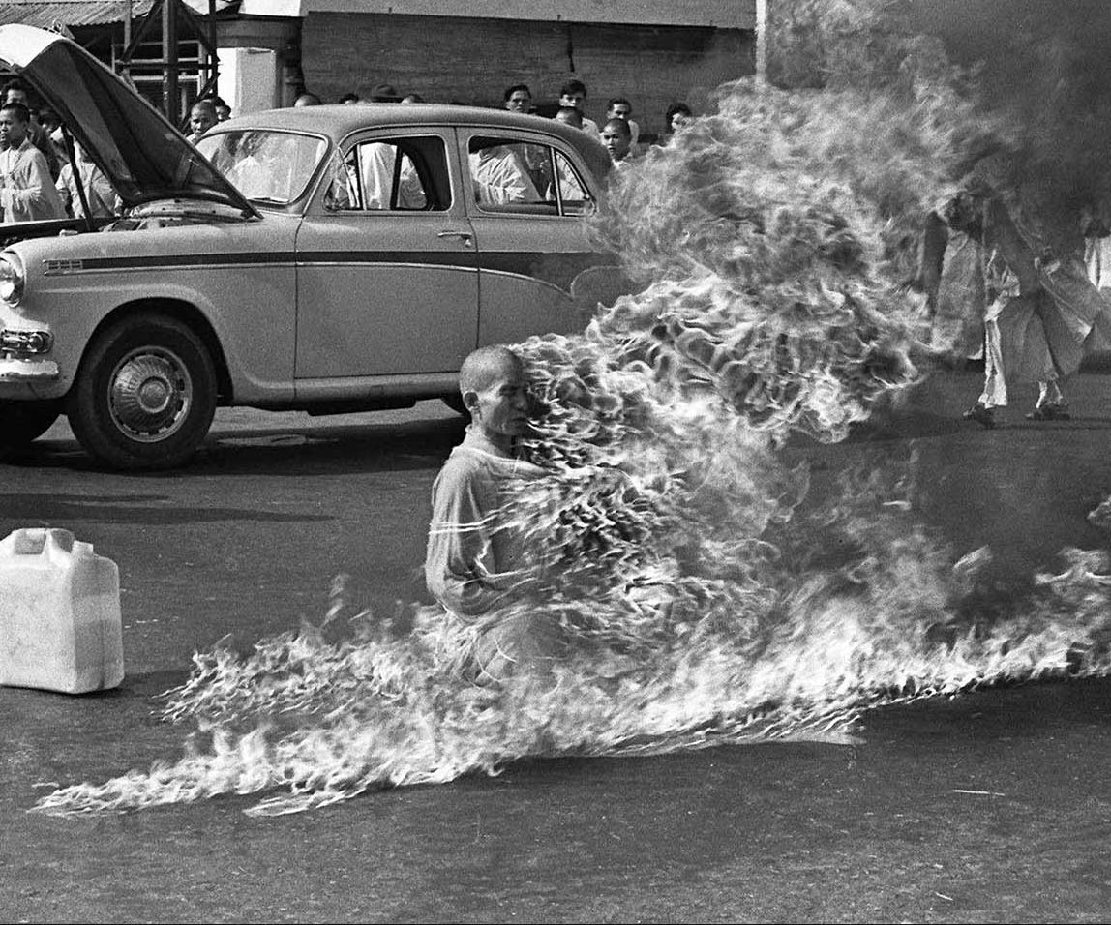
Ike & JFK
Geneva Conference
U.S. sends in “advisors”
Ngo Dinh Diem
Buddhist Protests

Slide 12
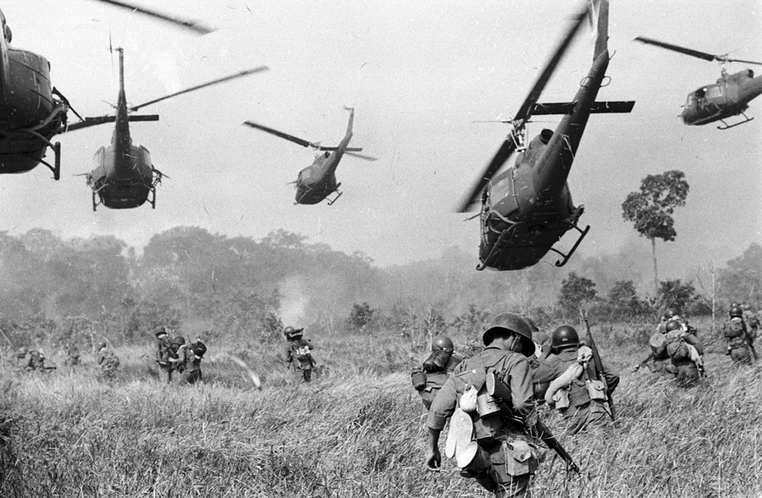
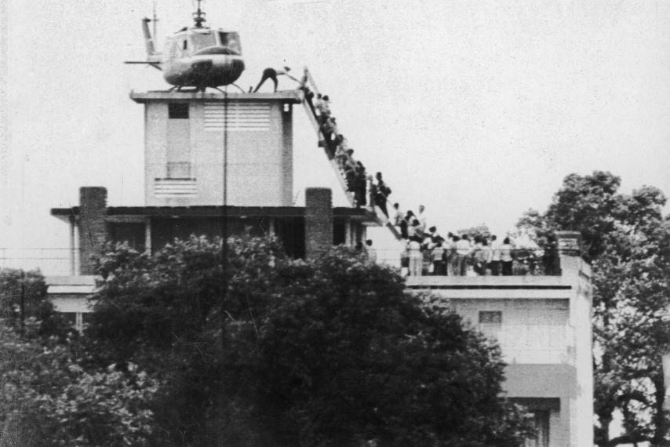
Johnson & Nixon
Johnson pushes for Escalation
Don’t lose Vietnam
Ultimately stains Johnson’s legacy
1968 – Tet Offensive
Nixon, détente, & Vietnamization
Laos & Cambodia
Final helicopter leaves in 1975

Slide 13
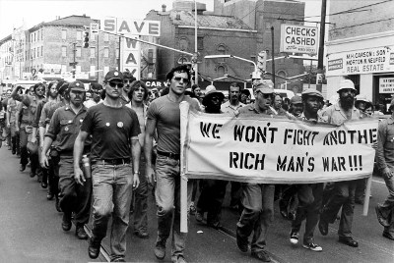
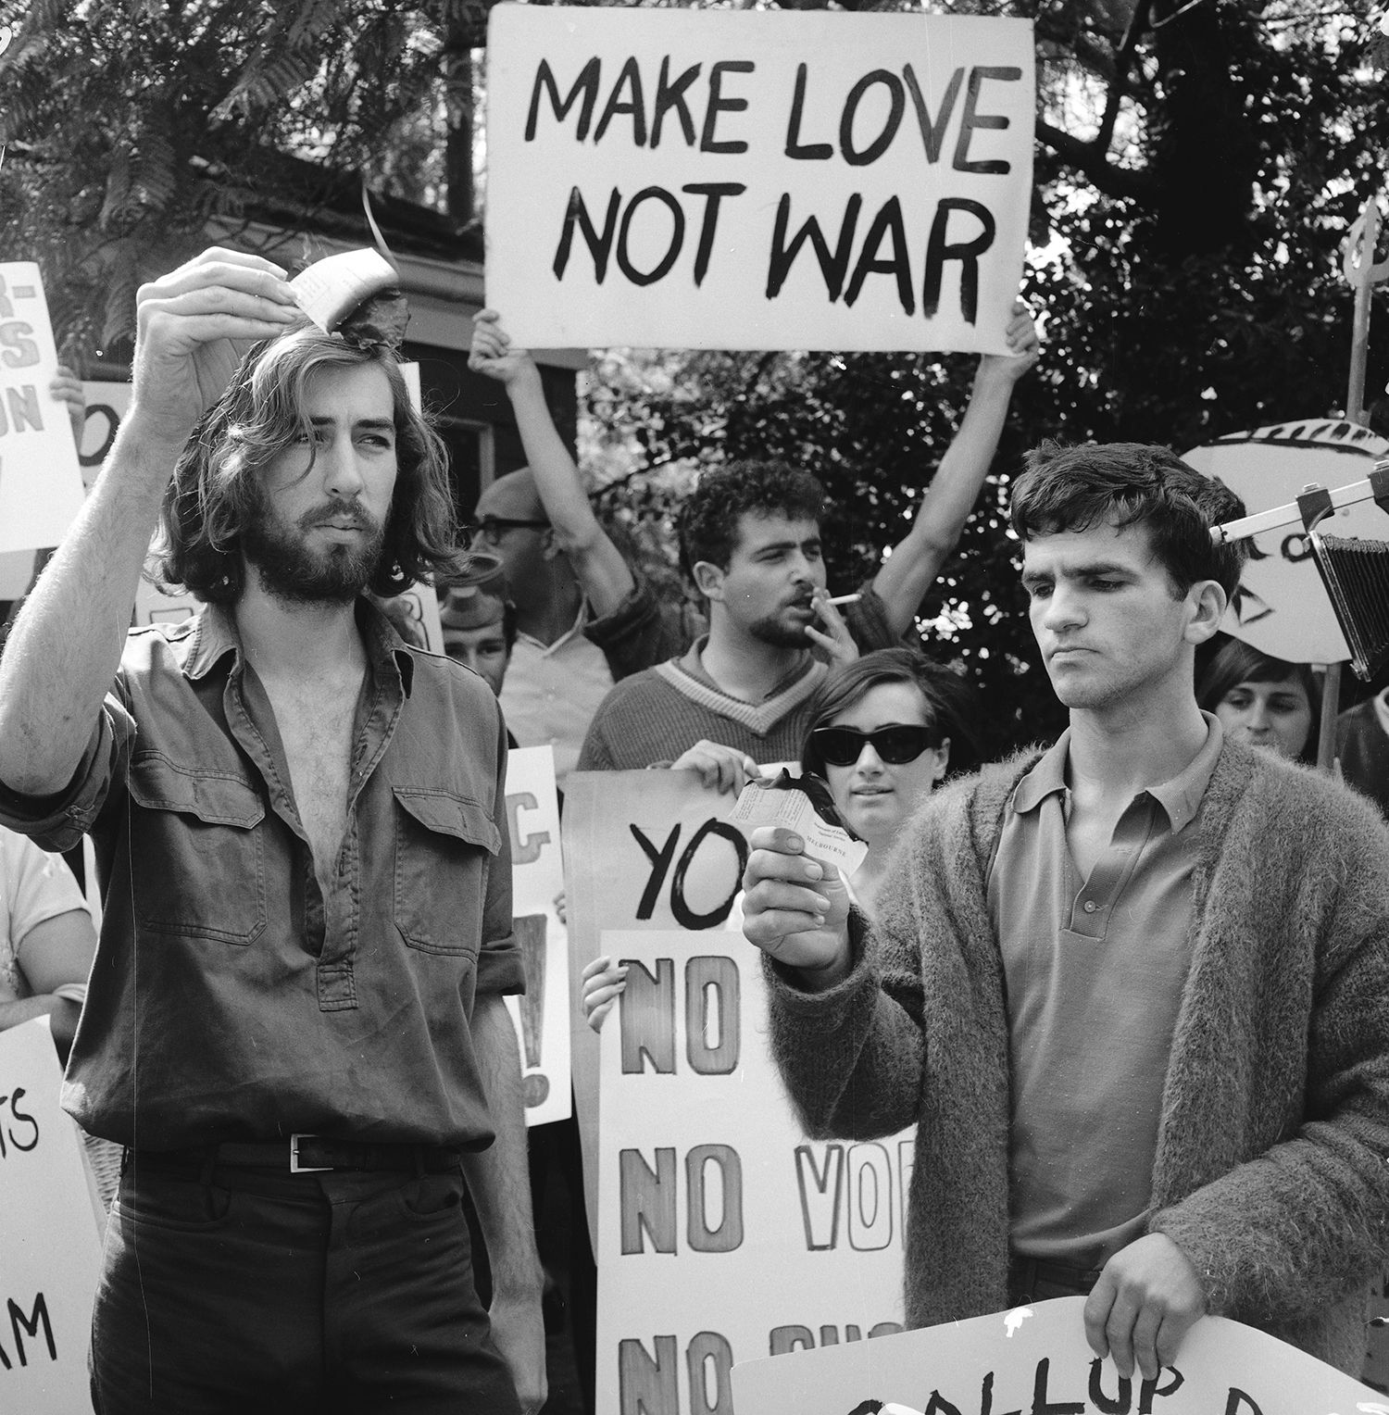
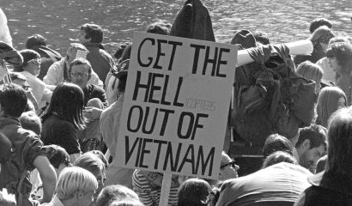
Anti-War Protests
Most Americans couldn’t find Vietnam on a map
Support at the start, quickly changes
Television shows images that don’t match what the govt is saying
Young people become upset
“Hey hey LBJ, how many kids did you kill today!”

Slide 14
Batman, Bond, & the Beatles
A look at 1960s’ pop culture

Slide 16
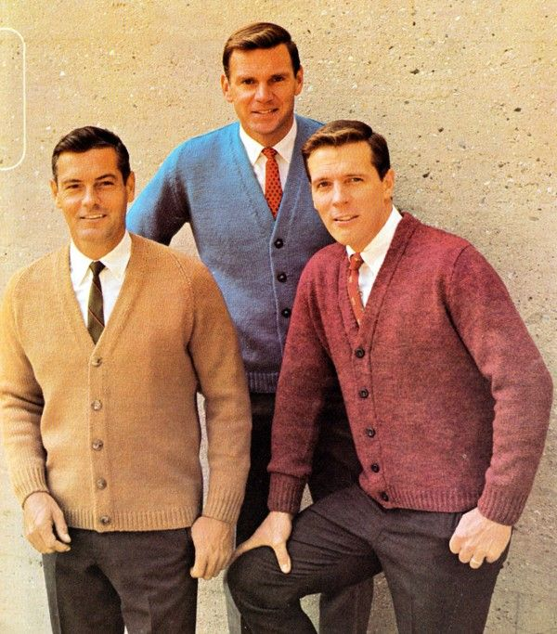
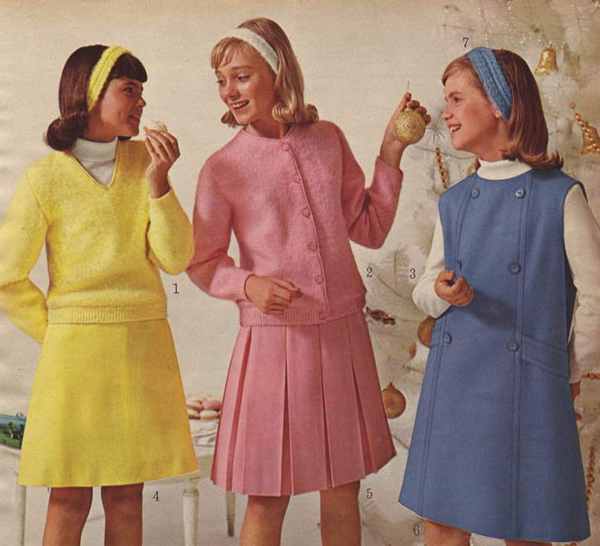
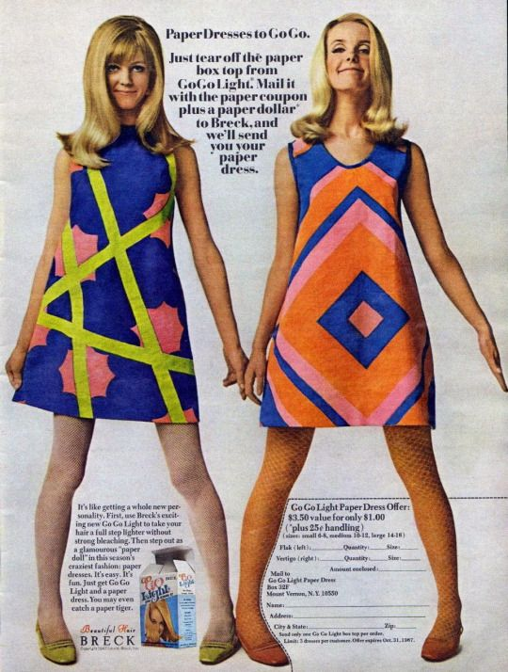
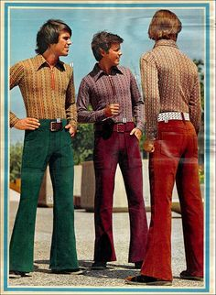
Early 60s vs. Late 60s
Early 60s = very similar to the 1950s
Late 60s = Flower Power
What happened?
JFK Assassination
Civil Rights Movement
Vietnam
1968

Slide 17
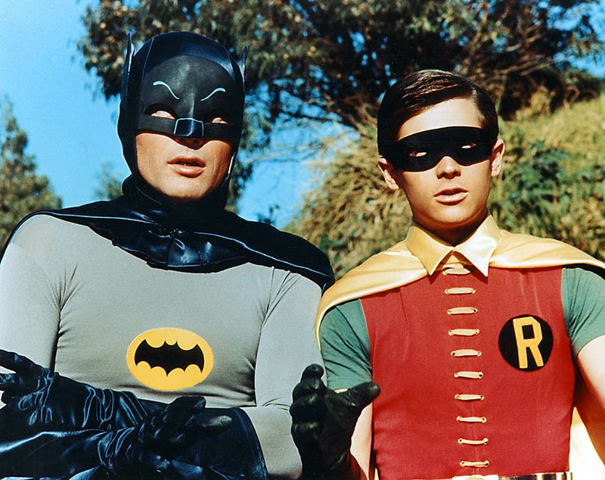
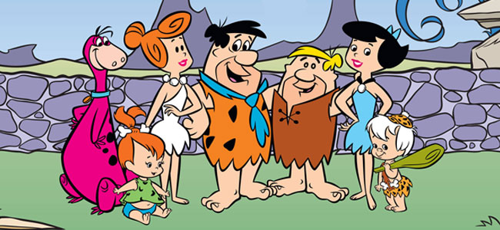
Television
Really takes off in the 60s
Brought news right into the home
Sitcoms
Sci-fi
Westerns
Variety Shows
Idealistic

Slide 18
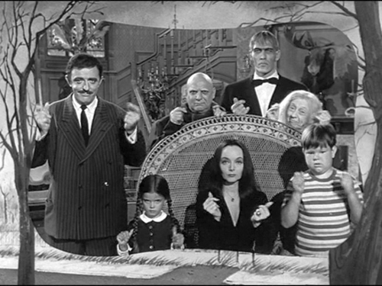
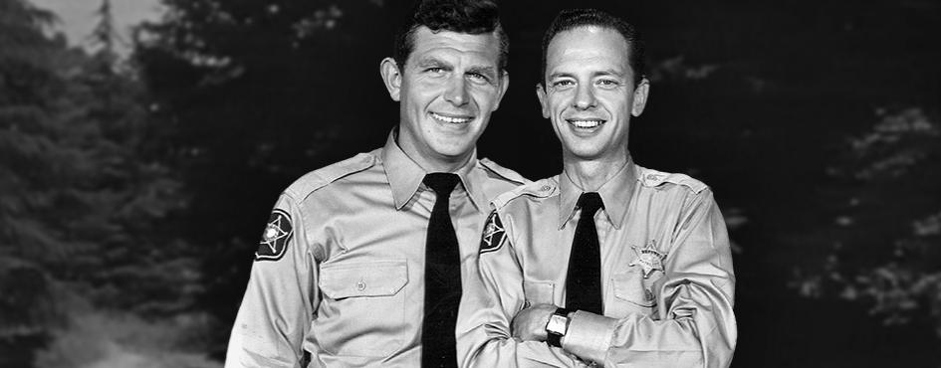
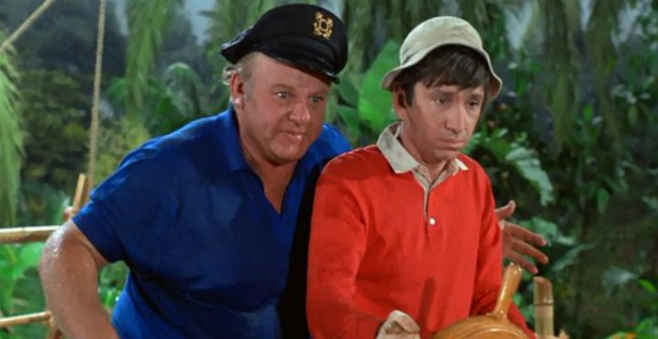
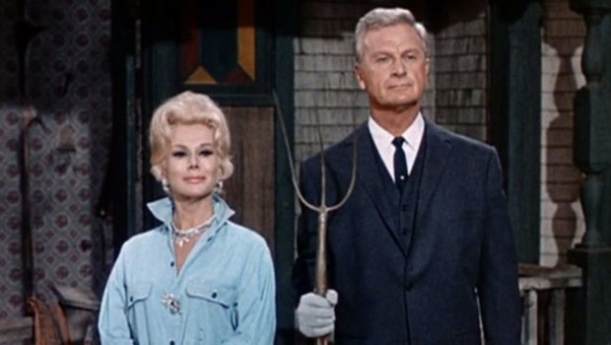
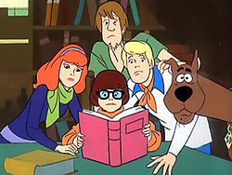
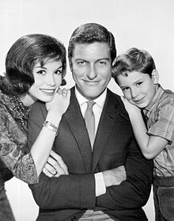
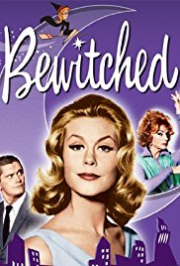
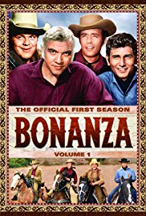
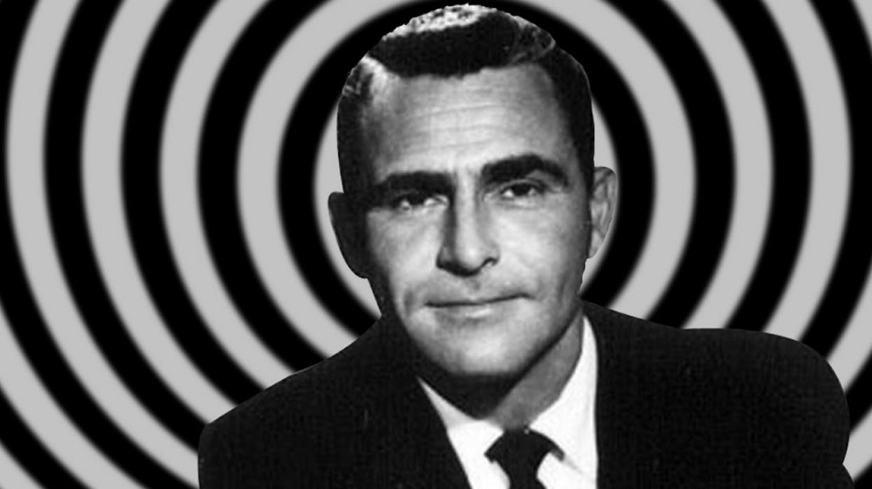
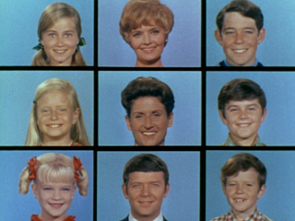
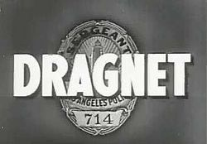
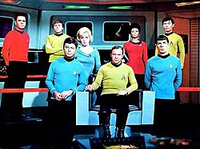
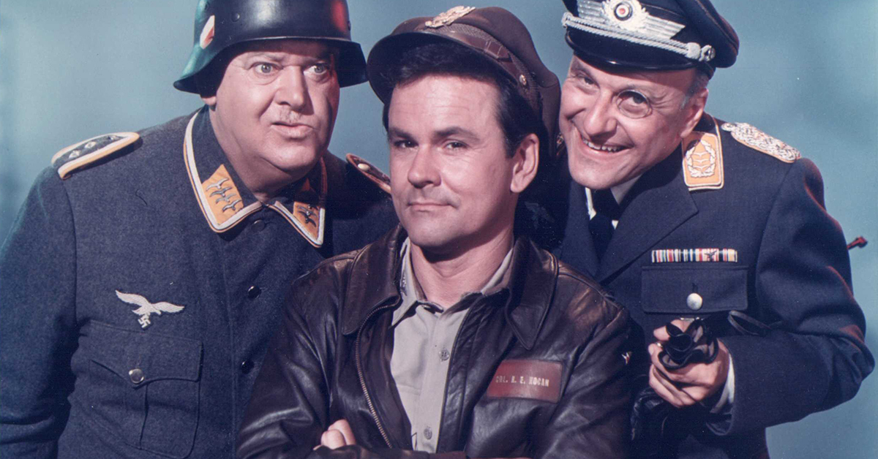

Slide 19
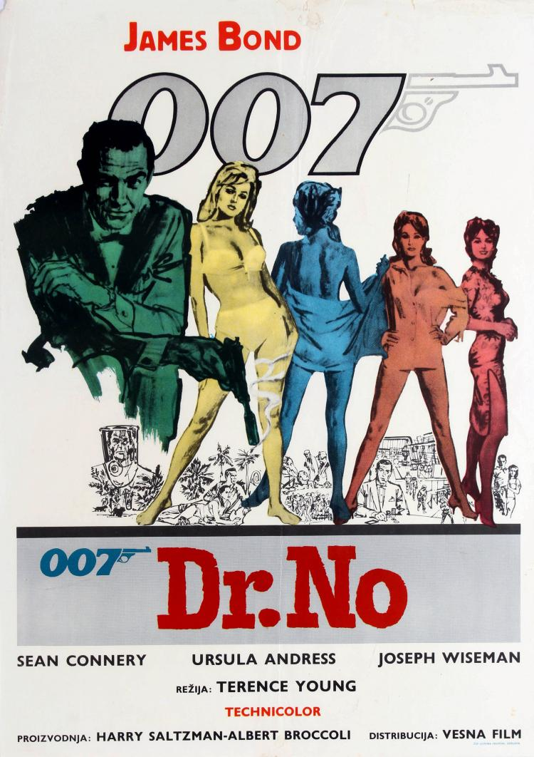
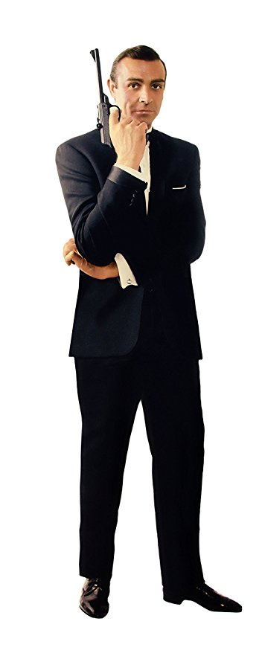
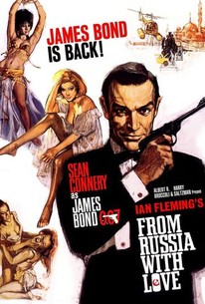
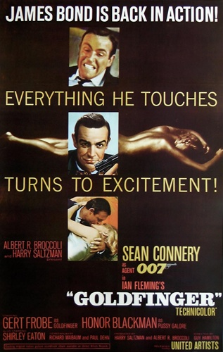
Movies
Historical Dramas
Psychological Horror
Comedy
Spy films
Spaghetti Westerns
Sci-fi & fantasy

Slide 20
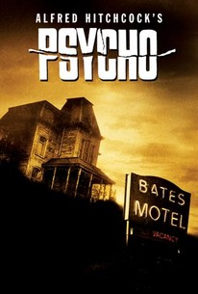
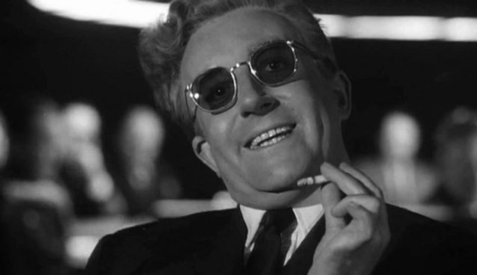
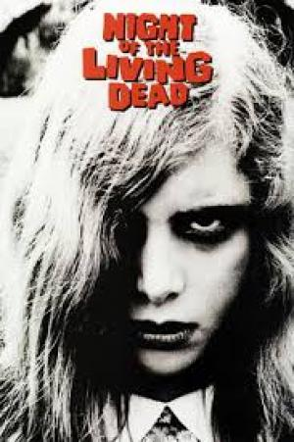
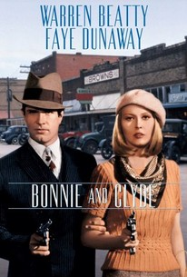
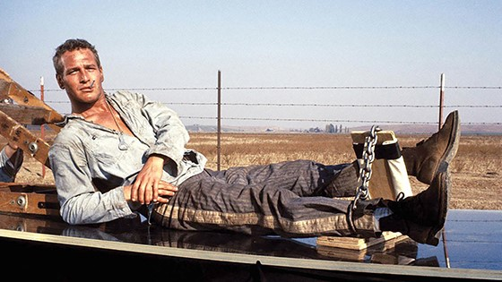
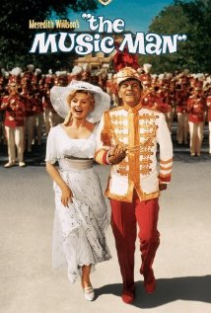
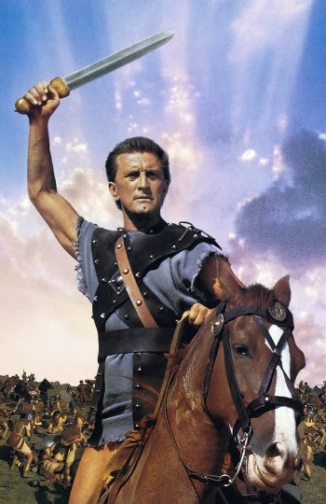
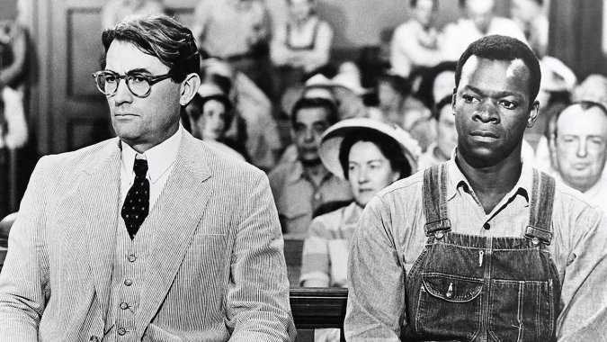
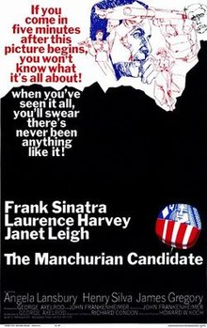
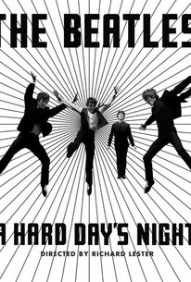
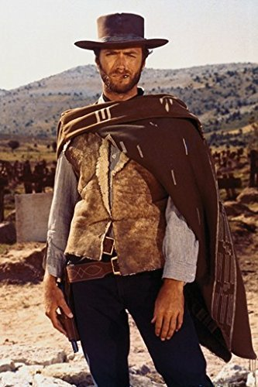
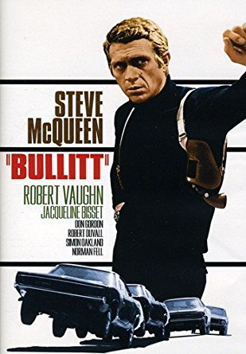
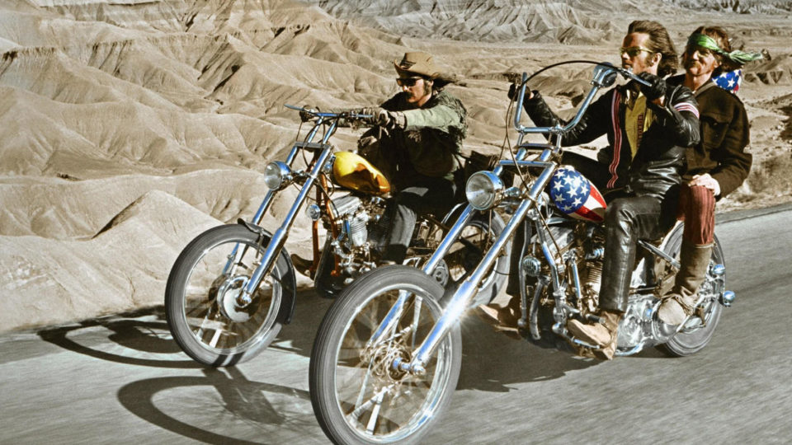

Slide 21
Music
Grows out of 1950s rock ‘n roll
Early 60s = light & poppy
Late 60s = more psychedelic, gets heavier
The British Invasion
Protest music
Experimentation

Slide 24
Woodstock
August 1969
3 Day Festival
Sold 100,000 tickets; 500,000 show up
Weather didn’t help

