Slide 1
The Pacific and the Homefront

Slide 2
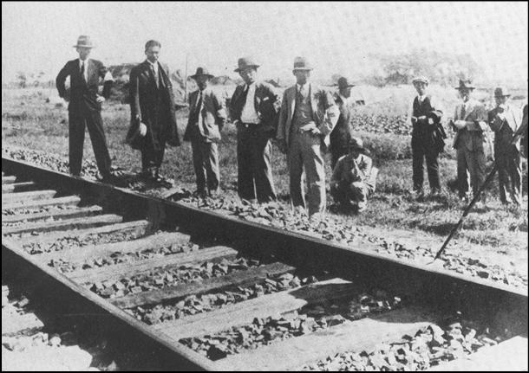
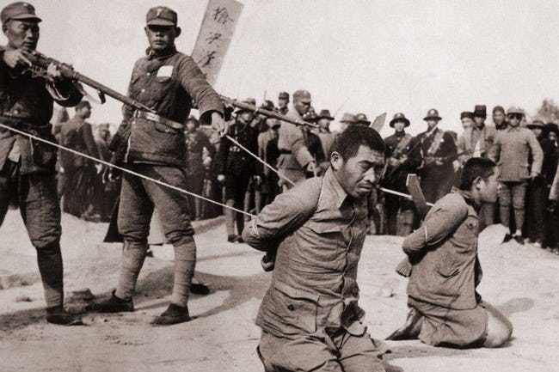
Mukden, Marco Polo Bridge, & Nanking
Mukden Incident
Marco Polo Bridge Incident
Rape of Nanking

Slide 3
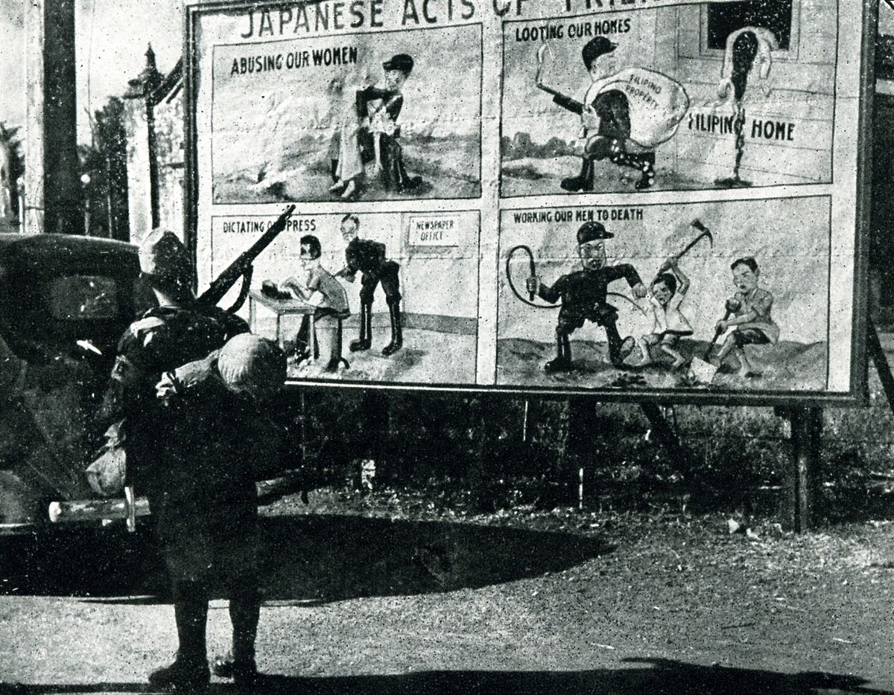
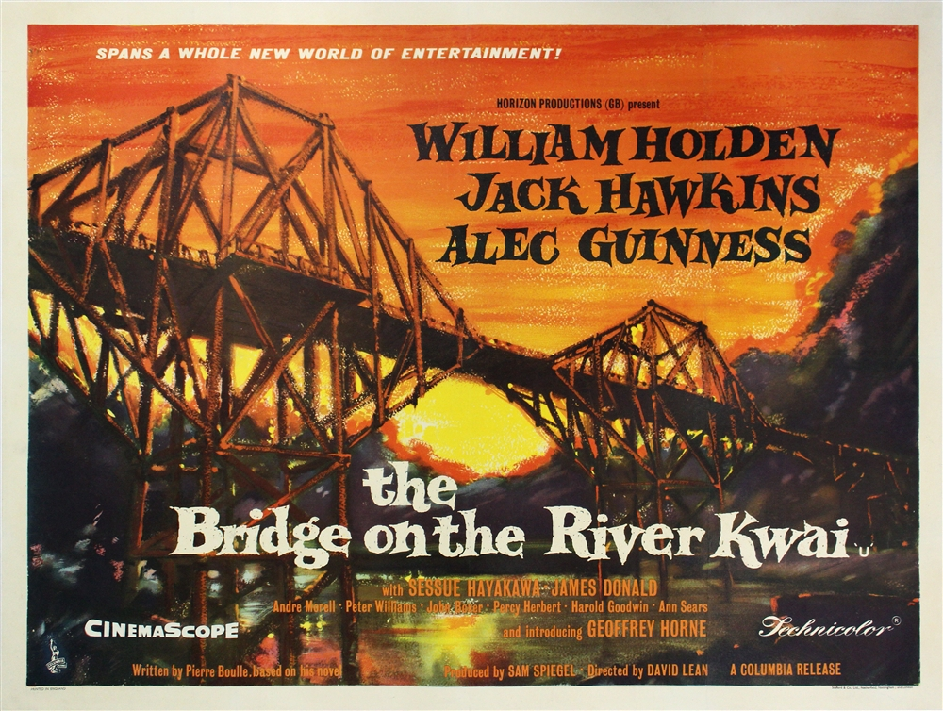
U.S. – Japanese Relations
U.S. oil embargo
Japanese invade Southeast Asia
Philippines

Slide 4
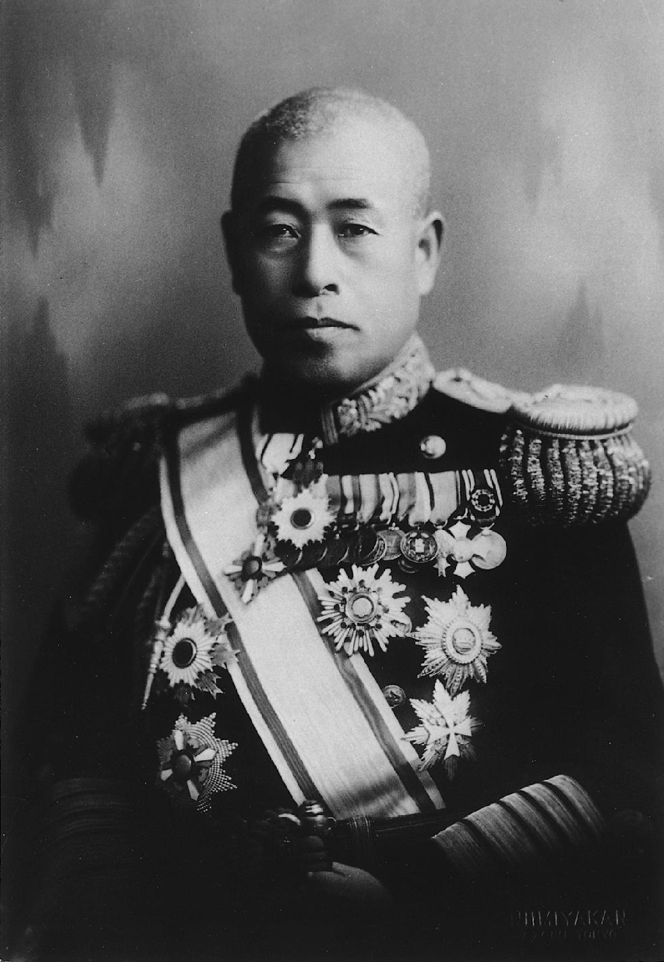
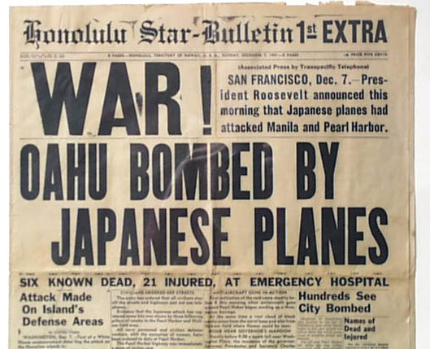
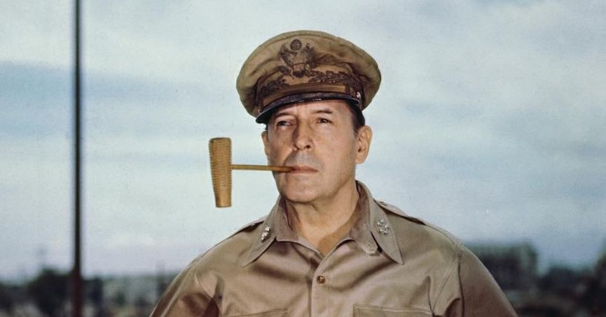
Pearl Harbor & Island Hopping
December 7, 1941
“A day which will live in infamy.”
“I fear all we have done is to woken a sleeping giant.”
Island Hopping

Slide 5
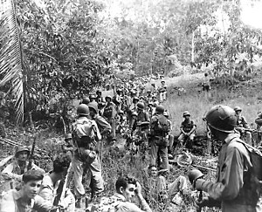
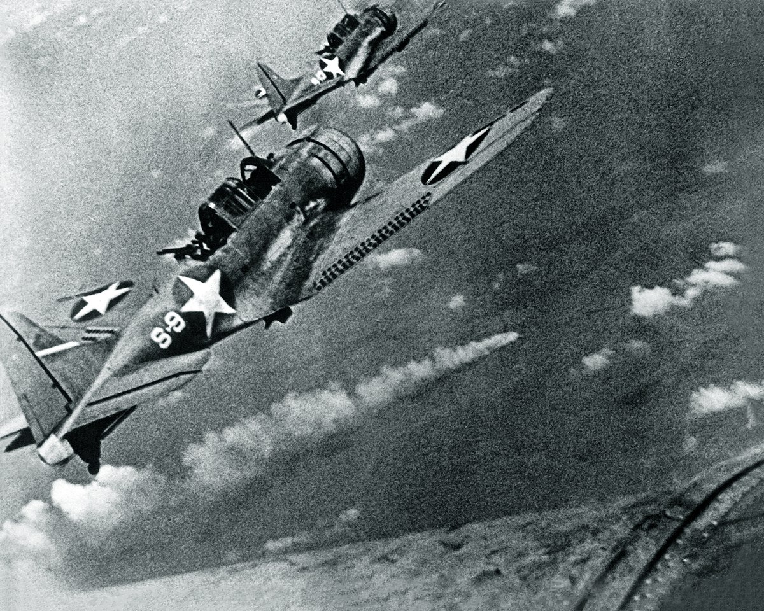
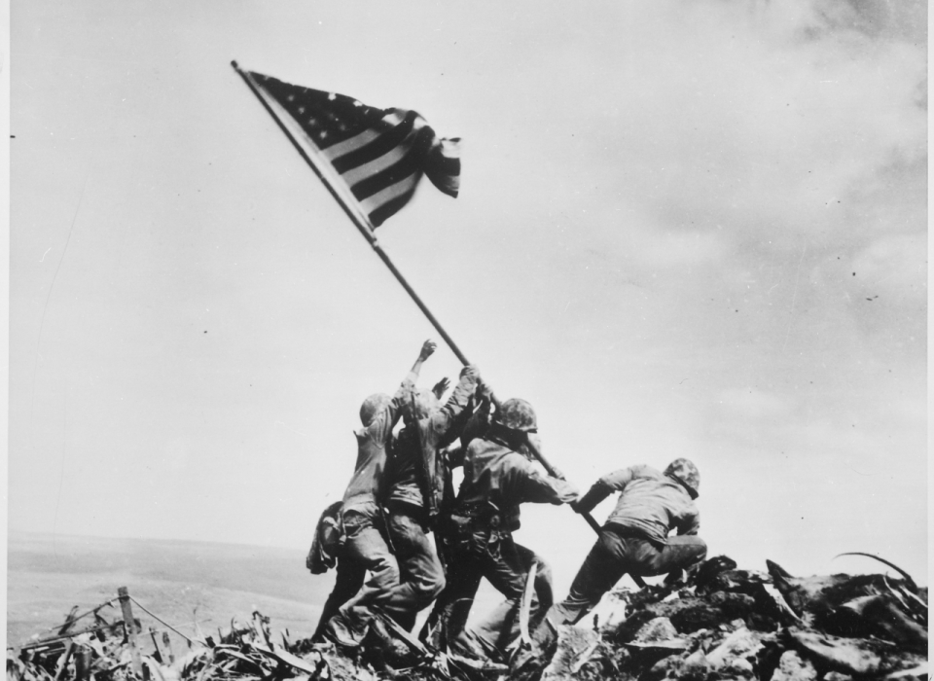
Important Battles
Guadalcanal
Midway
Iwo Jima
Okinawa

Slide 6
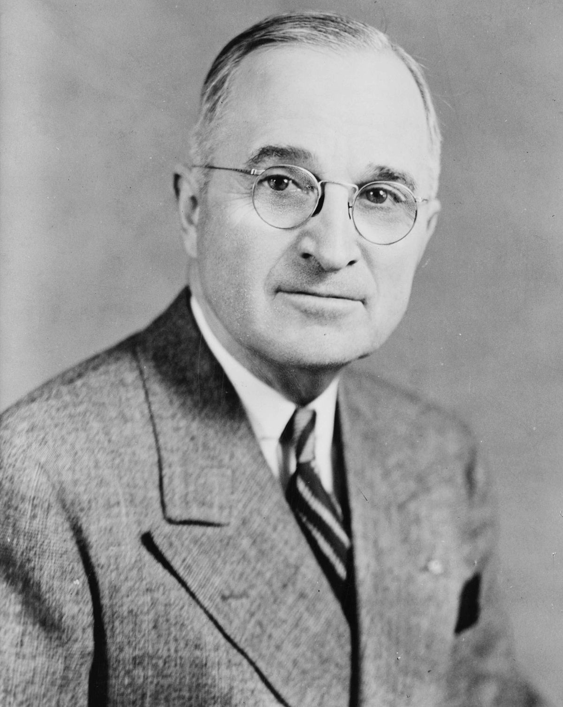
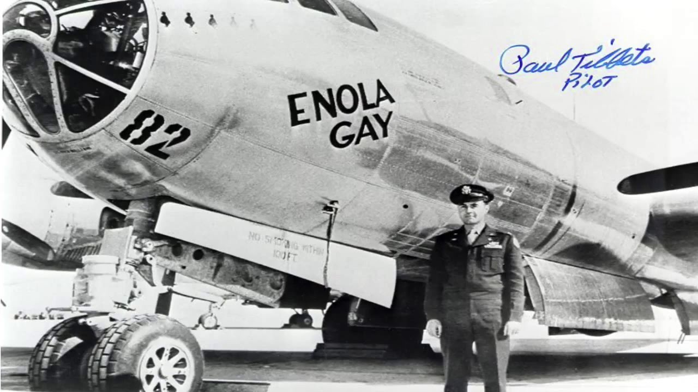
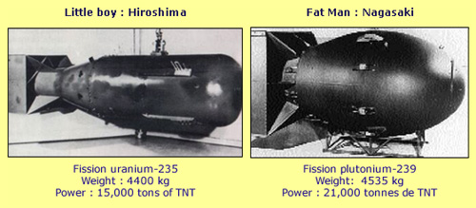
Should we drop the bomb?
Don’t drop:
Invade the Japanese homeland
Possibly 1,000,000 causalities
Do drop:
No invasion
80,000 – 100,000 killed in an instant

Slide 7
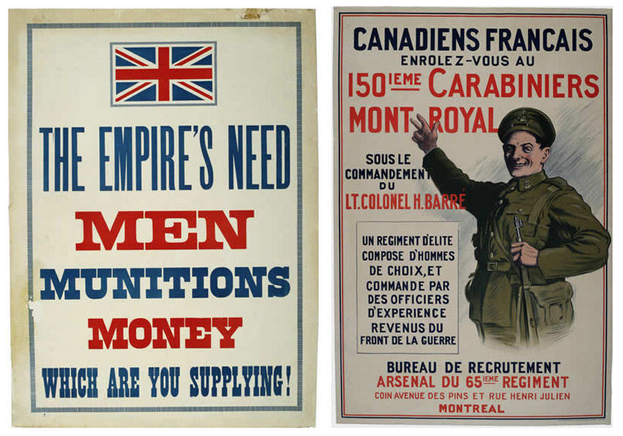
The Homefront
Major Powers dedicated 50-61% of their total GDP to munitions production
Allies produced 3x the munitions than the Axis
Rationing programs
War Bond Drives

Slide 8
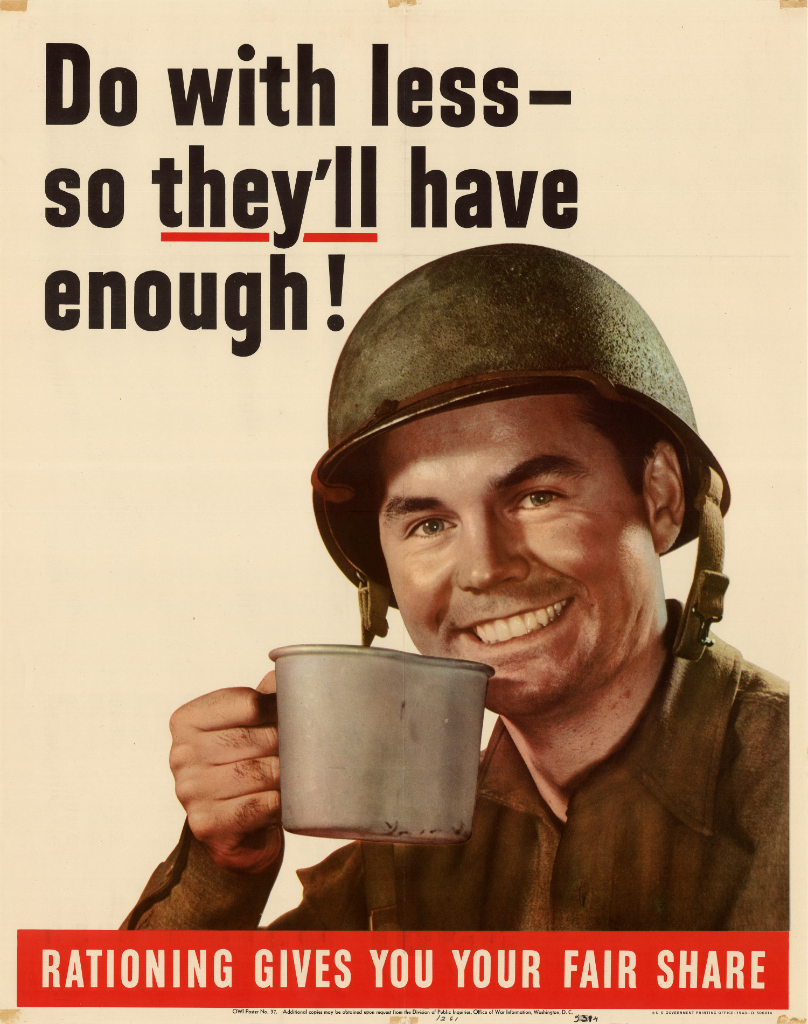

Slide 9
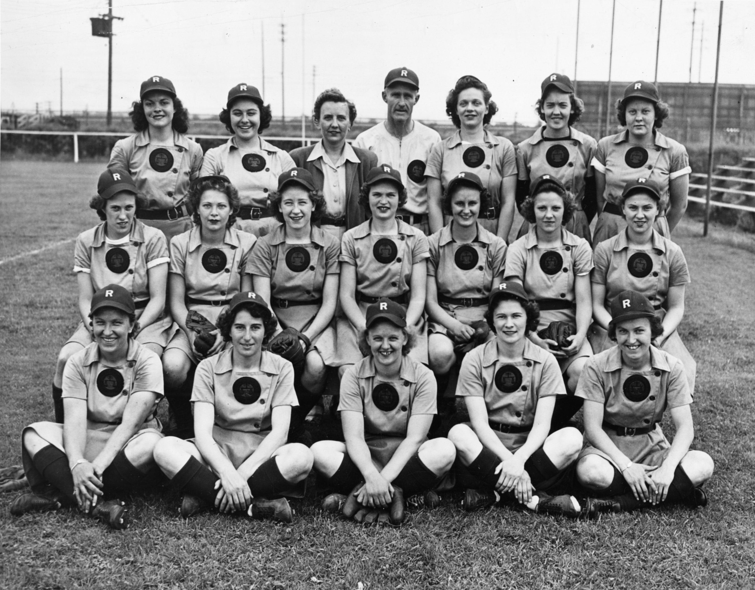
Women during the War
Unprecedented opportunities
Overcoming stereotypes
Armed Forces – 350,000
Factory Jobs
After the War

