Slide 1
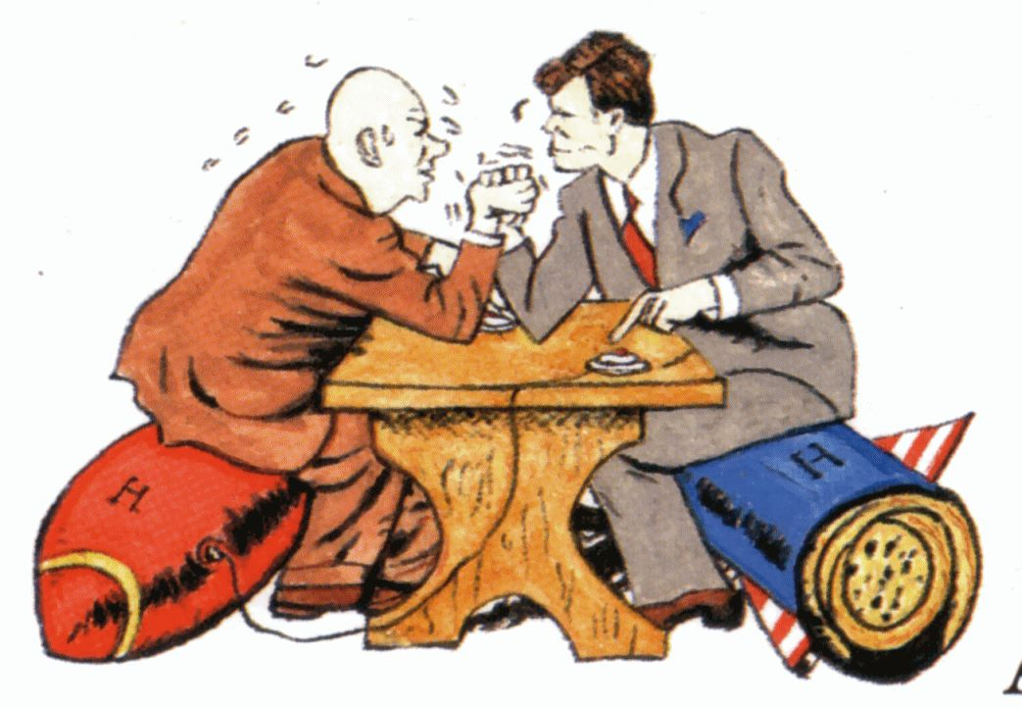
The Cold War: the 1950s

Slide 2
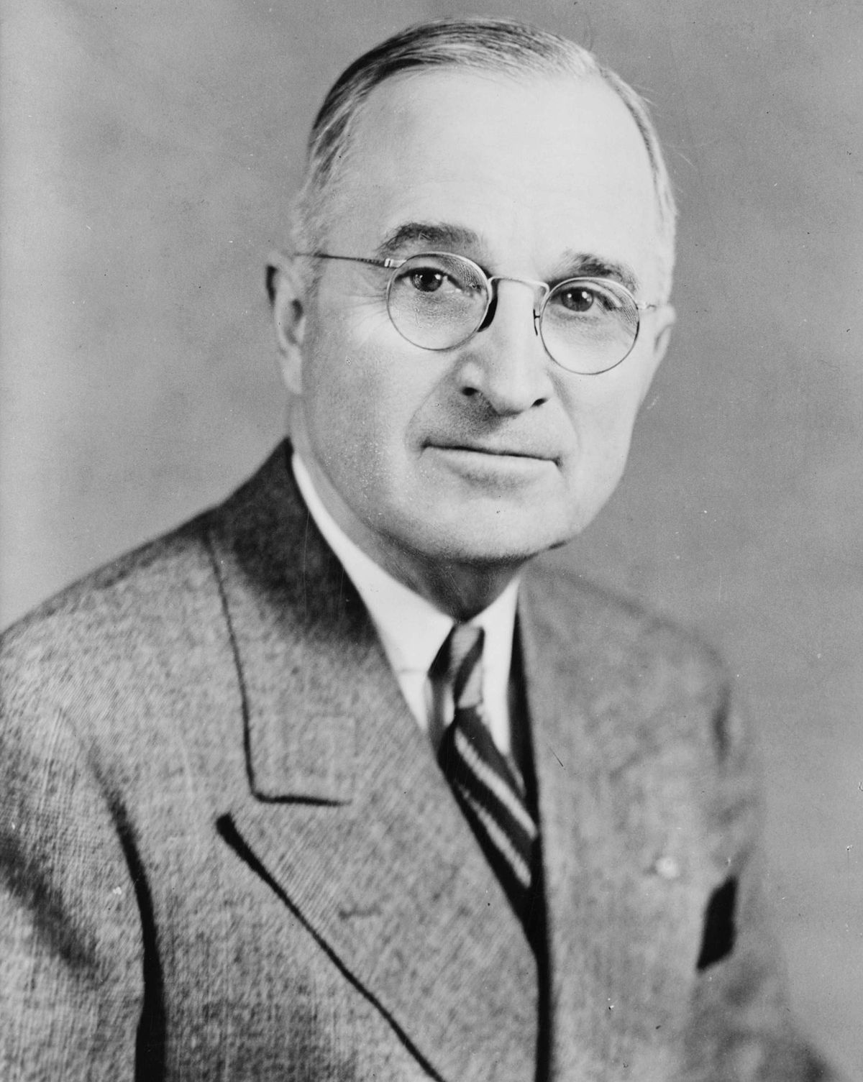
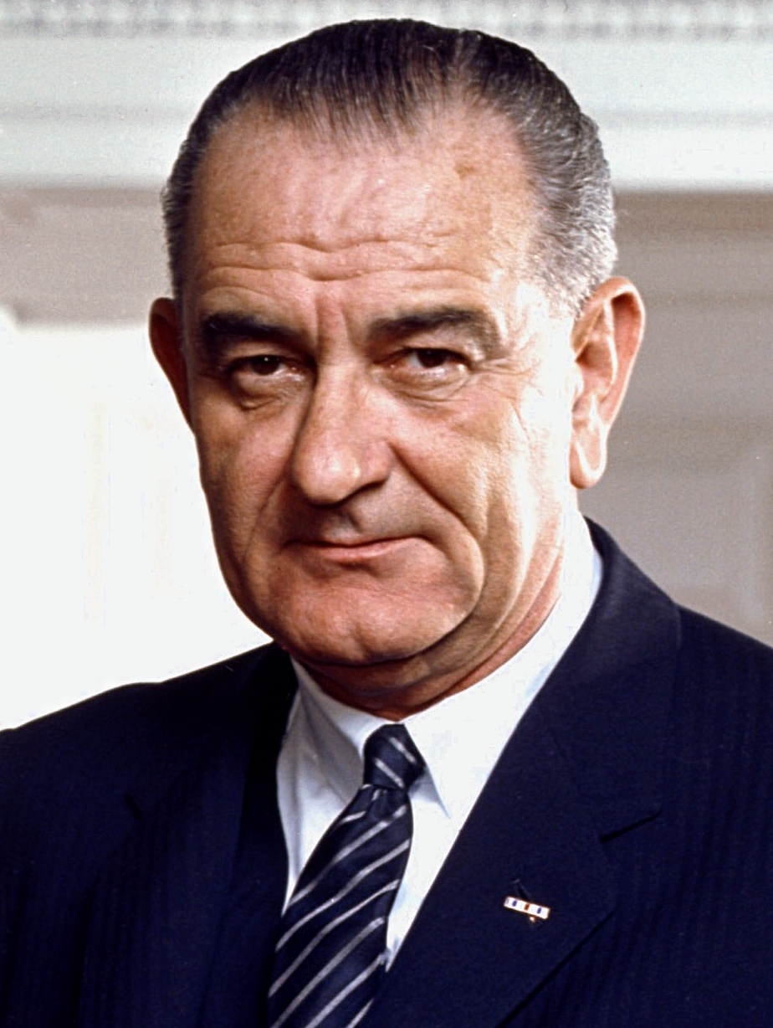
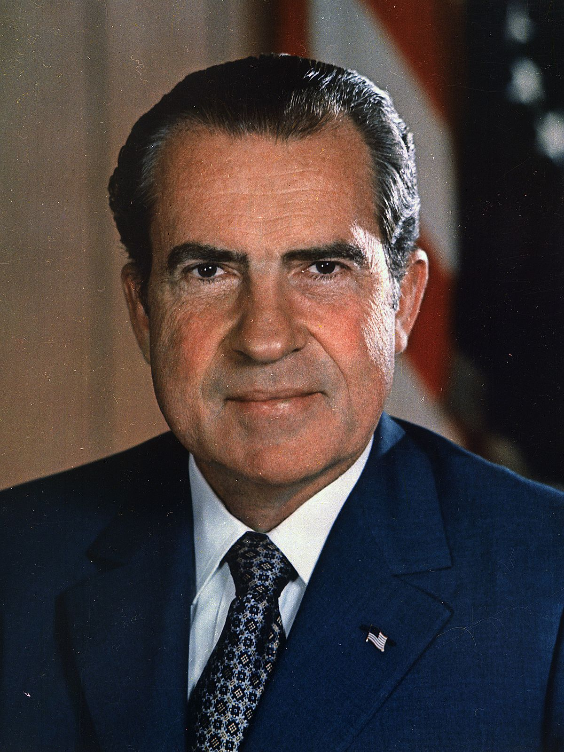
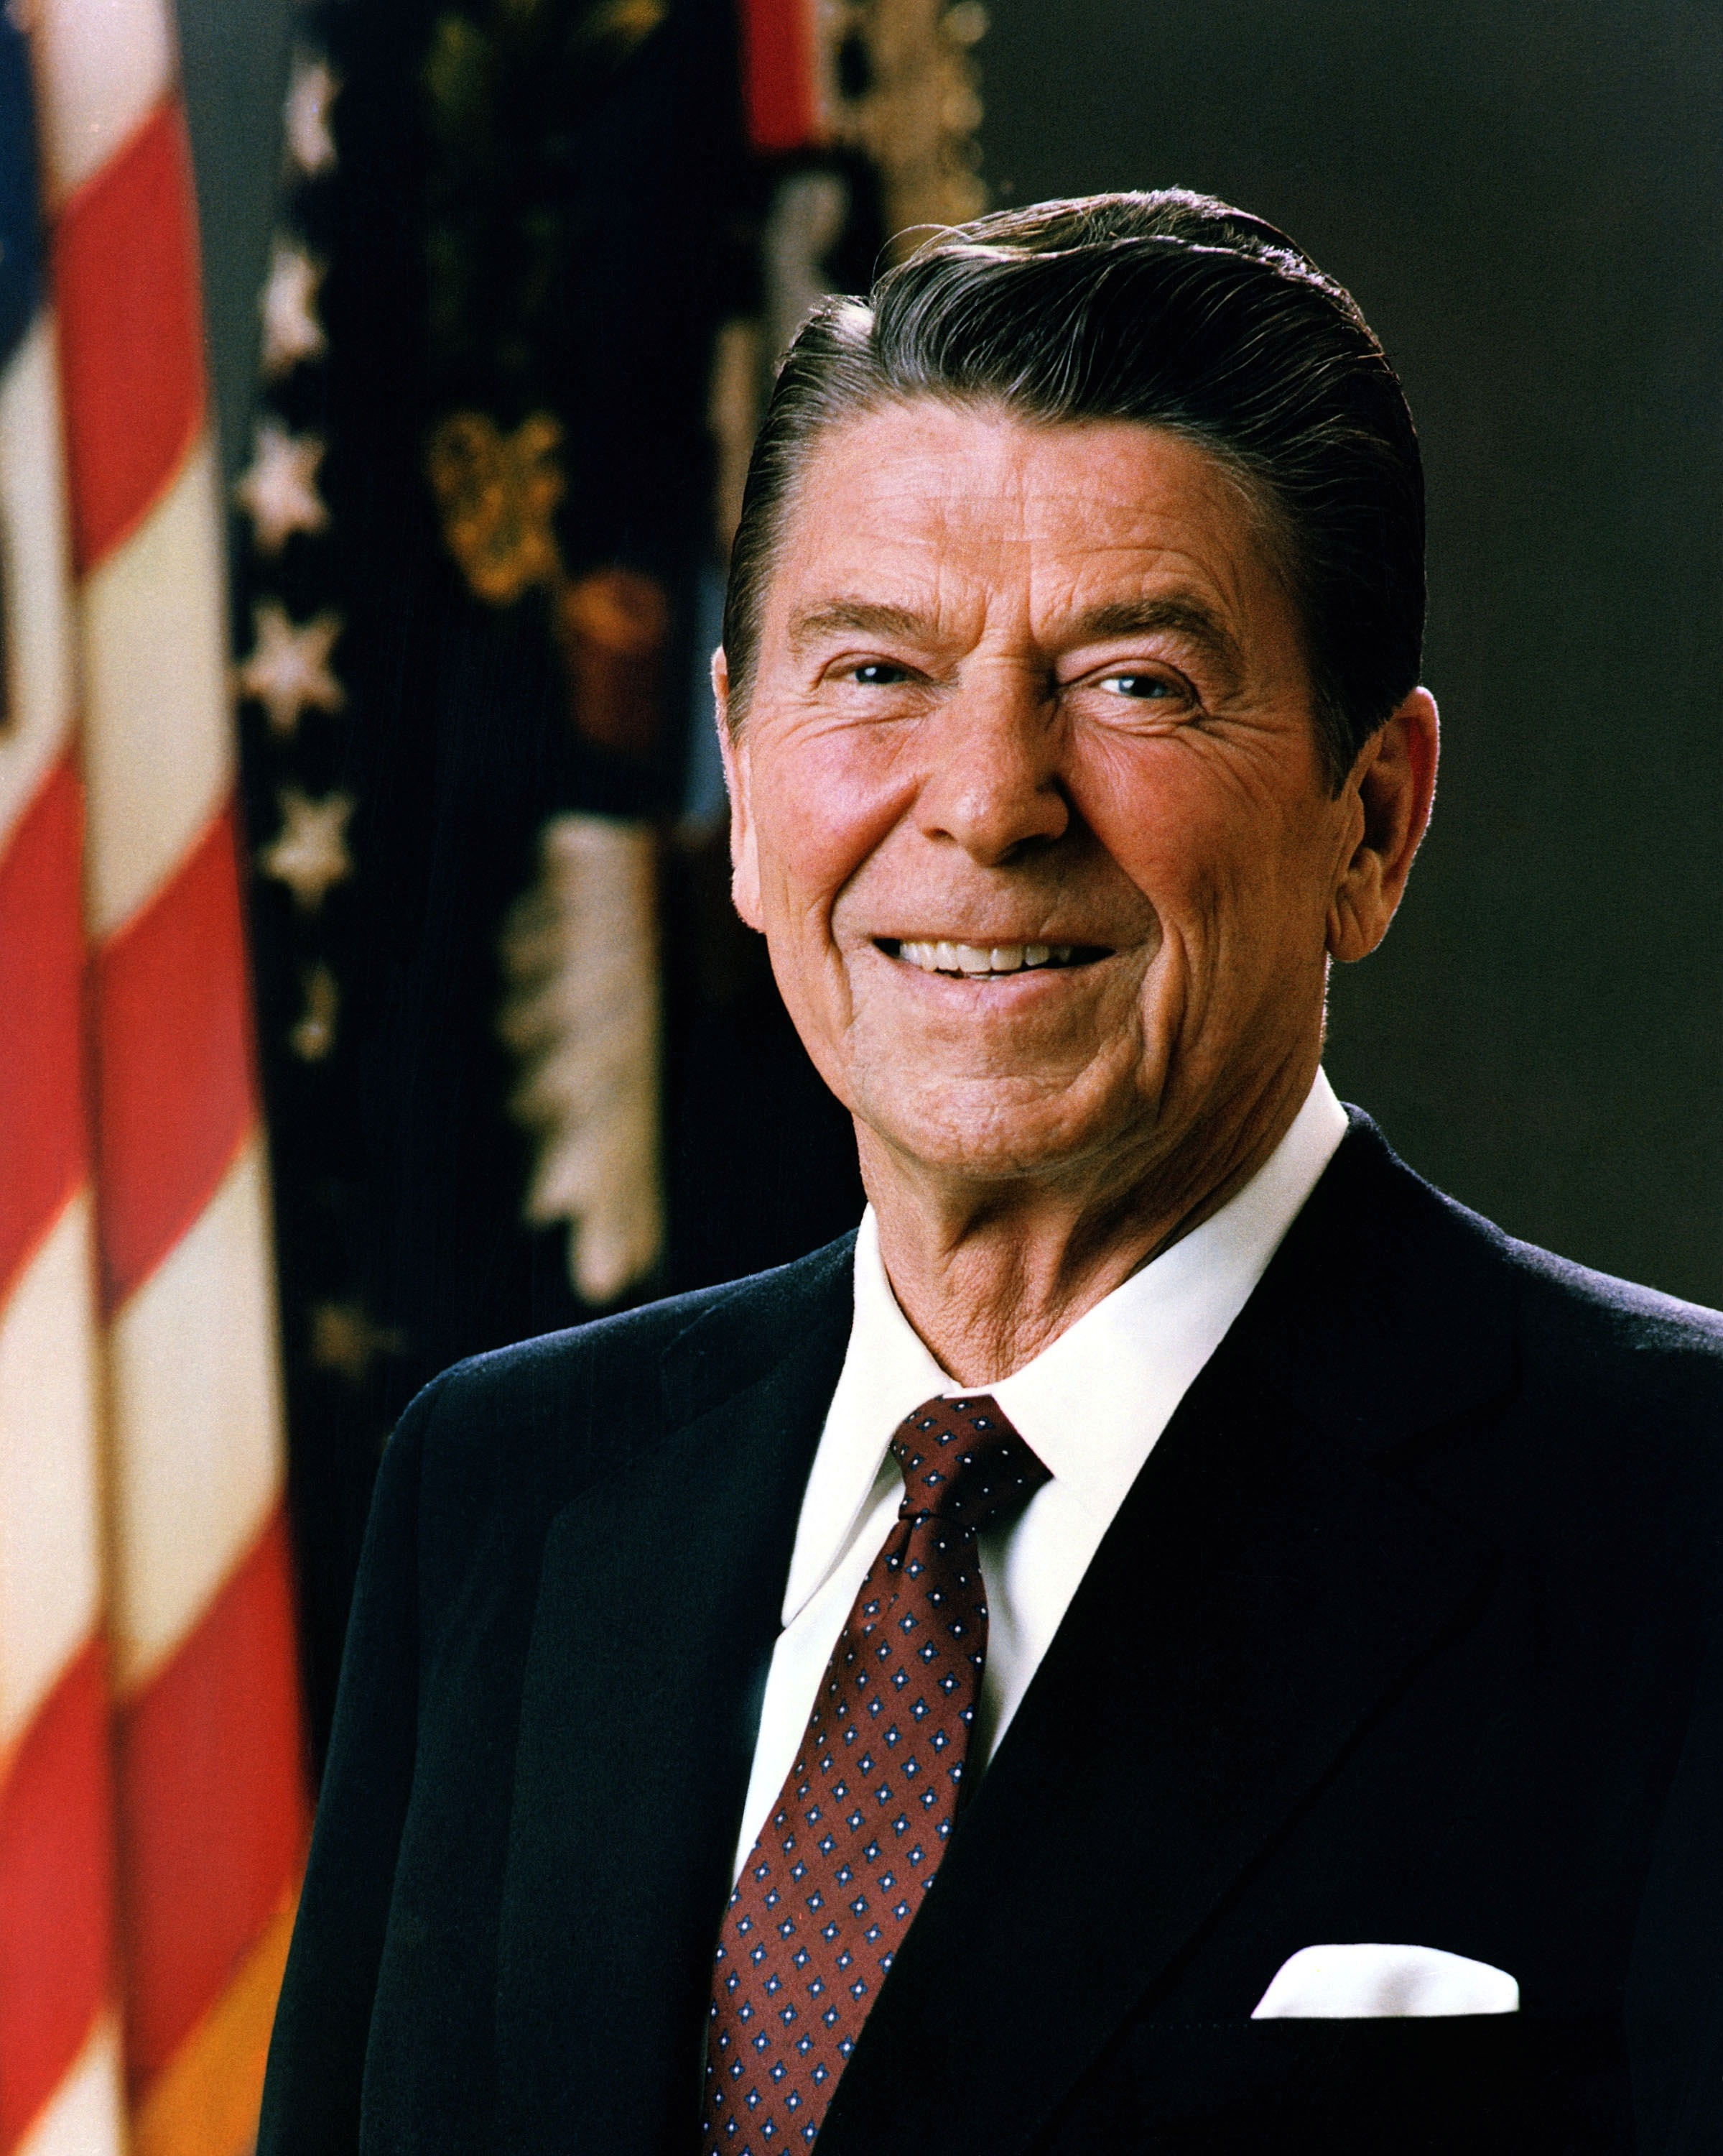
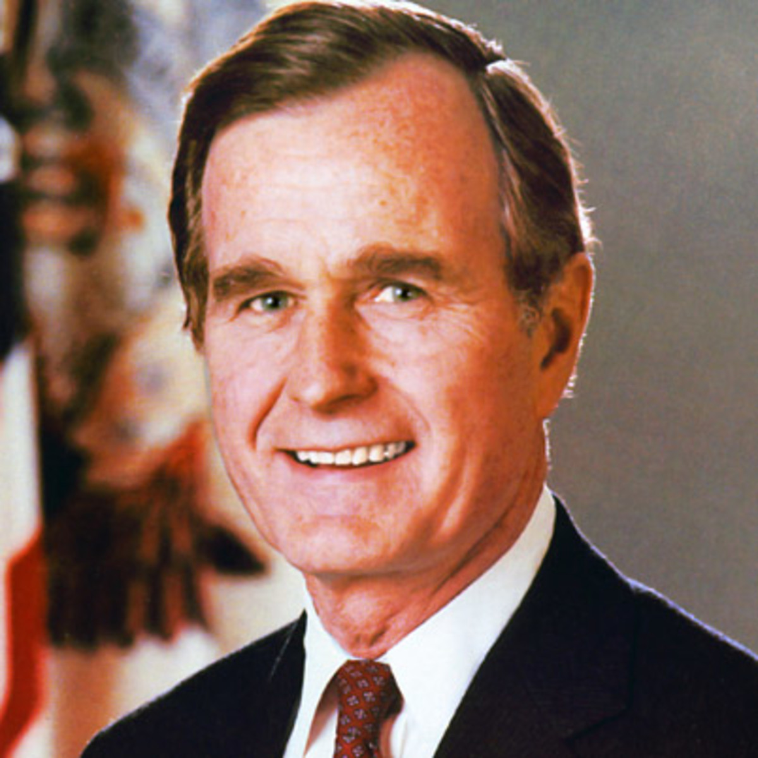
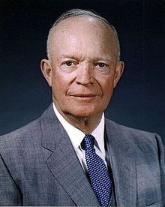
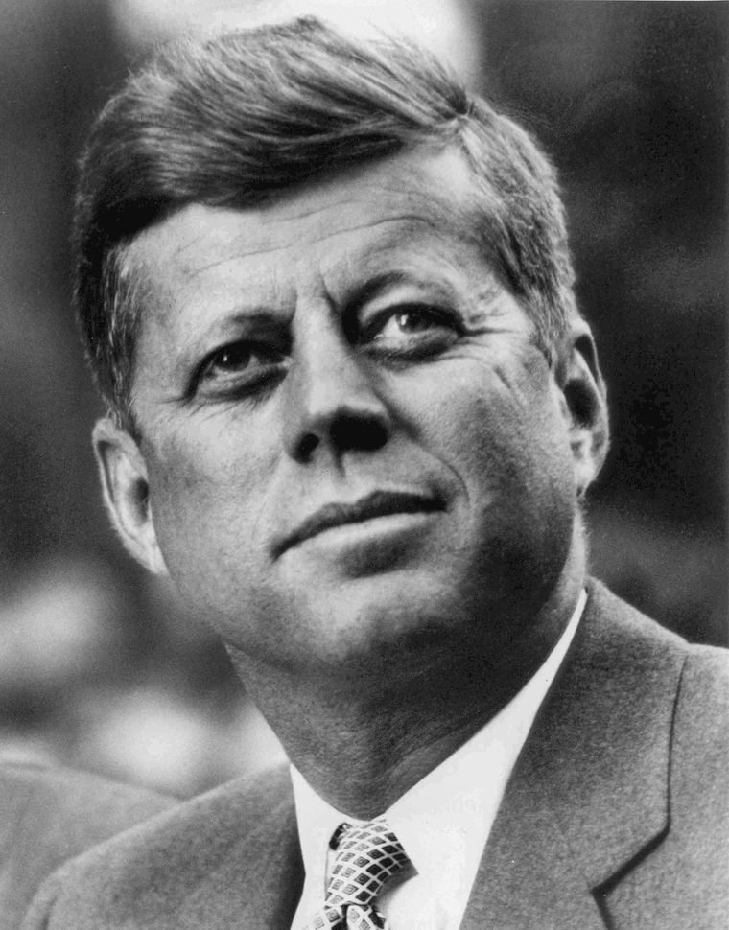
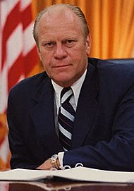
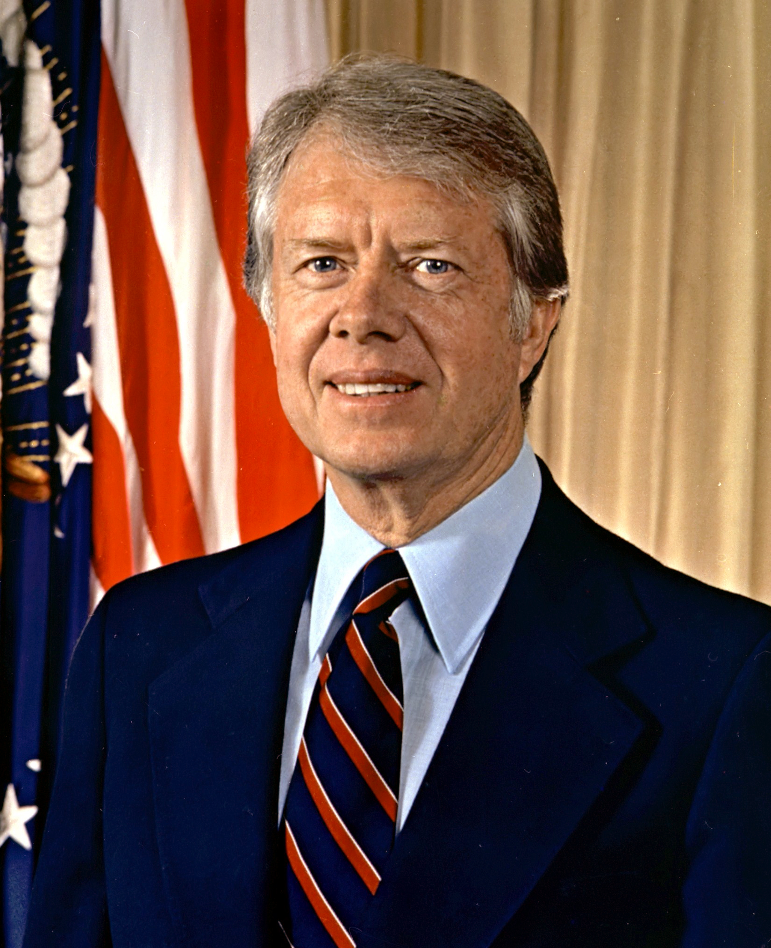
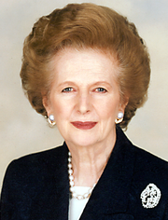
Important Leaders – the West

Slide 3
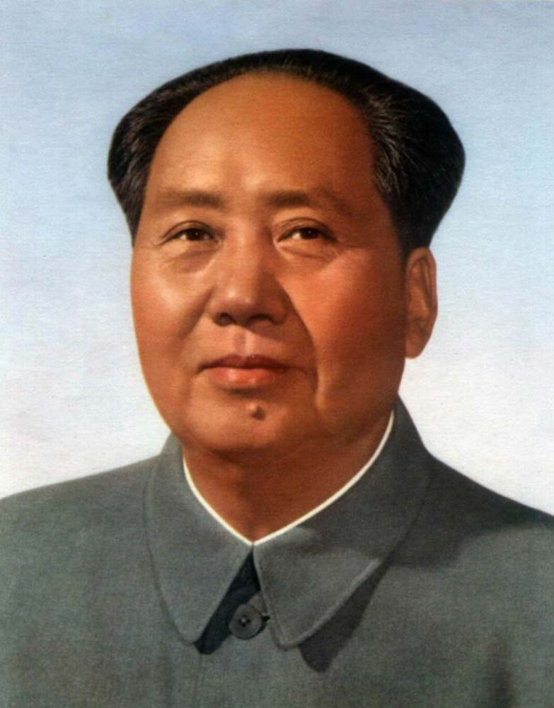
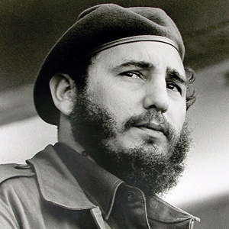
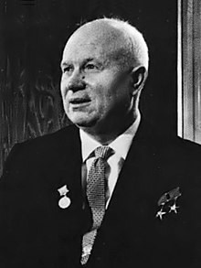
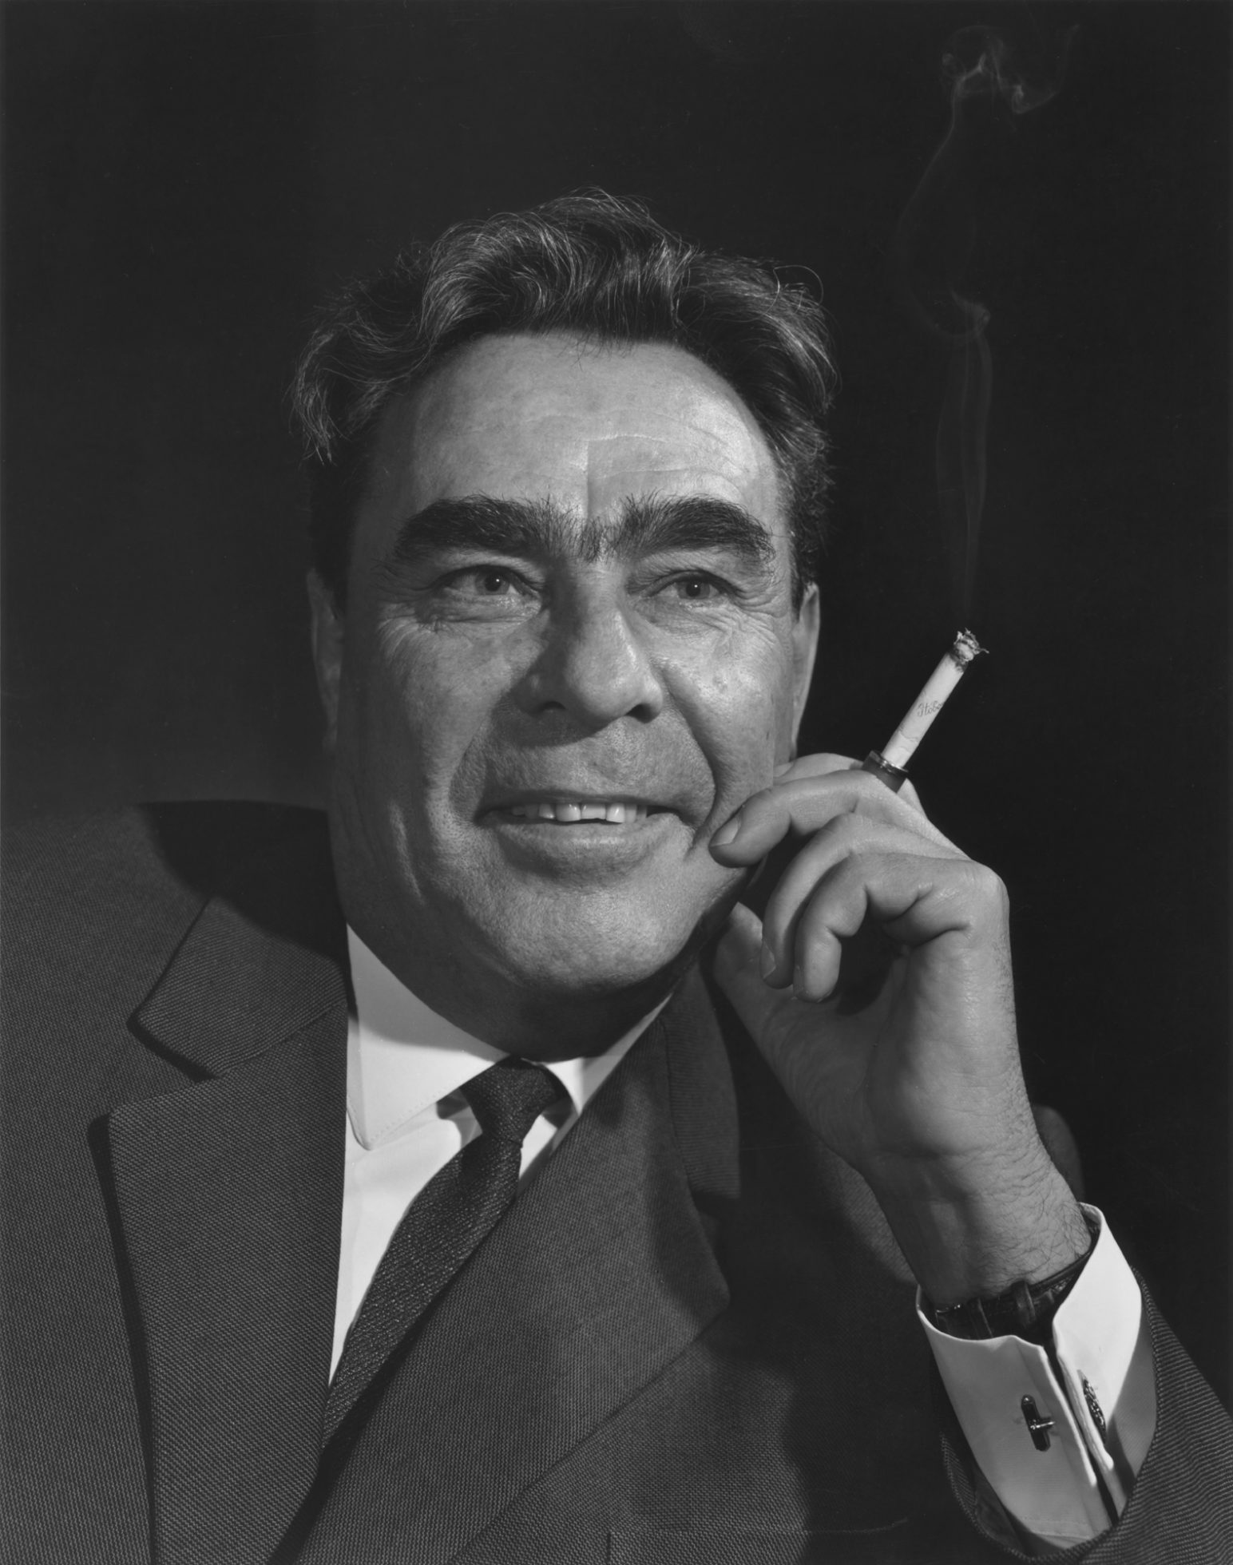
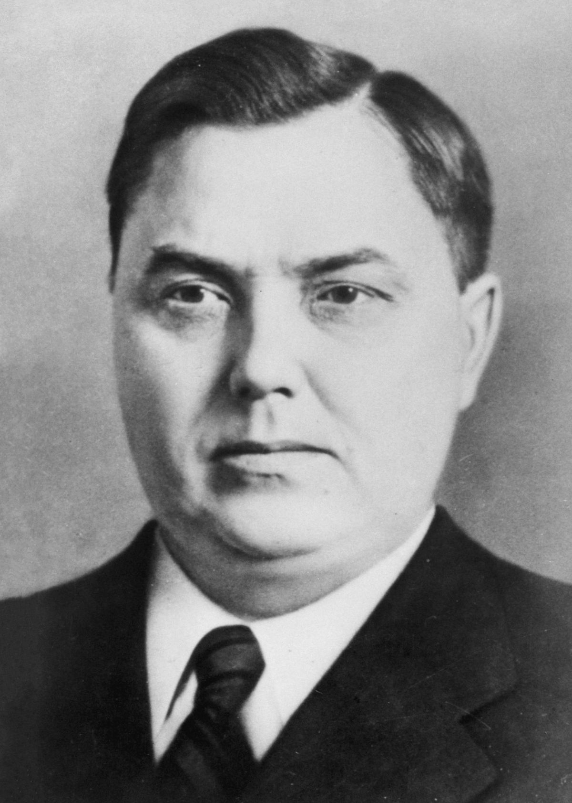
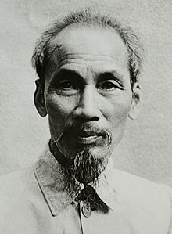
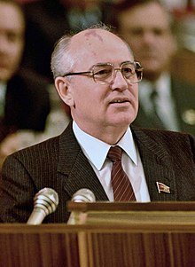
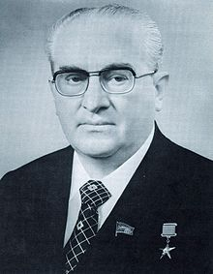
Important Leaders – The East

Slide 4
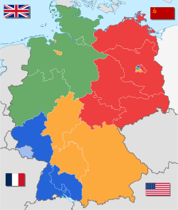
Fallout of WWII – Splitting of Germany
Division of Germany
Occupation Zones
Marshall Plan
West Germany (Federal Republic of Germany)
East Germany (German Democratic Republic)

Slide 5
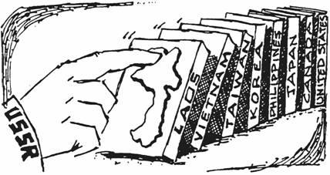
The Domino Theory
U.S. foreign policy throughout Cold War
A communist government in one nation would quickly lead to communist takeovers in neighboring states, each falling like a row of dominos
Made famous by Eisenhower
Now it is largely discredited

Slide 6
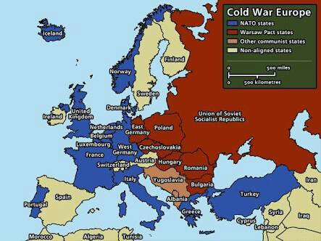
Soviet Satellite States
Russia had been invaded twice in 40 years, 3x in 130 years
Wanted protection
Also wanted to rule other Slavic peoples
Eastern Bloc
Iron Curtain

Slide 7
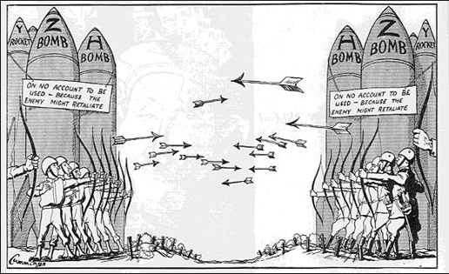
The Arms Race
Competition between two or more states to have the best armed forces
Bikini Atoll
Strategic Bombers
ICBMs – Intercontinental Ballistics Missiles
Bomber Gap

Slide 8
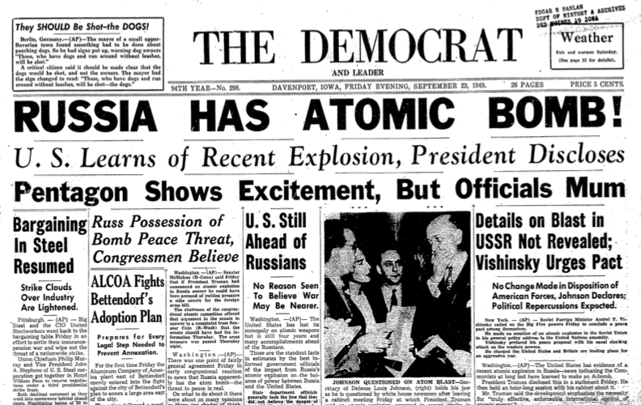
Russkies get the Bomb
August 1949 – “First Lightning”
Copy of Fat Man
USSR had spies in the Manhattan Project
What does this mean?

Slide 9
Mutual Assured Destruction
full-scale use of nuclear weapons by two or more opposing sides would cause the complete annihilation of both the attacker and the defender
Deterrence
If they have it and we have it then nobody will do anything

Slide 10
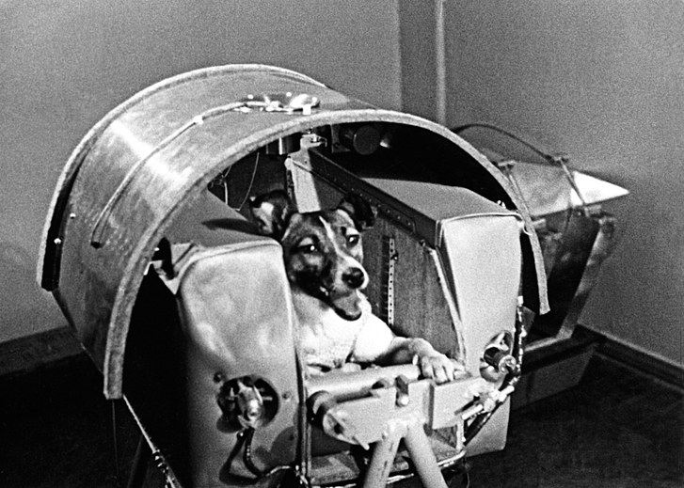
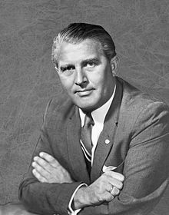
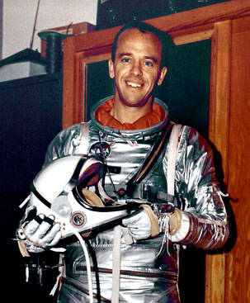
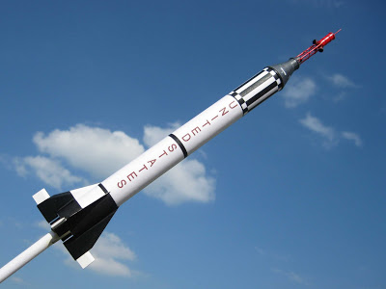
The Space Race
Origins
National Security
Ideological Superiority
Germans in WWII

Slide 11
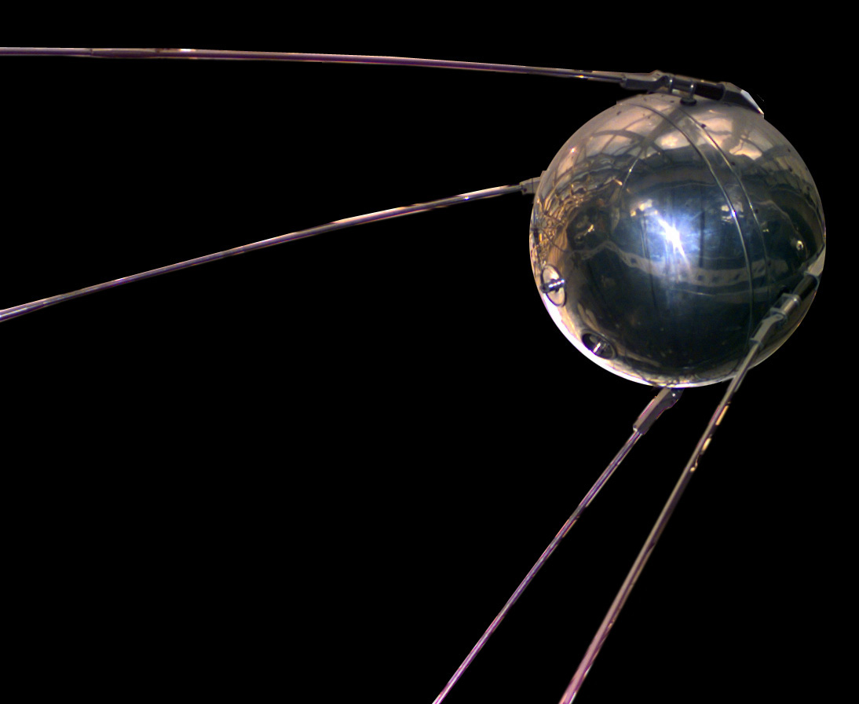
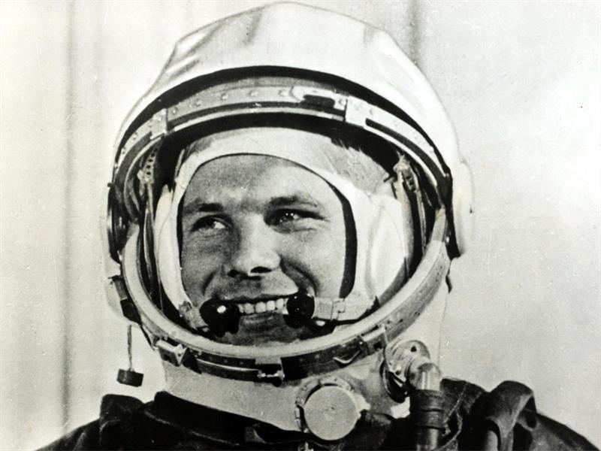
Sputnik
1957 – 1st artificial satellite
U.S. Reaction
1959 – Yuri Gagarin = 1st human in space
1961 – Alan Shepard = 1st American in space
“We choose to go to the Moon! We choose to go to the Moon in this decade and do the other things, not because they are easy, but because they are hard…”

Slide 12
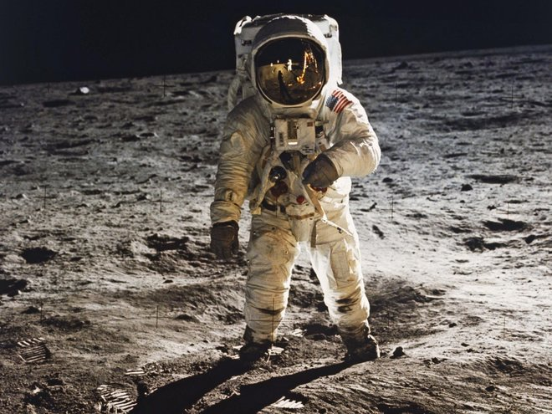
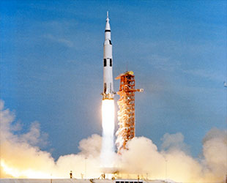
Race to the Moon
July 16, 1969 – Apollo 11 launches
Neil Armstrong, Buzz Aldrin, & Michael Collins
Effectively ends the Space Race
Watershed moment in US history

