Slide 1
The Russian Revolution

Slide 2
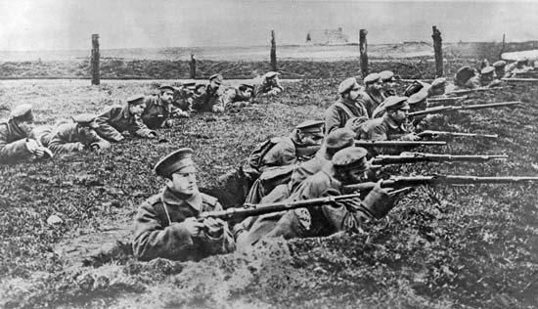
Background
Russian unprepared for WWI after Russo-Japanese War
No competent military leader – Nicholas II insisted on leading the troops
Industry could not produce necessary weaponry
Ill prepared, disorganized, and untrained
Suffered incredible losses – 2 million killed between 1914 & 1916
By 1917 – will to fight was gone

Slide 3
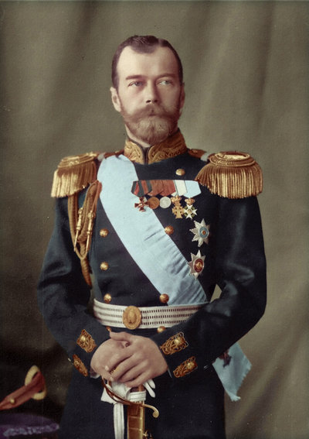
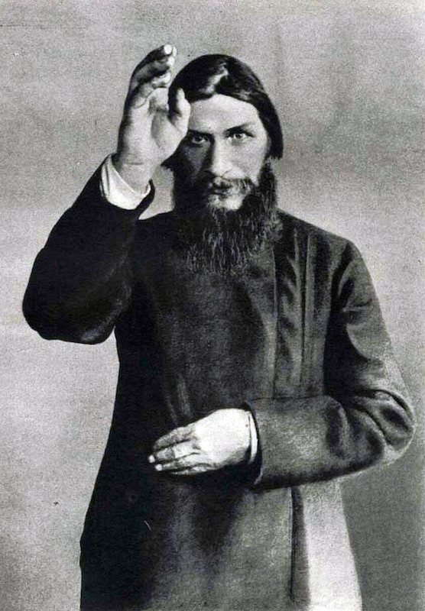
Upheaval
Nicholas II relied on military power and bureaucracy to keep control
Cut off from domestic events by being on the front lines and the queen’s advisor – Grigory Rasputin
Queen made all decisions with Rasputin’s input – his influence grew dangerous
Military and economic disasters made people upset
1916 – Rasputin assassinated

Slide 4
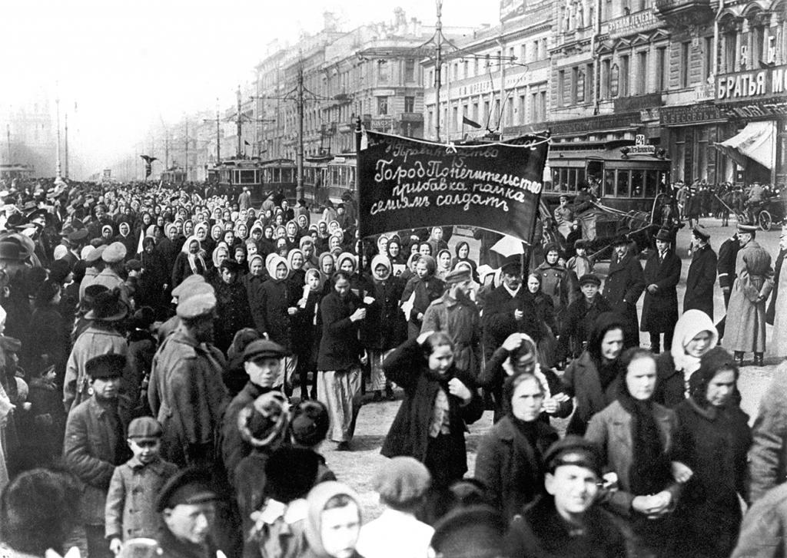
The March Revolution
March 1917 – women led strikes in St. Petersburg – bread was insanely expensive and being rationed
Troops ordered to break it up – ended up joining the protestors
The Duma established a provisional government and urged the czar to step down.
Nicholas II stepped down on March 15, 1917 – ending the 300-year old Romanov dynasty

Slide 5
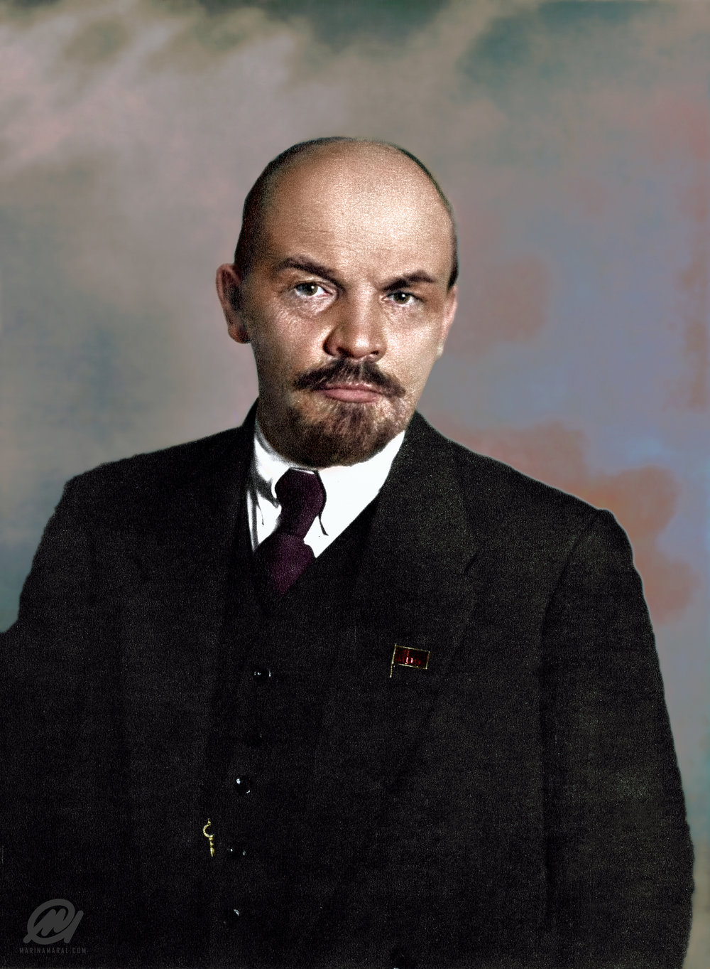
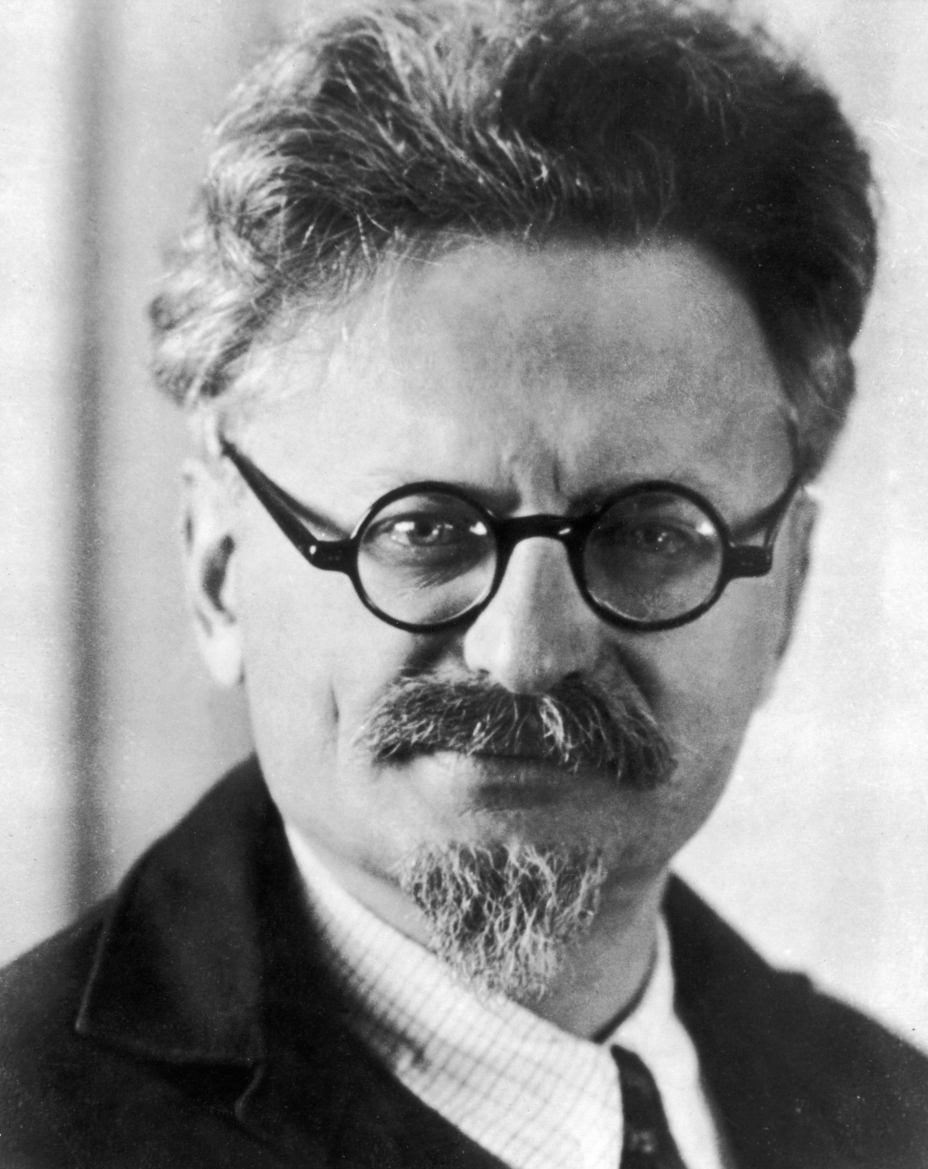
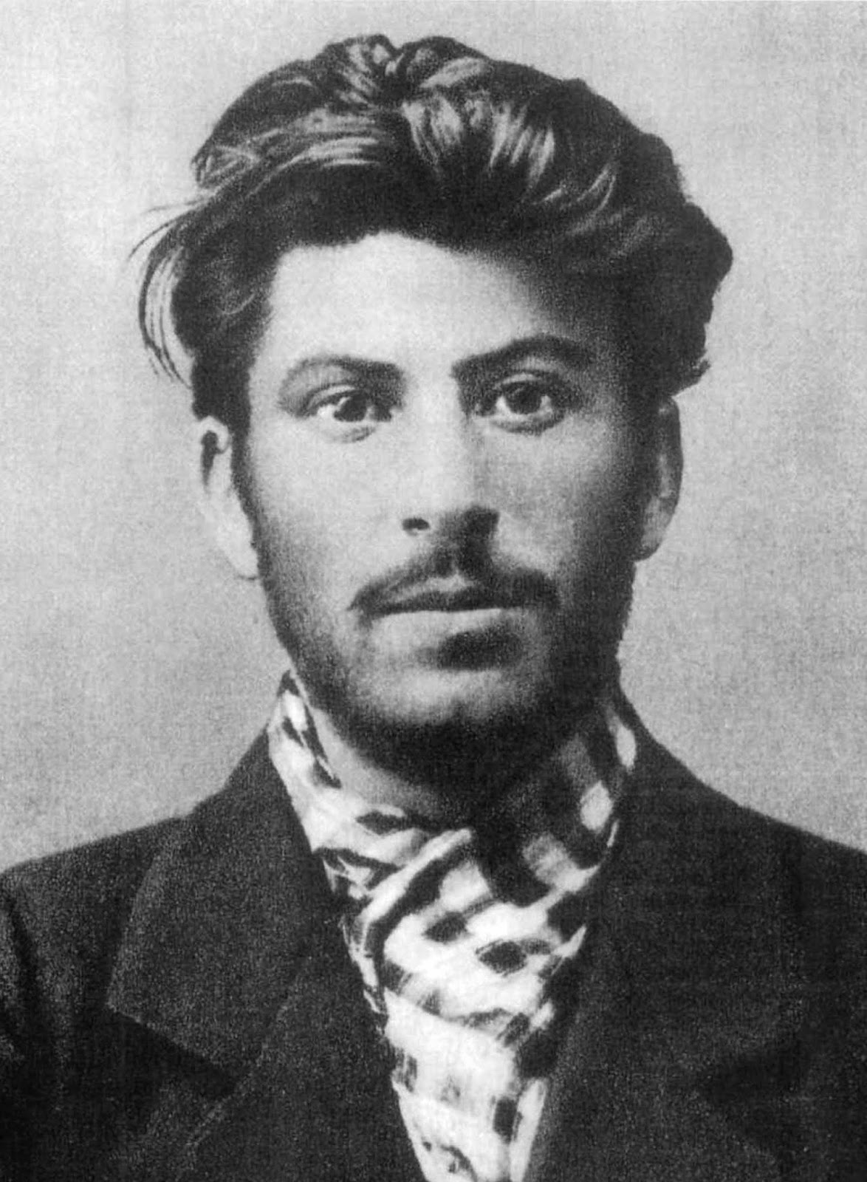
The Bolsheviks
Provisional government decided to remain in the war – big mistake
Also faced challenges from the Soviets
Bolsheviks – small faction of a Marxist party called the Russian Social Democrats – led by Vladimir Lenin (Leon Trotsky and Joseph Stalin were right-hand men)
November 6, 1917 – Bolsheviks seized the Winter Palace and the power
March 3, 1918 – Lenin signs the Treaty of Brest-Litovsk – gets Russia out of WWI and gives Germany eastern Poland, Ukraine, Finland, and Baltic provinces

Slide 6
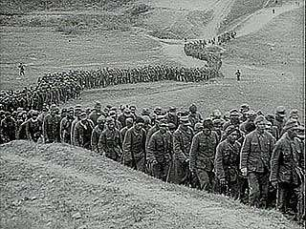
Civil War
Bolsheviks faced resistance – czarist loyalists, constitutional monarchists
Allies sent troops to Russia hoping to bring them back into the war
1918 – 1921: Red Army (Communists) vs. White Army (loyalists)
July 1918 – royal family murdered and thrown into a mine shaft
Why did the Communists win?
Trotsky’s organization
Disunity of anti-Communist forces
Single goal in mind
Cheka – secret police

