Slide 1
Tying it all together: the major causes of WOrld war i

Slide 2
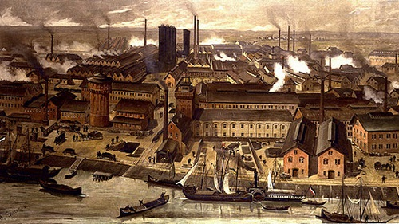
Industrialization
Over the course of a century, rural societies became industrial and urban very rapidly
Transportation, production, communication, and people’s health all improved
Increase in machinery & technology combined with old war tactics led to total carnage
Mass production – allowed for weapons to be made faster & new technology to be developed

Slide 3
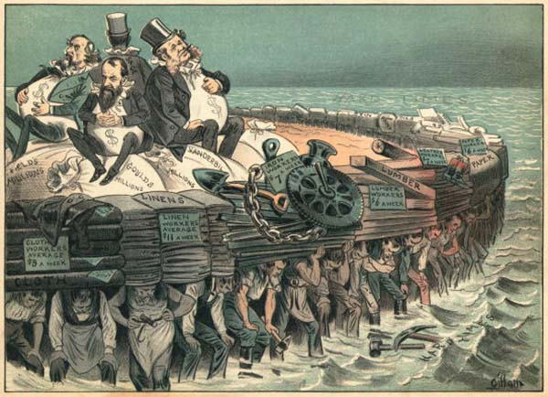
Imperialism
Goal: build up national wealth & influence
Scramble for Africa (and other territory) led to intense rivalries
Also led to a race for resources & high tensions
Fostered strong senses of nationalism in imperialized peoples

Slide 4
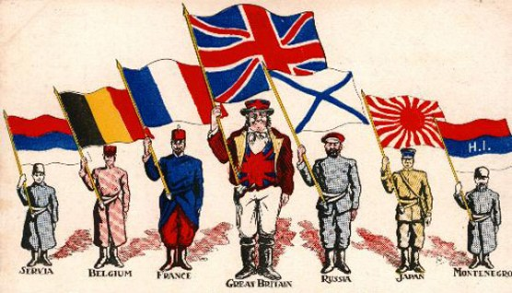
Nationalism
Extreme pride in one’s country & ethnic background along with the belief that your country is superior to others
Led a lot of oppressed ethnic groups to call for their own nations (Serbs, Vietnamese, Indians, etc.)
In order to fuel this idea of national superiority, European powers built up their militaries, looked to expand their empires, and sought exuberant amounts of wealth/resources
Also fueled by propaganda, literature, and other mass media
All this chest-pounding led to rising tensions between European powers to prove themselves to be the best

Slide 5
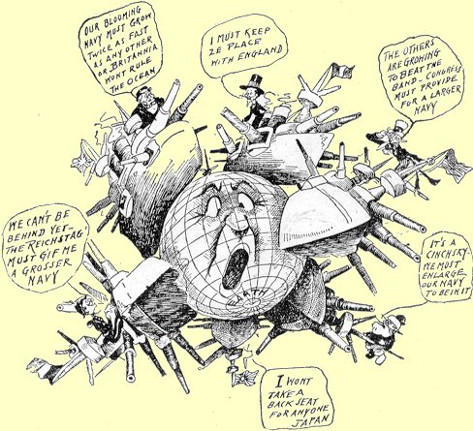
Militarism
Essentially a massive arms race
Britain had a large navy so others wanted one
France & Germany competed to have the larger army
Because of prestige & self-defense when one nation would update or change their military others would follow suit
Led to high taxes on civilians
Between 1870 and 1914 every nation (except UK and US) doubled the size of their army

Slide 6
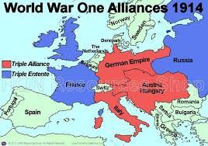
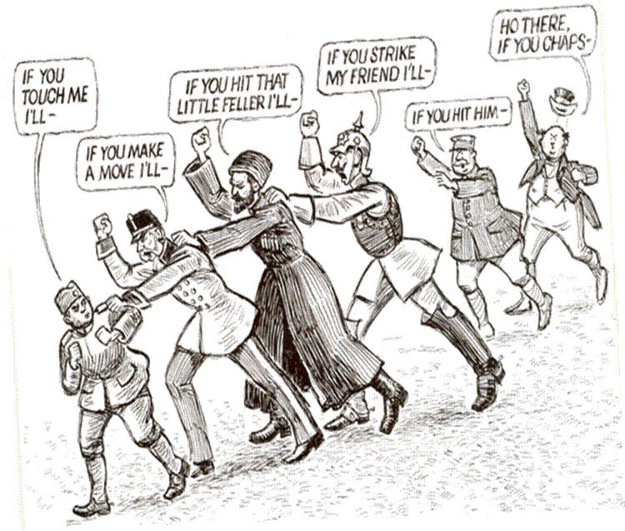
Alliance Systems
Out of fear of the rise of militarism alliances were formed
Triple Alliance (Central Powers) – Germany, Austria-Hungary, & Italy – 1882
Triple Entente (Allied Powers) – Britain, France, & Russia – 1907 (U.S. comes in later)

