Slide 1
WWII: The European Theater

Slide 2
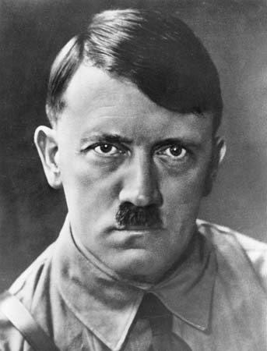
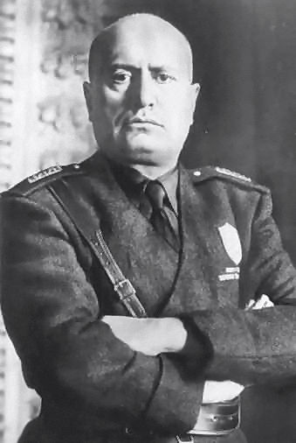
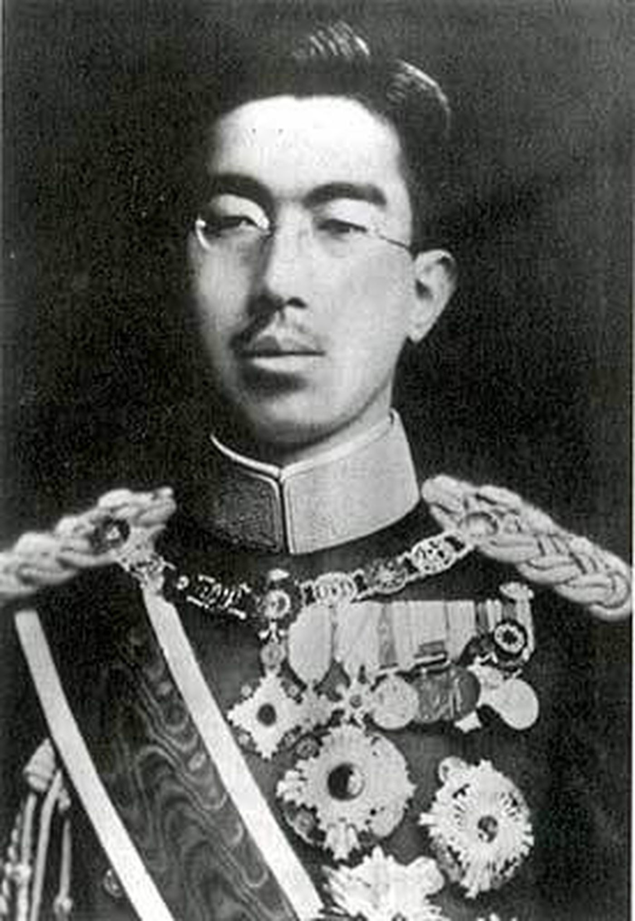
The Main Players – The Axis Powers

Slide 3
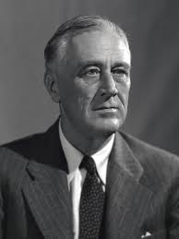
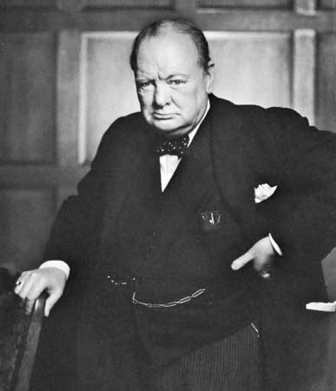
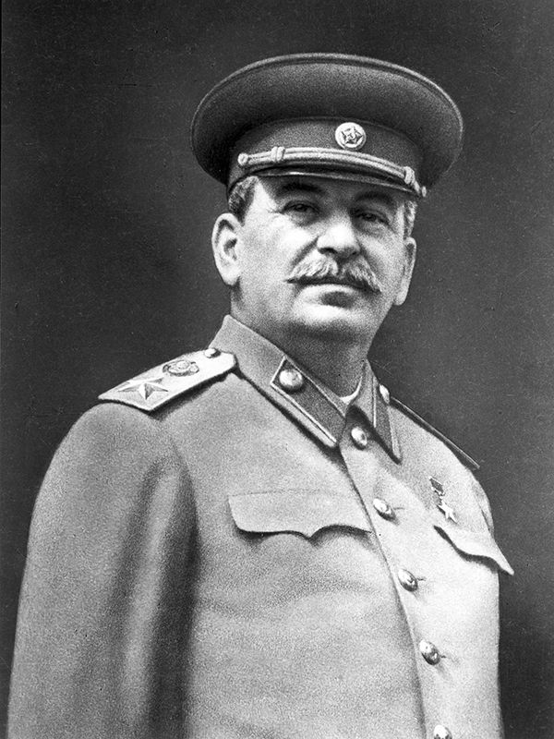
The Major Players – The Allied Powers

Slide 4
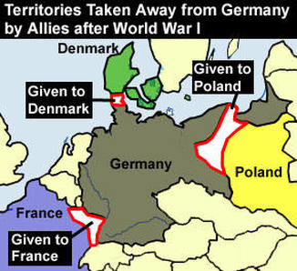
The Rhineland & Sudetenland
Rhineland is remilitarized – 1936
Germany takes back Sudetenland - 1938

Slide 5
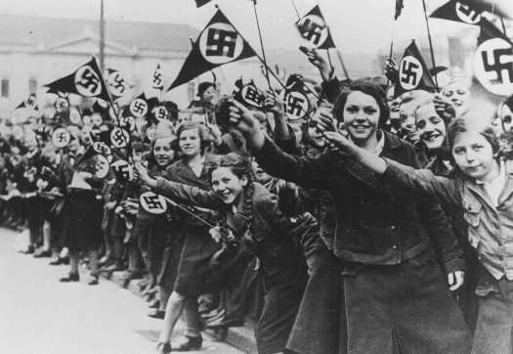
The Anschluss
Germany annexes Austria – 1938
Reactions and Consequences

Slide 6
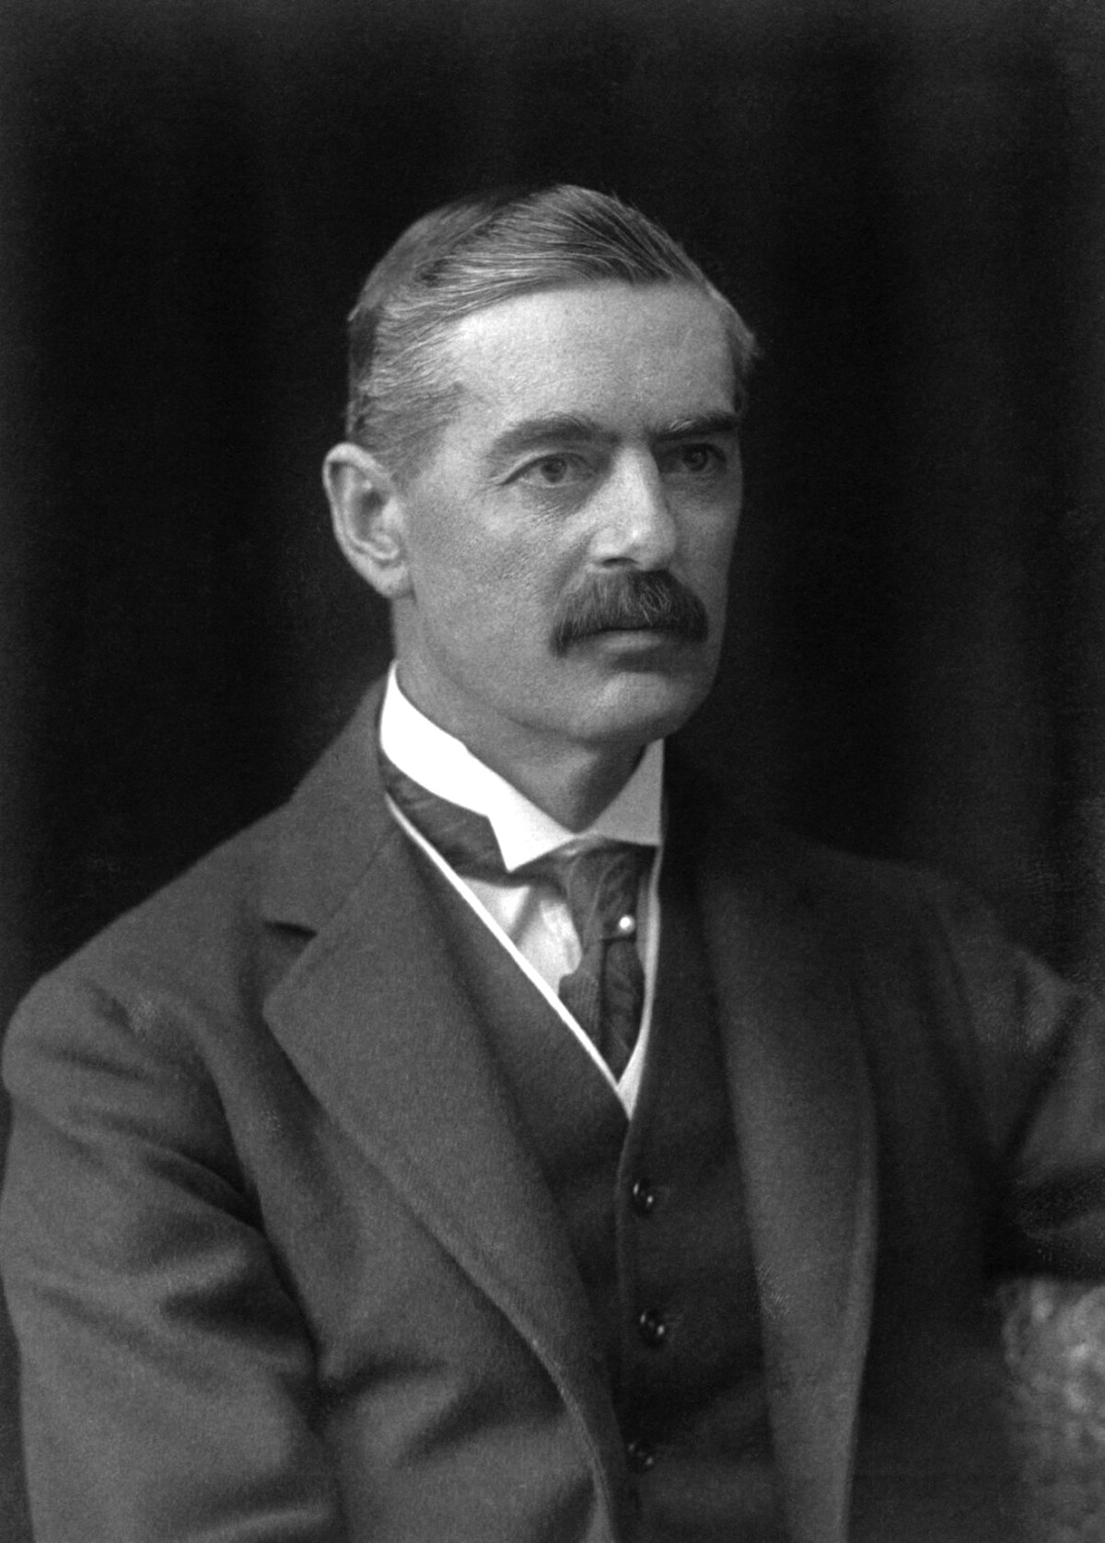
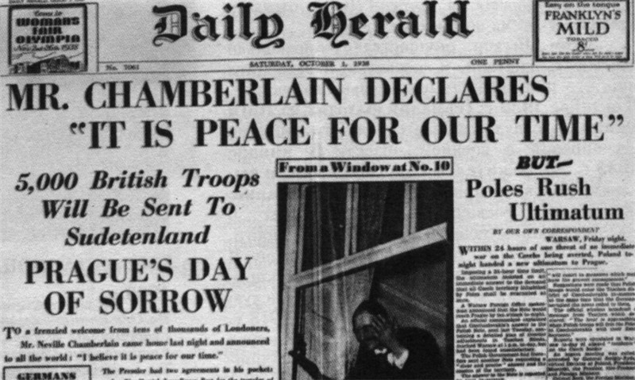
Appeasement
Neville Chamberlain
“Peace in our time.”

Slide 7
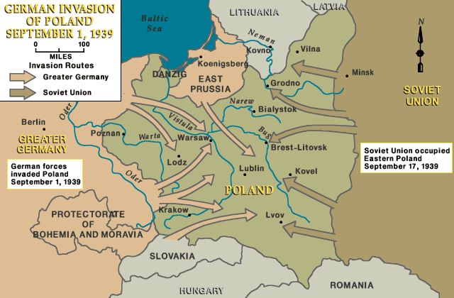
Case White
Invasion of Poland – Sept. 1, 1939
Blitzkrieg
Ribbentrop-Molotov Pact

Slide 8
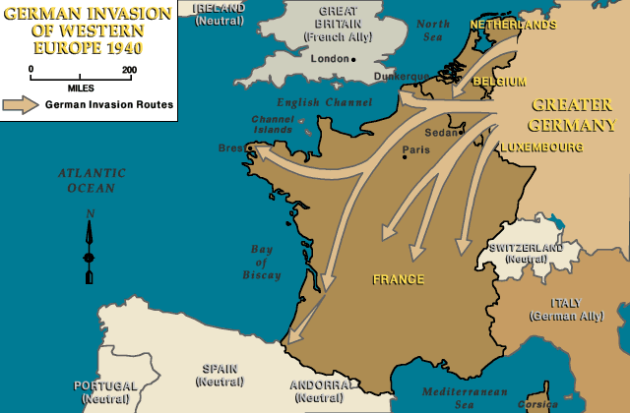
Fall of France: May – June 1940
Sitzkrieg
The Maginot Line
Dunkirk
Vichy France

Slide 9
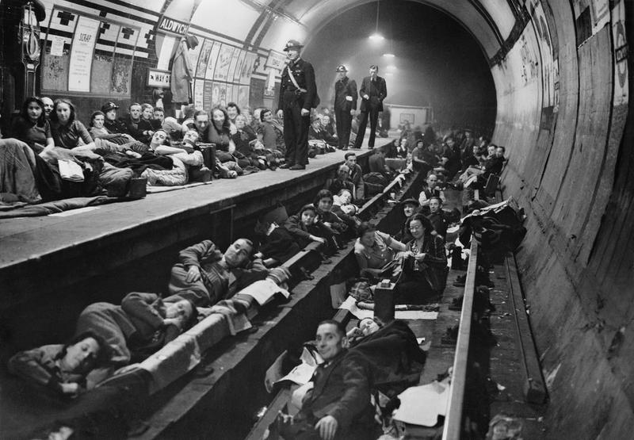
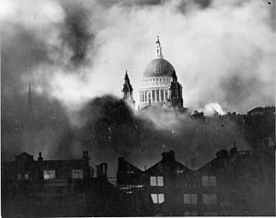
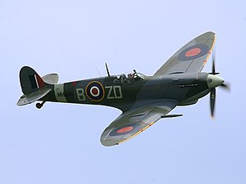
Operation Sea Lion
The Battle of Britain
The Blitz
The RAF
Citizen Morale

Slide 10
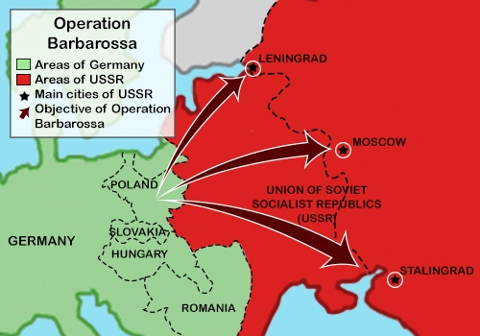
Operation Barbarossa: June – Dec. 1941
Objective: Destroy the Red Army
Moscow
The Caucuses

Slide 11
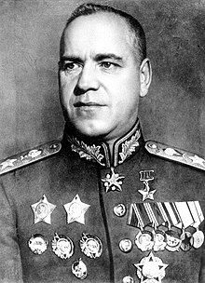
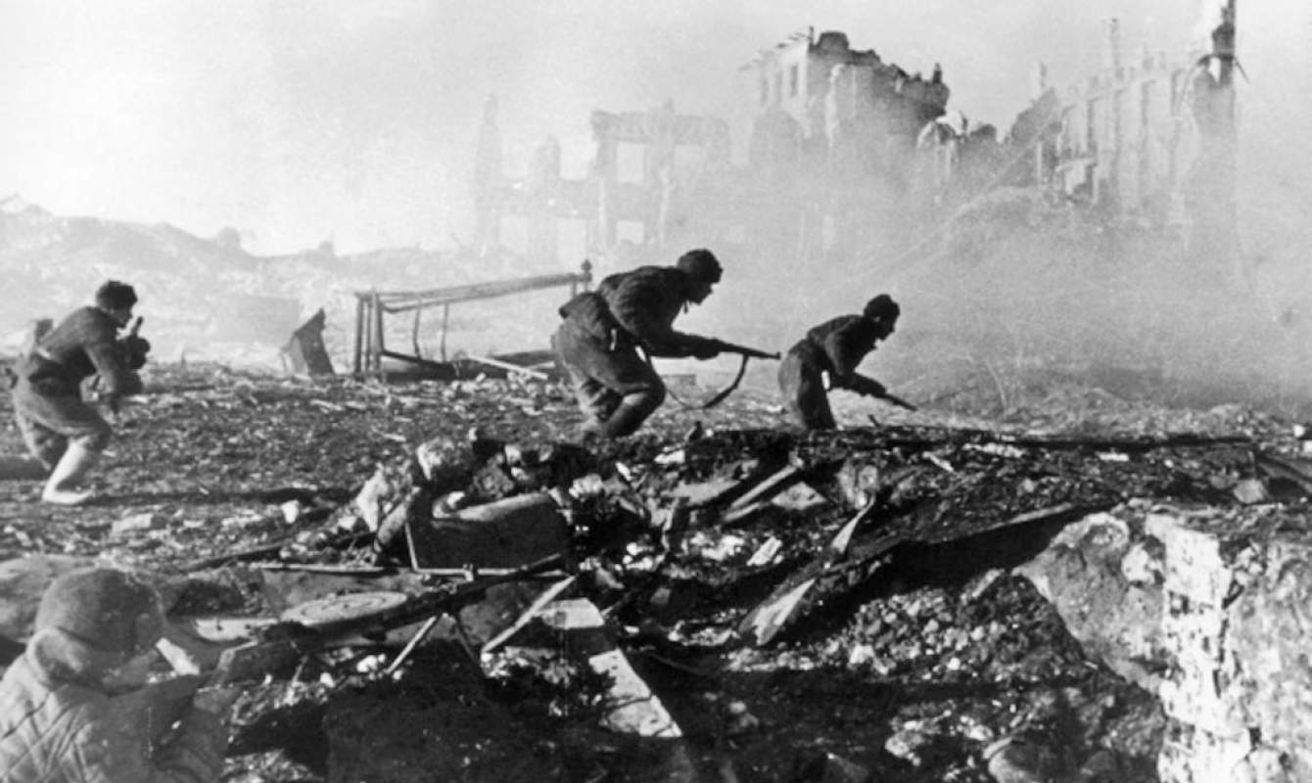
Battle of Stalingrad: Aug. 1942 – Feb. 1943
One turning point of the war
Intense, bloody fighting
Soviets were surrounded
Georgy Zhukov

Slide 12
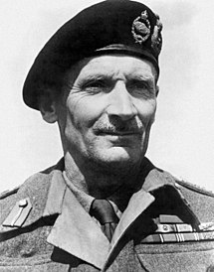
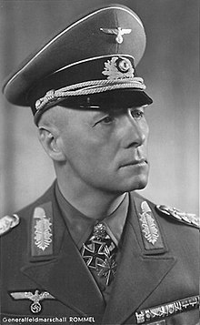
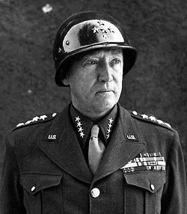
The North African Campaign
Erwin “The Desert Fox” Rommel
Axis seizes crucial British ports
Battles of Alamein
Operation Torch

Slide 13
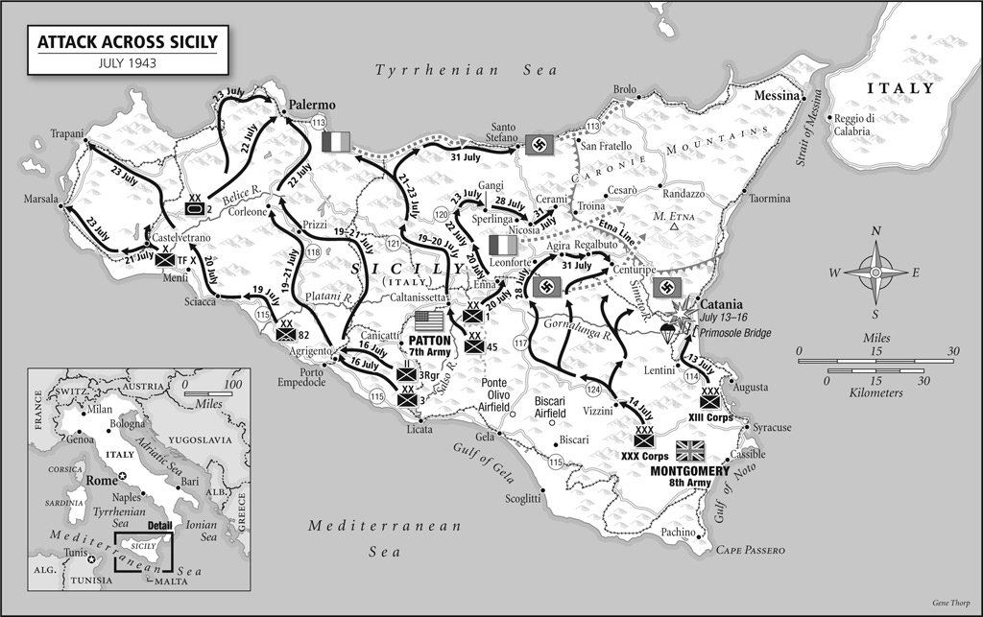
Operation Husky
Goal: Take Sicily and gain a foothold in Europe
Patton vs. Montgomery

Slide 14
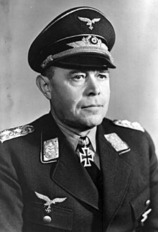
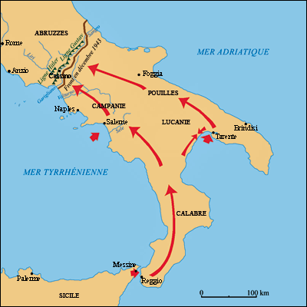
Operation Avalanche
Goal: begin to push up through the Axis’ underbelly
Fighting was slugfest
Albert Kesselring

Slide 15
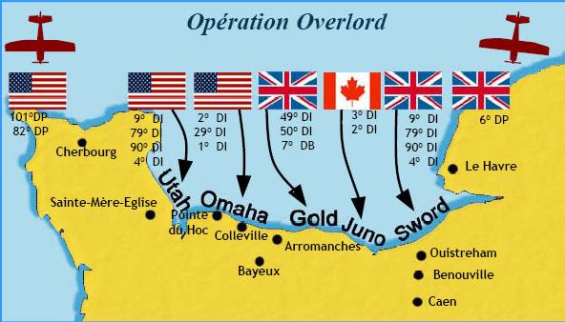
Operation Overlord
June 6, 1944
Germans thought it would come at Calais
Paratroopers drop in behind Nazis
Amphibious invasion follows

Slide 16
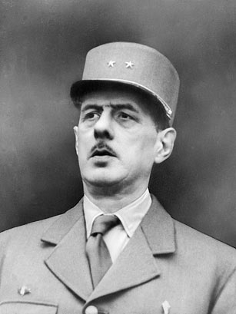
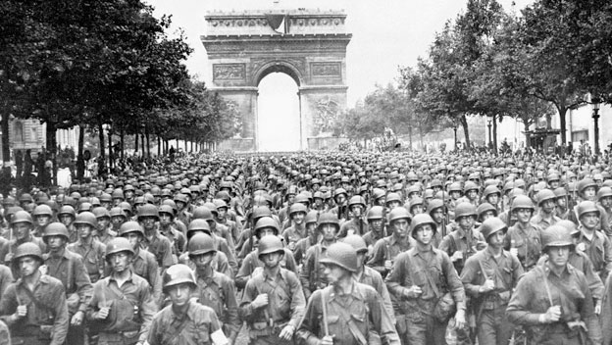
Liberation of Paris
De Gaulle vs. French Resistance
Eisenhower wants to bypass it

Slide 17
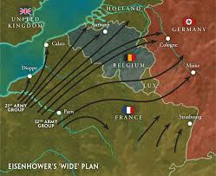
Operation Market Garden
A mess all around
Attempt to cross the Rhine into Germany

Slide 18
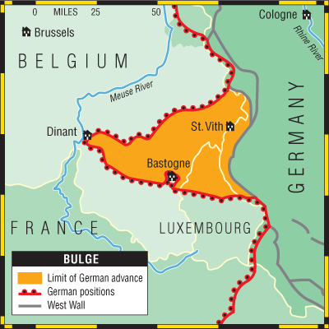
The Battle of the Bulge
Last major German offensive
St. Vinth
Bastogne

