Slide 1
China & Japan: a tale of two societies
1800 – 1914

Slide 2
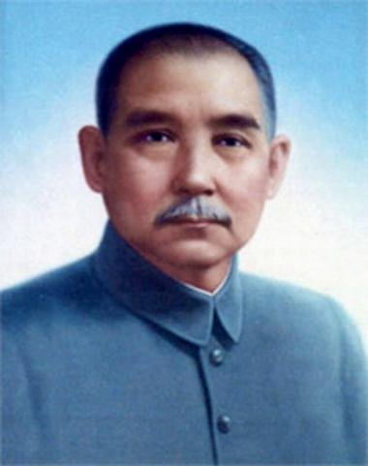
Revolution in China
Fall of the Qing Dynasty – 1911
Tried to reform after Boxer Rebellion
Emerging new elite – intellectuals, merchants, professionals
Reforms did not help peasants
Rise of Sun Yatsen
Formed Revive China Society
1905 – formed Nationalist Party
Three People’s Principles
Nationalism
Democracy
Right to pursue livelihoods

Slide 3
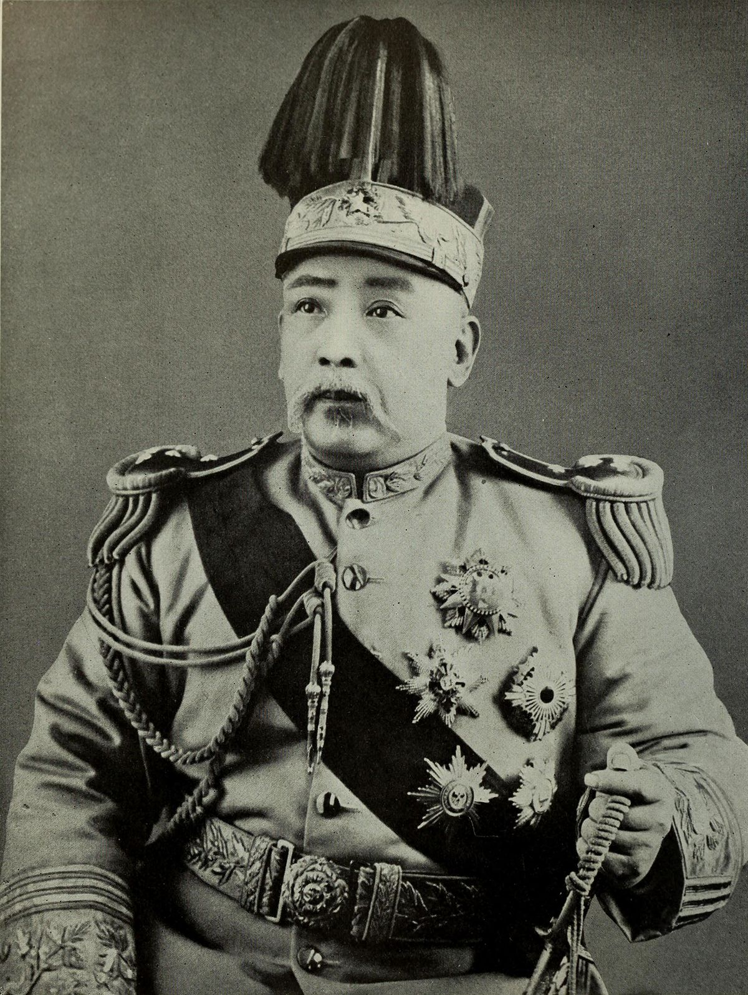
Revolution of 1911 & Civil War
Sun Yatsen’s followers stage an uprising – Qing dynasty collapses
Sun turns to Yuan Shikai – needed military support
Produced no new political or social – just a collapse of old order
Yuan and military take over – clash with Sun’s supporters
Nationalists stage a rebellion – fail, Sun flees to Japan
Yuan sets up a dictatorship – dies in 1916 – civil war between war lords follows

Slide 4
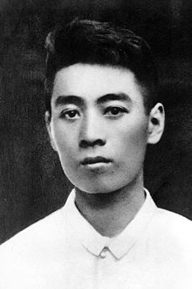
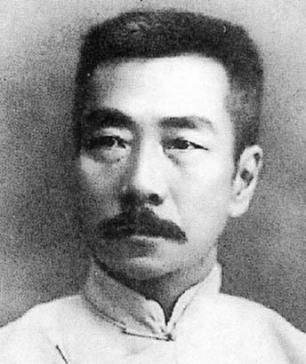
Culture and society changes
Economy had never been more productive
Westerners had affected trade
Introduced modern transportation and communication
Created export market
Integrated Chinese market into global economy
Imperialism imposed a state of dependence
Most people farmers; changes most striking in cities
Confucian social ideals starting to decline
Radicals wanted to eliminate culture

Slide 5
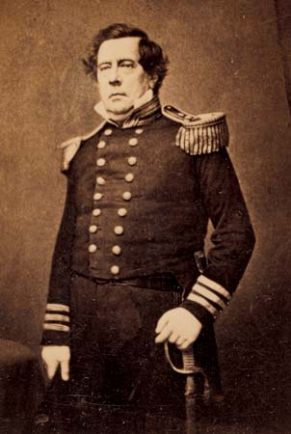
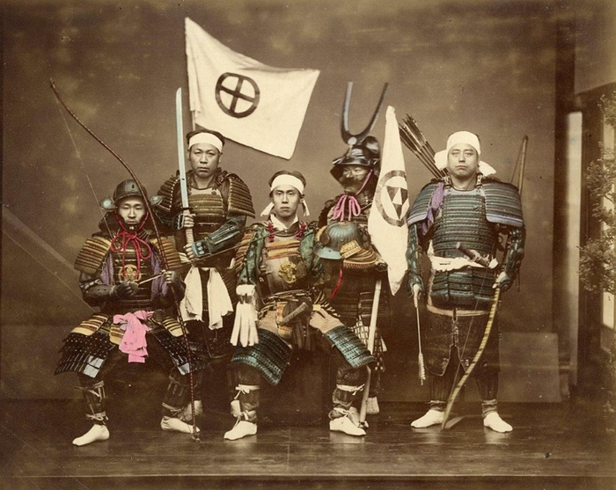
Japan – end of Isolation
US broke 200 years of isolation – sent in navy to demand access
1853 – Commodore Matthew Perry
Treaty of Kanagawa – opened Japanese ports to West
Resistance to New Order
Strongest in samurai class
Sat-Cho alliance – 1863
1868 – Sat-Cho attack shogun’s palace – start Meiji Restoration

Slide 6
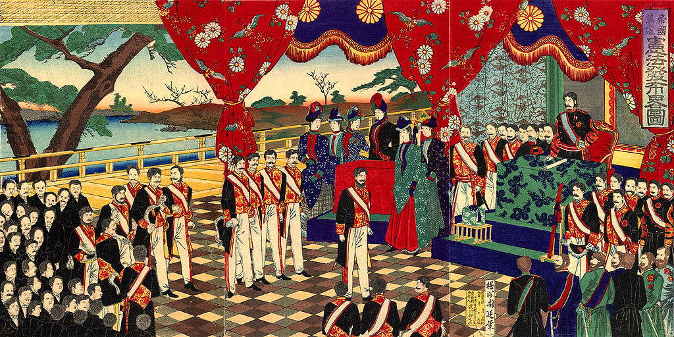
Meiji Restoration
Policy of industrialization begun by Sat-Cho alliance
Sought to abolish old order; stripped daimyo of property
1868 – Charter Oath signed
Modeled new constitution after Imperial Germany
Began to send people to study in the West – military in particular
Reforms
Redistributed land & land taxes
Promoted Industry to protect against the West
Fostered a close relationship between govt. & business

Slide 7
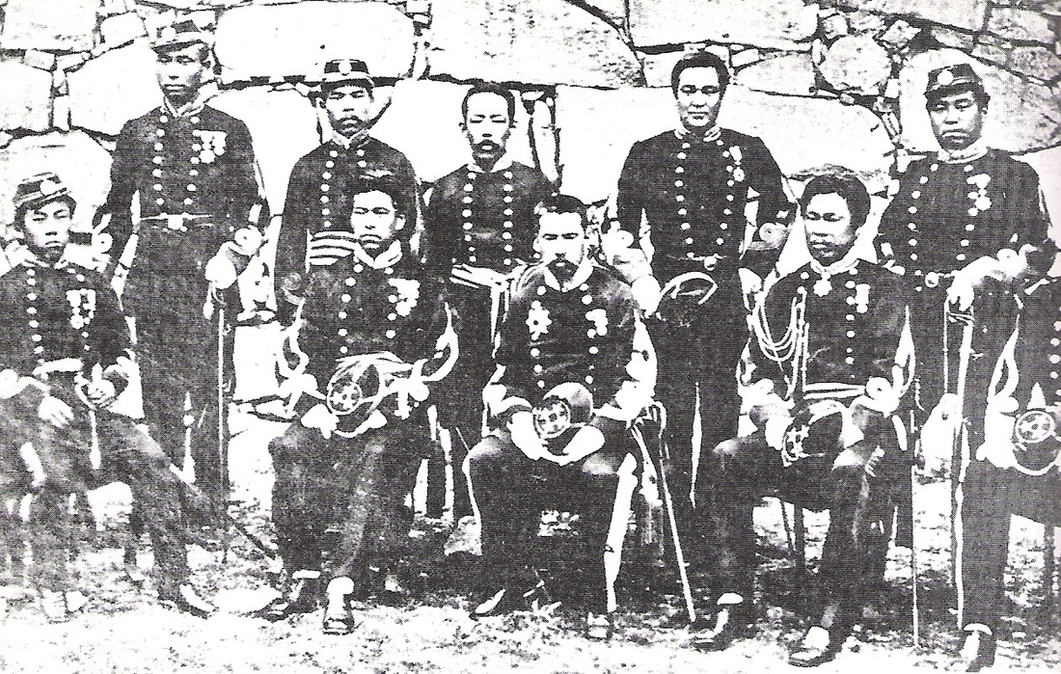
Military education & social structure
Knew they needed a modern military to compete with West
1871 – instituted compulsory military service
Brought in foreign specialists & sent students abroad to learn new tactics
Abolished old class system – aristocratic privileges abolished & new freedom for women
Western fashion and leisure activities allowed – BASEBALL!!

Slide 8
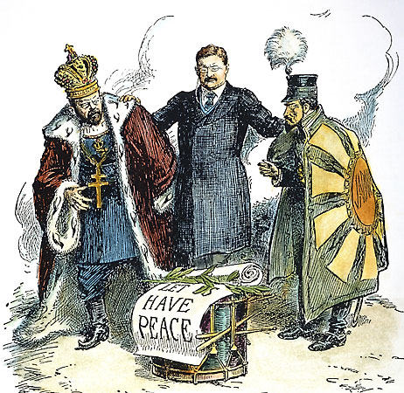
Japanese Imperialism
Attempted to copy the West
1876 – forced Korea into a trading partnership
1894 – Sino-Japanese War – fought over Korean independence, Japan won
1904 – Russo-Japanese War – fought over Port Arthur in China, Japanese annihilates Russian fleet
Stuns everyone – Japan starts to see itself as equal in power to the West

Slide 9
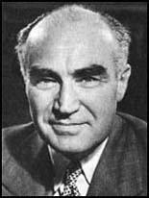
Japan – U.S. Relations
U.S. had recognized Japan’s authority in Korea, they had recognized ours in the Philippines
1907 – Theodore Roosevelt cuts deal to stop Japanese immigration to U.S.
Japanese resented this
1910 – Japan fully annexes Korea; American China Lobby is outraged
Henry Luce

Slide 10
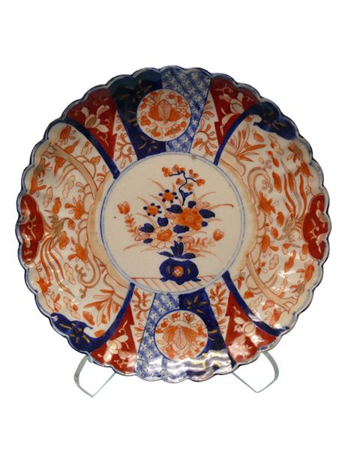
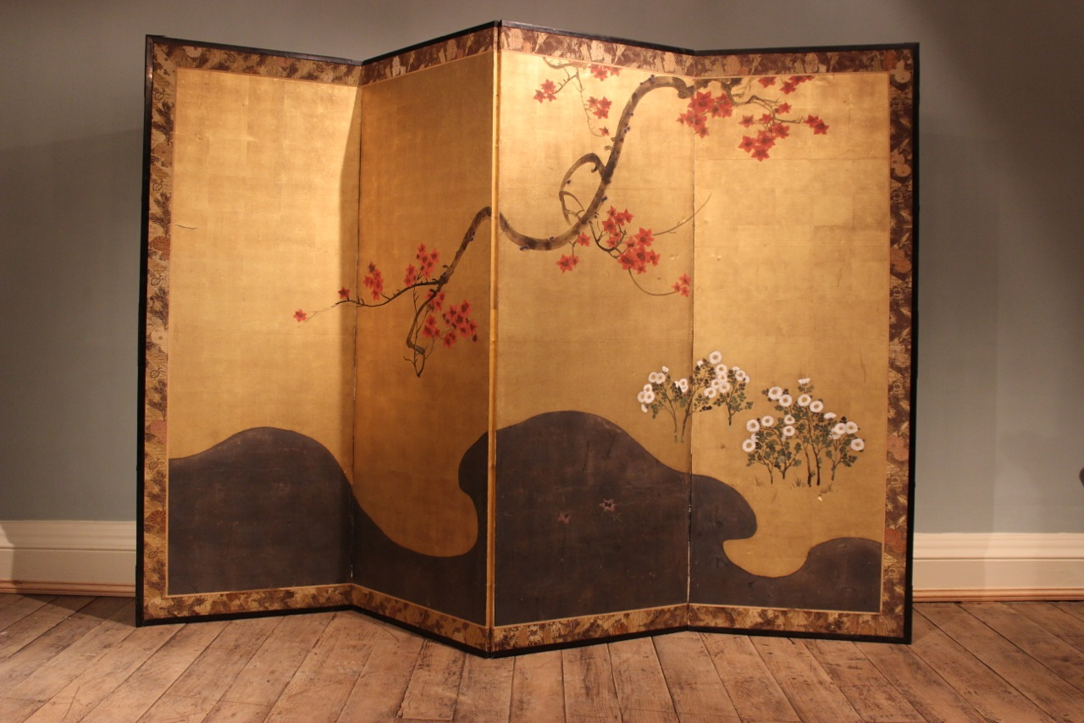
Return to tradition
Japanese people had started to reject Western influences
Artists returned to traditional techniques
1889 – Tokyo School of Fine Arts established
Japanese products & gardens become incredibly popular in the U.S.

