Slide 1
Conflict Widens

Slide 2
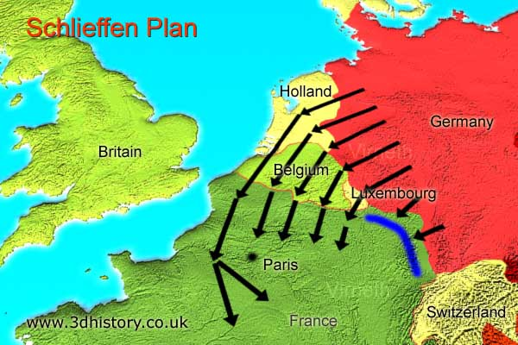
The Western Front
German used the Schlieffen Plan to get to France
Quickly take out France – deter Britain from getting involved
Use time gained to move troops to East to fight Russians
Quickly turned into a stalemate
Trenches ran from the English Channel to the borders of Switzerland

Slide 3
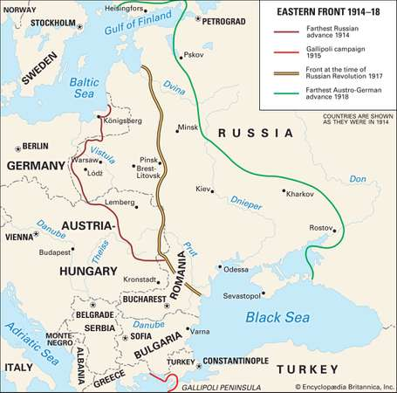
The Eastern Front
Marked by mobility
Russians managed to get into Germany, but are beaten back badly – no longer a real threat
Germany and Austria manage to eliminate Serbia from the war
Success in the East allowed Germans to focus on the West
Russia will also pull out of the war in 1917

Slide 4
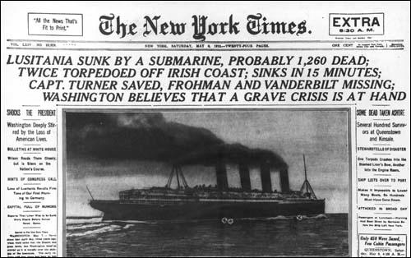
U.S. enters the conflict
Tried to remain “neutral”
Biggest cause of entry = naval war between Germany and GB threatened our neutrality on the sea
May 7, 1915 – Germans sink the Lusitania
January 1917 – Zimmerman Telegram
Enter war in April 1917 – completely unprepared; troops get to Europe in 1918

Slide 5
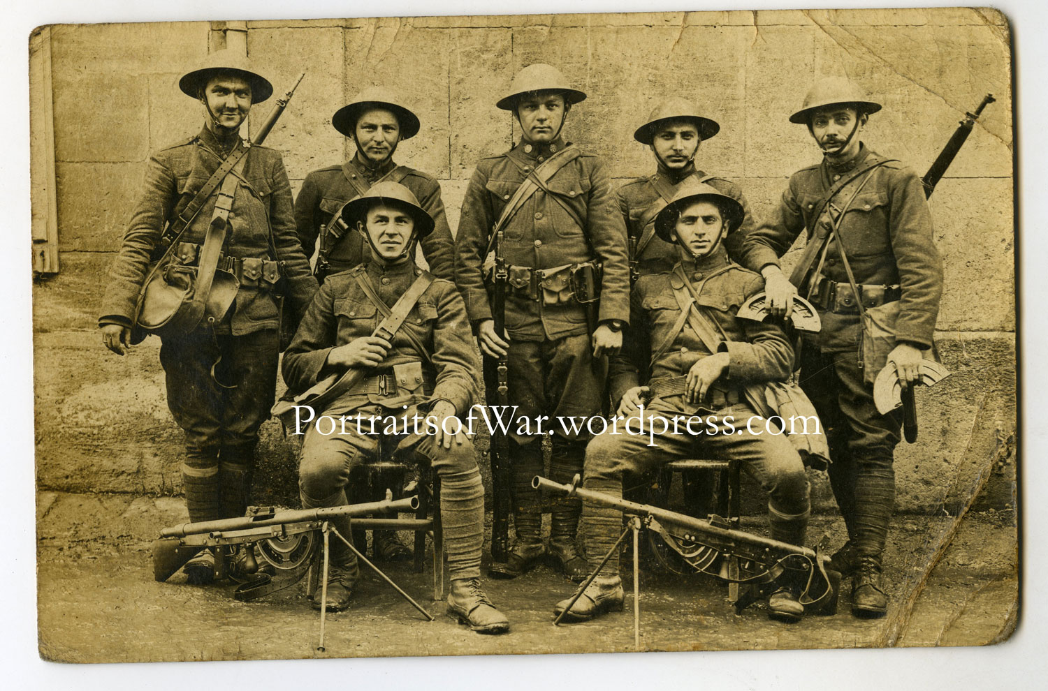
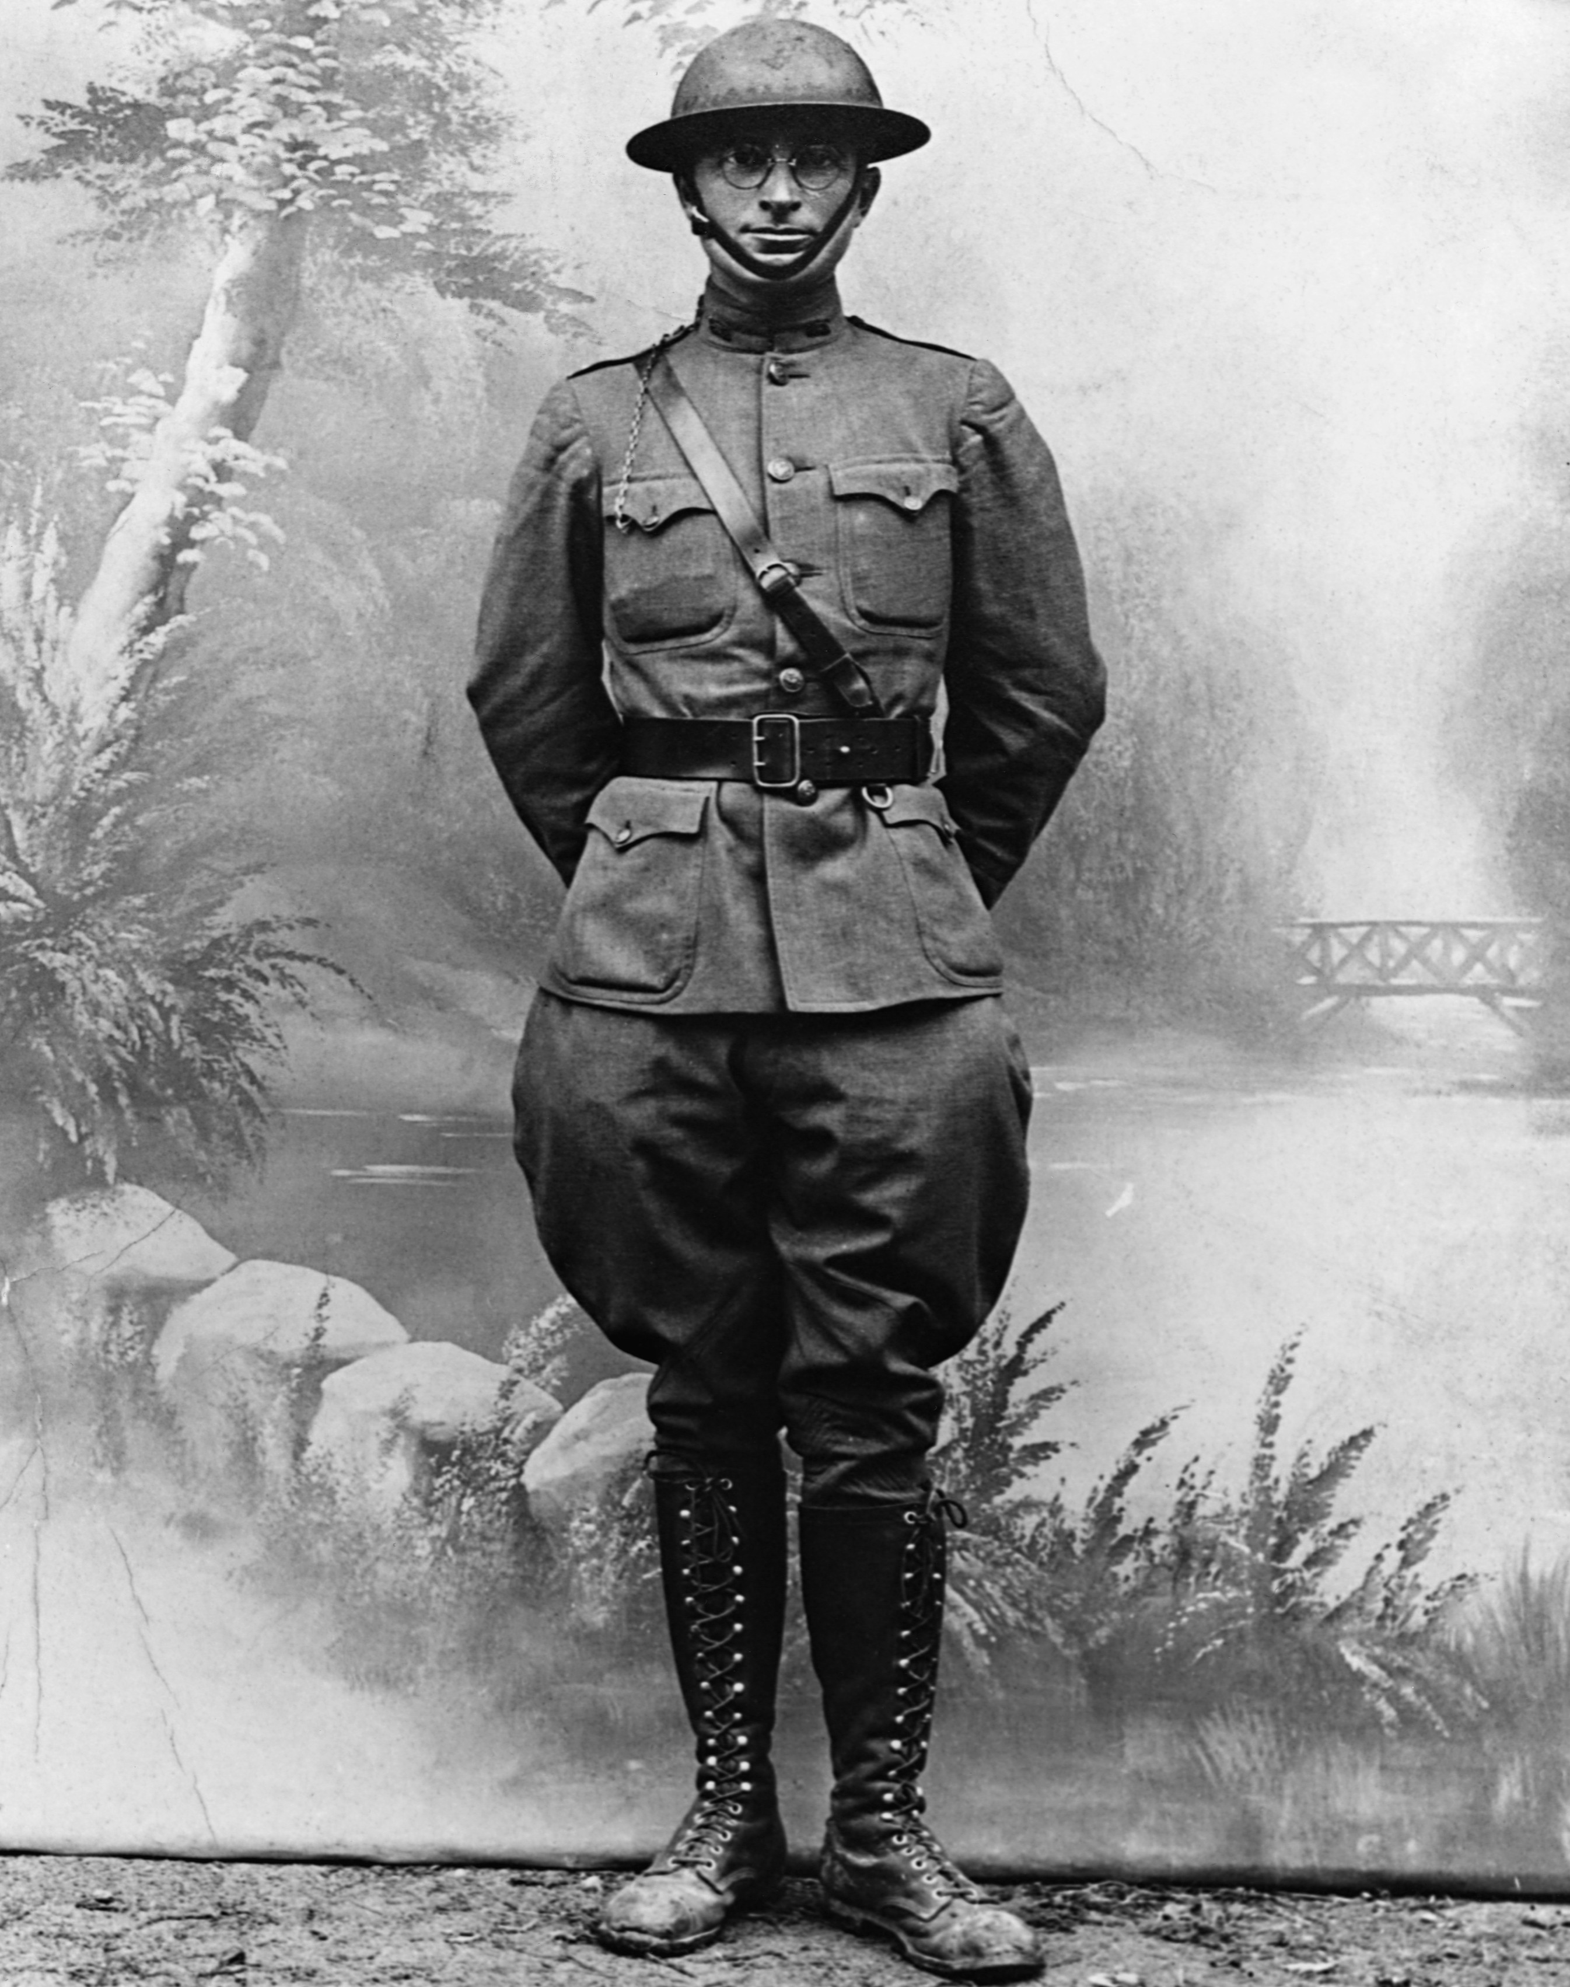
Preparedness Movement
Paying more attention to war by 1915
Teddy Roosevelt one of the biggest proponents of preparedness
Believed in practical approach to world affairs – economic strength and military muscle were more useful than idealistic crusades
US Army and Navy needed to be built up – never kept a large standing army during peace time

Slide 6
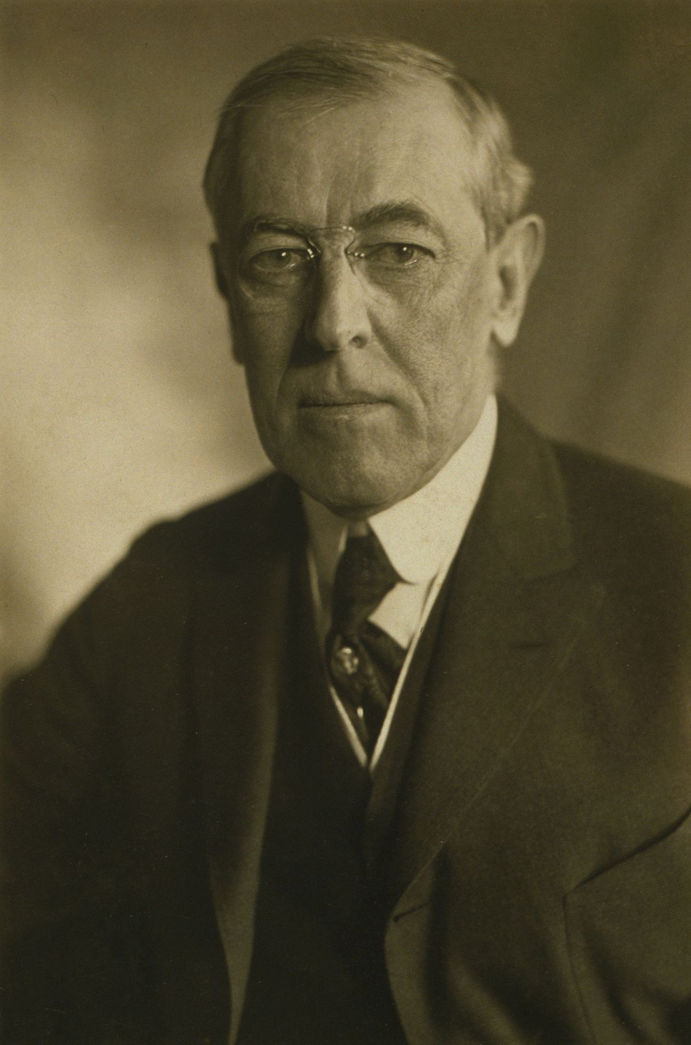
Woodrow Wilson
Born in Virginia
Studied at Johns Hopkins University – probably had dyslexia
Became President of Princeton then Governor of New Jersey
Idealistic – fighting war to preserve democracy
Doctrine of Self-Determination

Slide 7
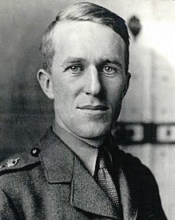
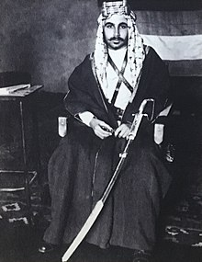
The Middle East
British helped Arab tribes to overthrow the Ottoman Empire
Led by T. E. Lawrence (Lawrence of Arabia) and Prince Faisal
British had promised the Arabs they could rule the Middle East freely – pulled back on that promise and split the Holy Land between themselves and France

Slide 8
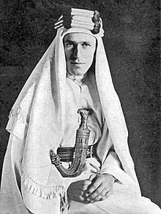
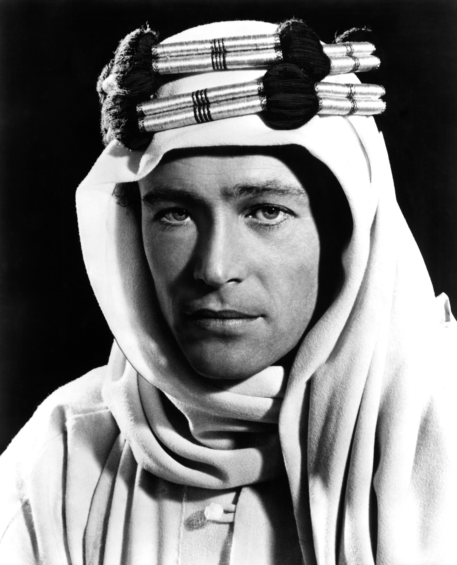
T.E. Lawrence
Archaeologist, military officer, diplomat, writer
Studied medieval history at Oxford
1910 – offered a job as an archaeologist in the Middle East, 1914 – contracted as a spy to watch the Ottoman Army
Quickly fell in love with Arab culture and was able to gain the respect of the Arab leaders
Instrumental in the Arab Revolt against the Ottomans
Wrote Seven Pillars of Wisdom
Died in a motorcycle crash in 1935

Slide 9
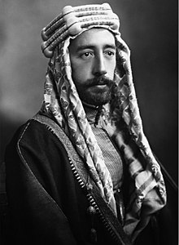
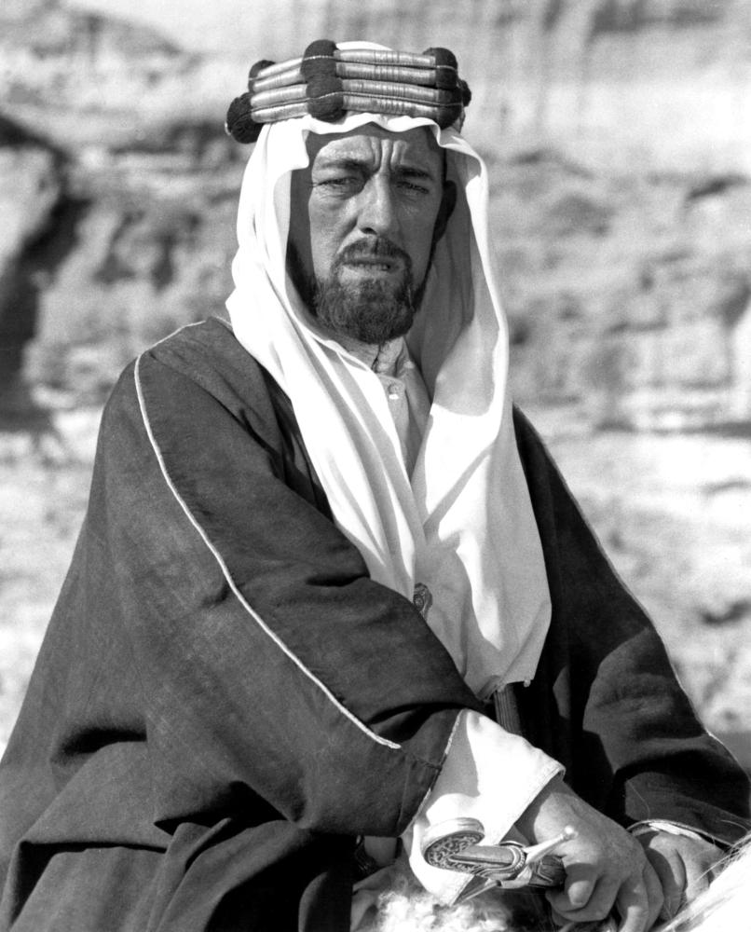
Prince Faisal I of Iraq
Born in Mecca, met Lawrence in 1916
Led the Arab forces against the Ottomans
Led the Arab delegation at the Paris Peace Conference
1920 – made Arab King of Syria
Died in 1933 – heart attack

Slide 10
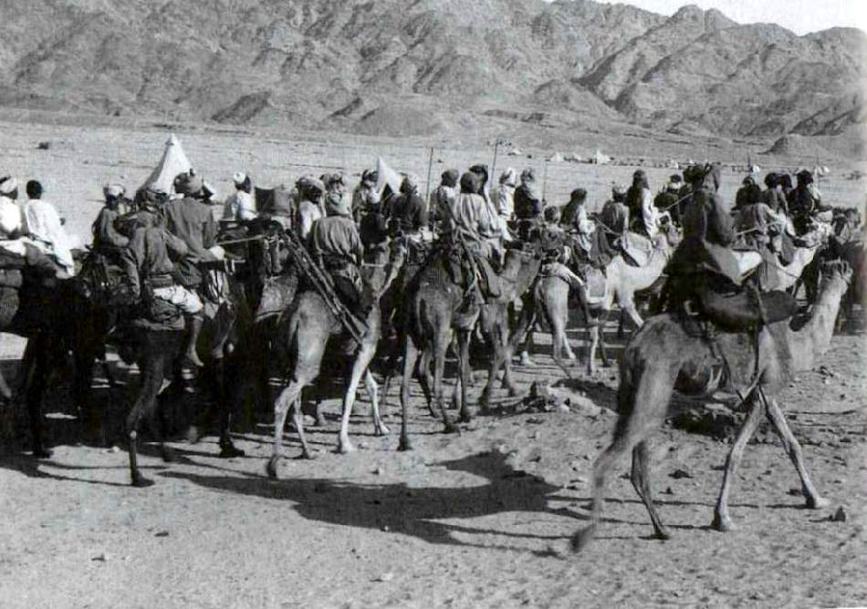
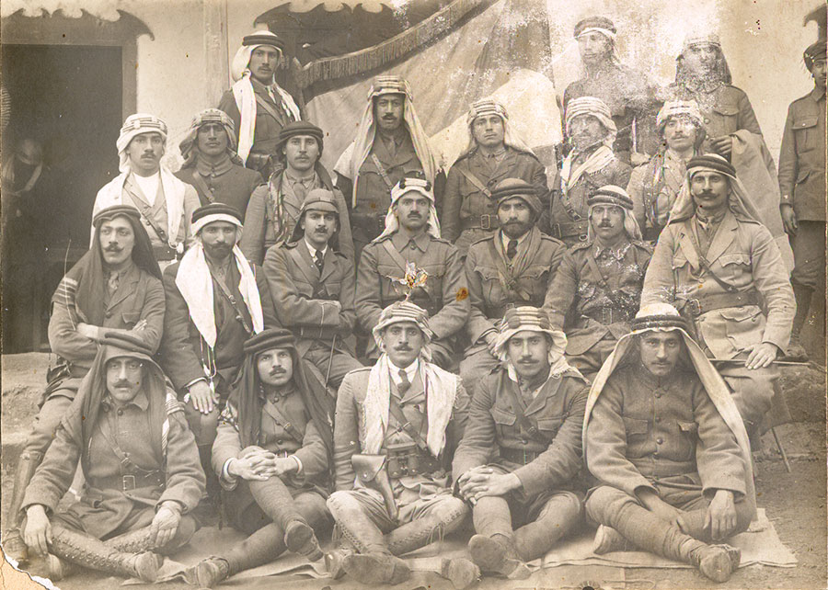
The Great Arab Revolt
Arab nationalism had been brewing for a while – tipping point comes in 1916
Lawrence not the only British officer sent to assist the Arabs, but the most prominent
1917 – Battle of Aqaba – last major Ottoman port city on the Red Sea
Take Jerusalem by Christmas

Slide 11
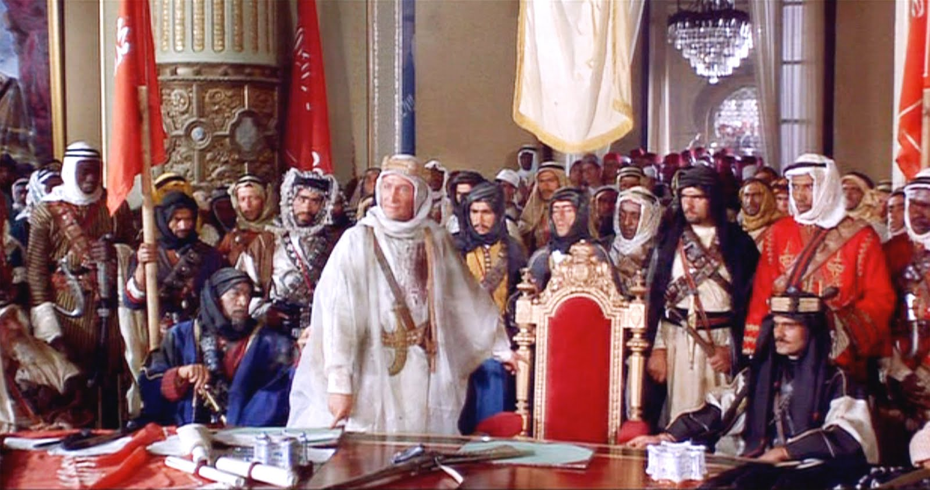
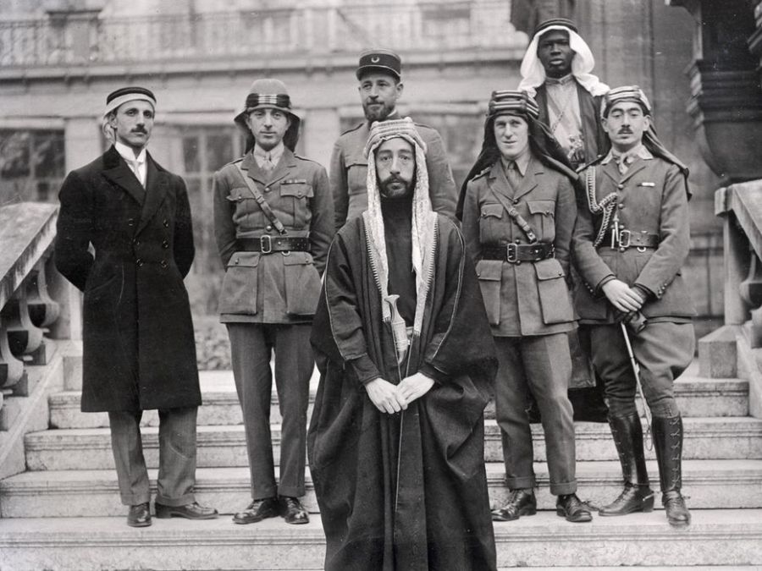
The Fall of Damascus
Had once been the capital of the Arab Empire
Liberated in 1918 by the Australian Light Horse Brigade
Lawrence entered the city on Oct. 1, 1918
Arabs led by Faisal arrived 2 days later

Slide 12
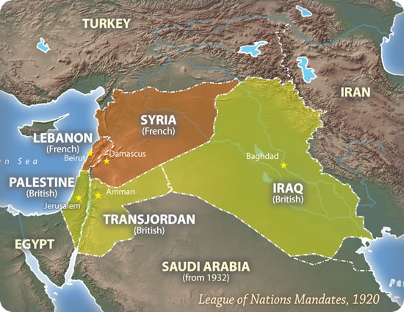
Aftermath
While Britain had supported the Arabs against the Ottomans, they had made a secret deal with the French to divide up the territory (Lawrence knew about this) – Sykes-Picot Agreement
Balfour Decision of 1917 – promised support for a Jewish “national home” in Palestine
Western Arabia became a self-declared state and unified – 1925

