Slide 1
Communist China

Slide 2
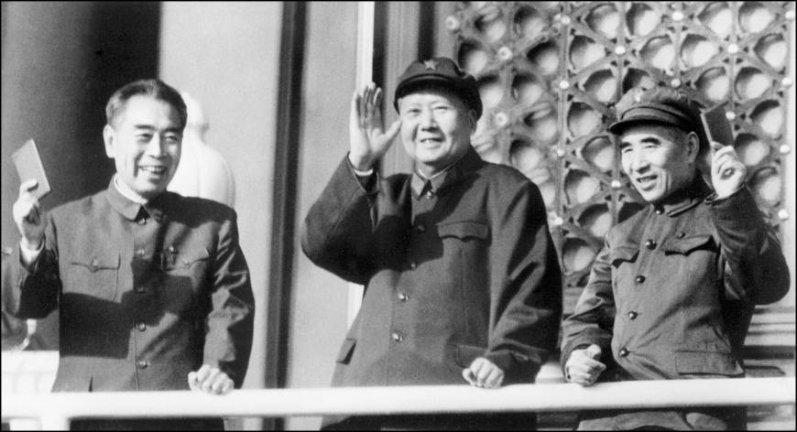
Early Communist Movement
Political Fragmentation
Chiang Kai Shek
Nationalists & Communists vs. Japan
People’s Republic of China - 1949

Slide 3
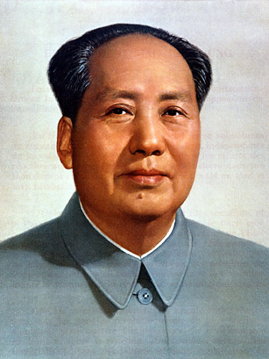
Mao Zedong (1893 – 1976)
Son of wealthy farmers
Rejects Confucianism
Chairman of the CCP in 1935
Jiangxi Soviet - 1929
The Long March – 1934

Slide 4
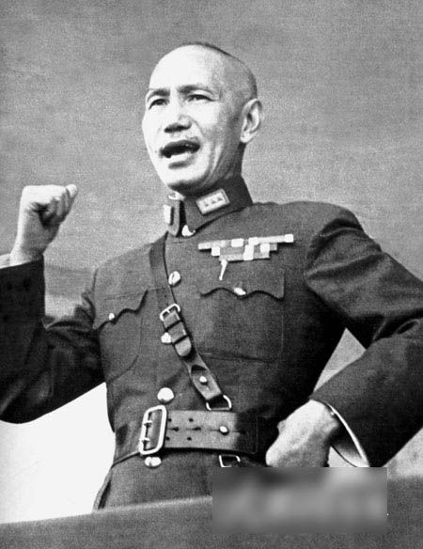
Mao vs. Shek
Chiang Kai Shek & the Nationalists
Peasant support
Japanese Invasion
U.S. Reconnaissance missions

Slide 5
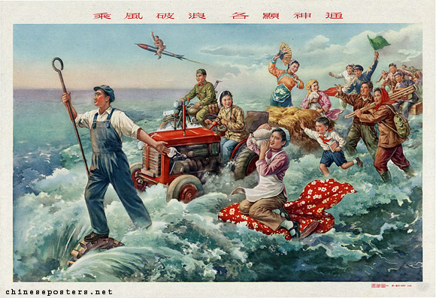
The Great Leap Forward
1958
Move from agriculture to industry
Leads to mass starvation
30 to 55 million die

Slide 6
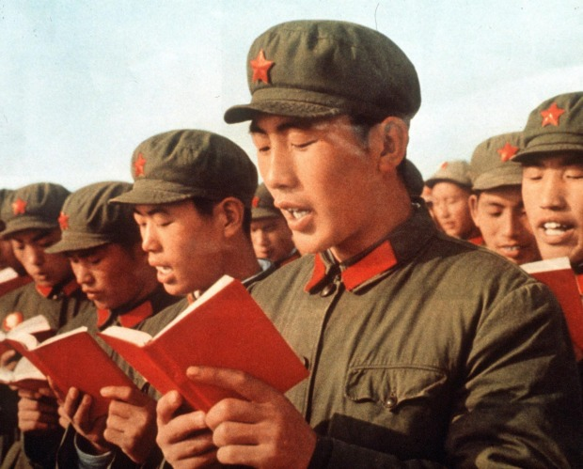
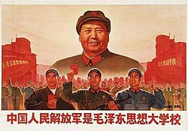
The Cultural Revolution (1966 – 1976)
Mao had been pushed aside
Attempts to regain power
Red Guards
Absolute Chaos
Destruction of Chinese heritage
Mao declares it over in 1969, not true

Slide 7
The Korean War
1950 - 1953

Slide 8
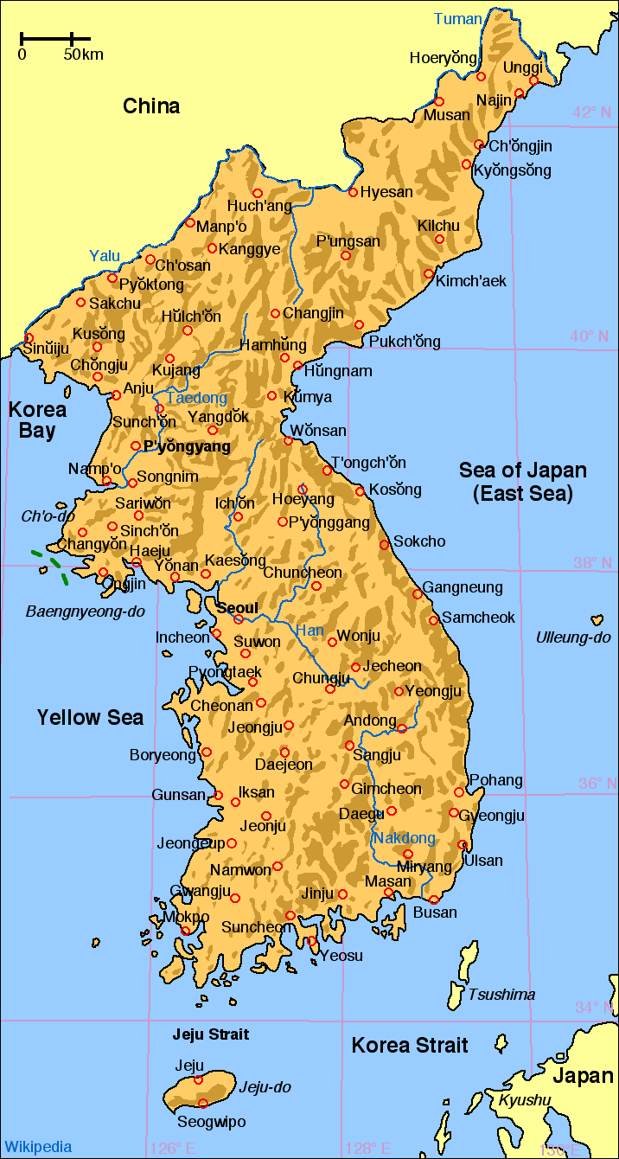
Background
Protectorate of China
Chinese forced out by Japan – 1870s
Korean Empire declared
Japan occupied Korea – 1910

Slide 9
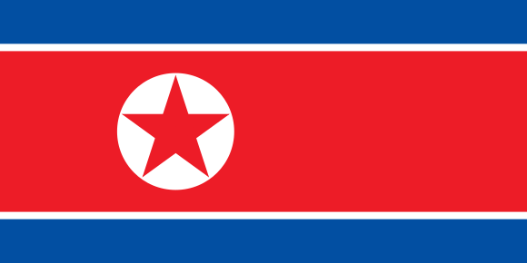
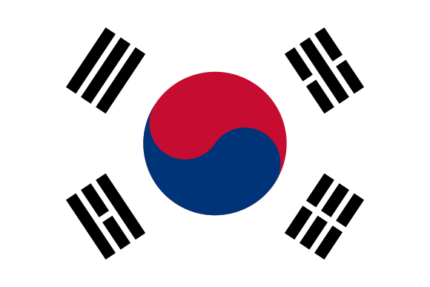
The Divide
1945 – Korea split between US & SU
Democratic People’s Republic of Korea= North Korea
Republic of Korea = South Korea

Slide 10
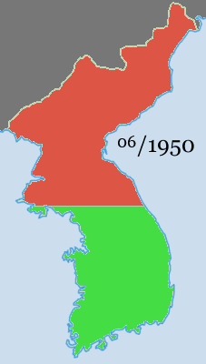
UN Police Action
NK attacks first – push to the tip of peninsula
U.S. not prepared
Technically a UN police action
MacArthur returns
Chinese Intervention

Slide 11
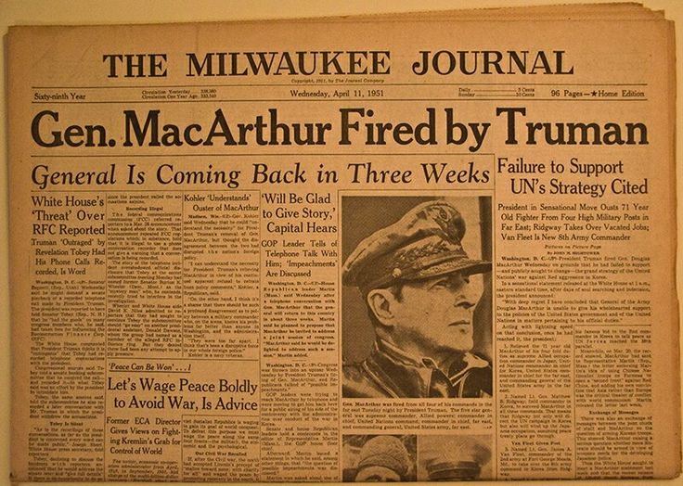
Firing MacArthur
MacArthur threatens to invade China
Insults Truman
Truman fires him
Highly debated move

Slide 12
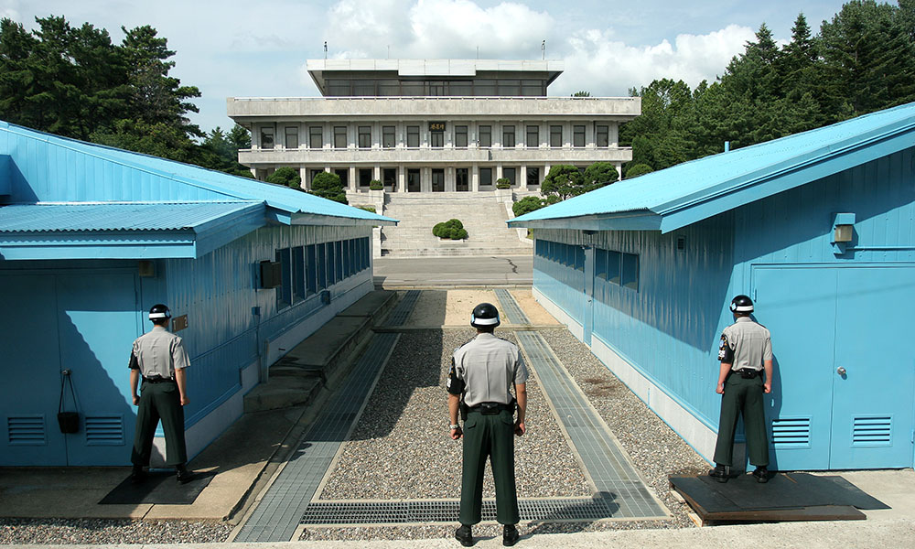
The Ceasefire
UN forces had pushed to Chinese border
NK forces push back to 38th parallel
Ceasefire signed in 1953
Demilitarized zone

Slide 13
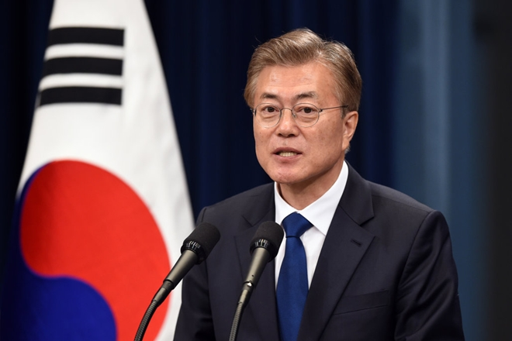
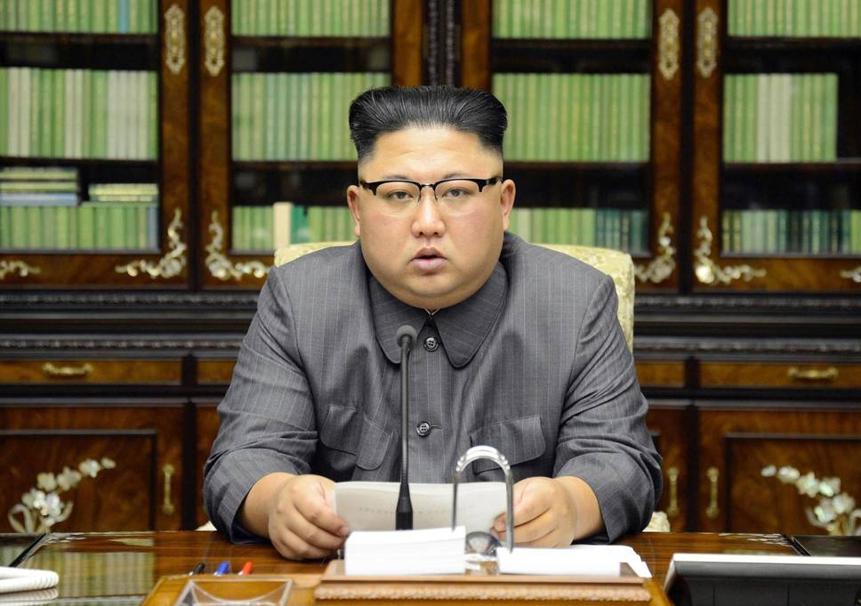
Korea Today
Kim Jong-un
Moon Jae-in
Foreign relations

Slide 14
1950s Culture

Slide 15
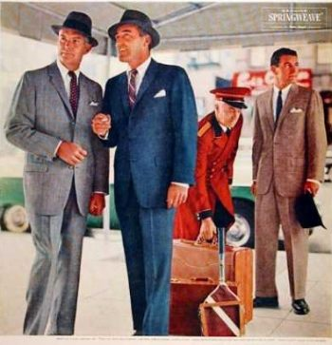
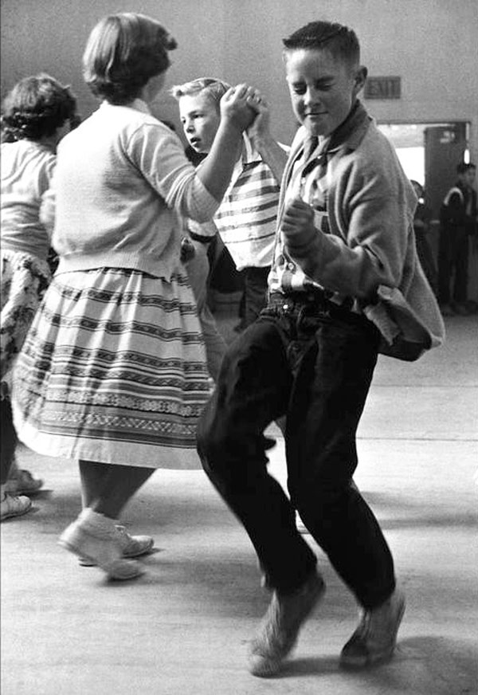
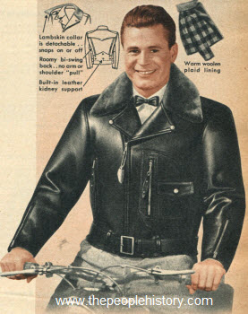
Emergence of Mass Culture and the Teenager
Era of Prosperity
Target Demographic: Teenagers
New Fashion

Slide 16
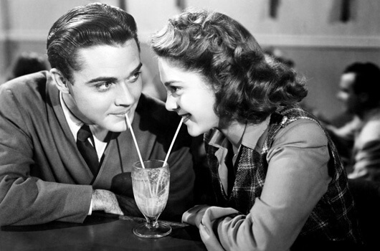
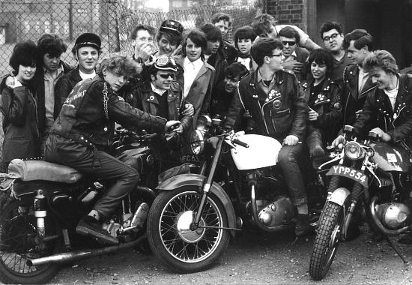
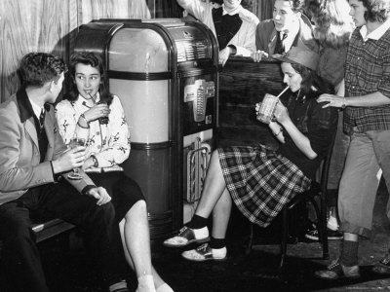
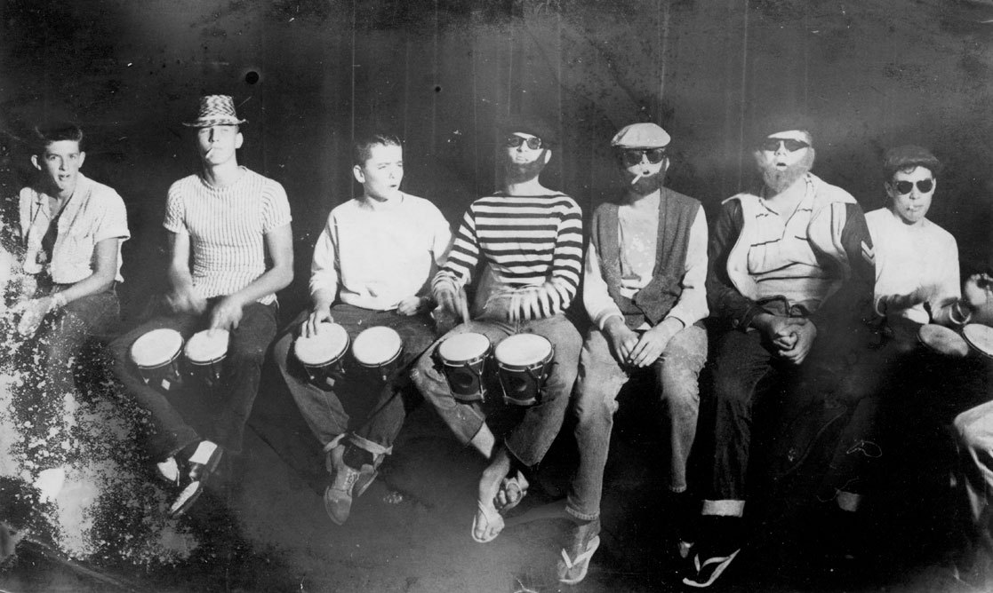
Dominant vs. Counter Culture
Dominant culture = most widespread
Counter culture = underground culture, not the norm

Slide 17
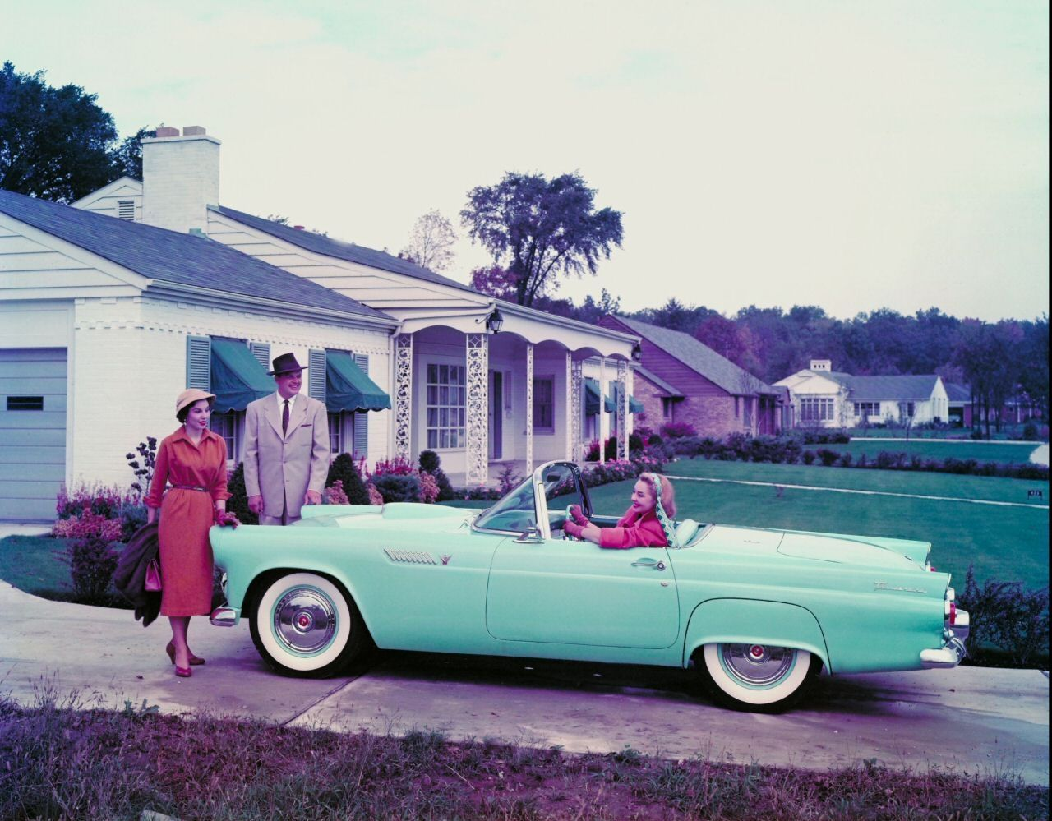
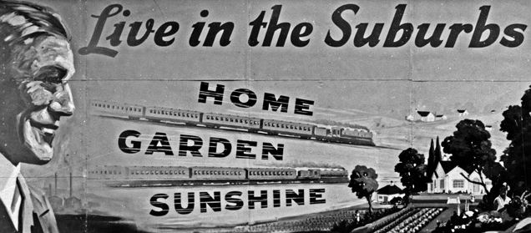
Suburban Life
Booming automobile industry
Baby Boom
“American Dream” was attainable

Slide 18
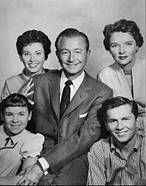
Television
Explodes onto the scene
Helped reinforce stereotypes & gender roles
“Electronic Fireplace”

Slide 19
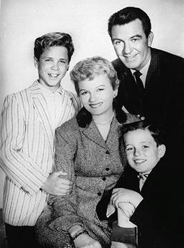
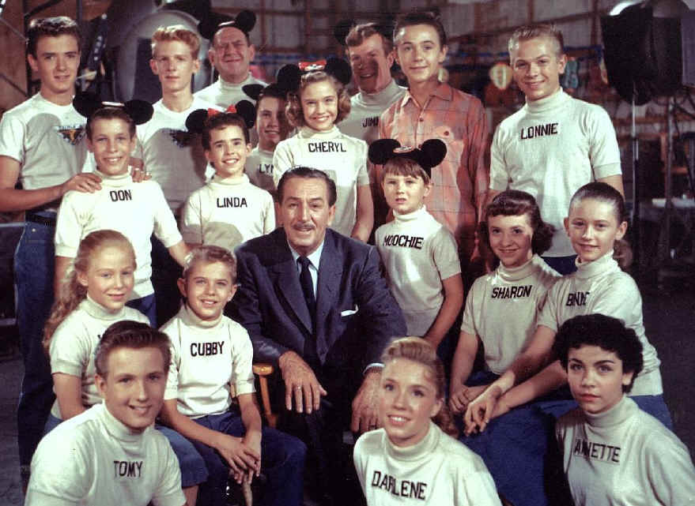
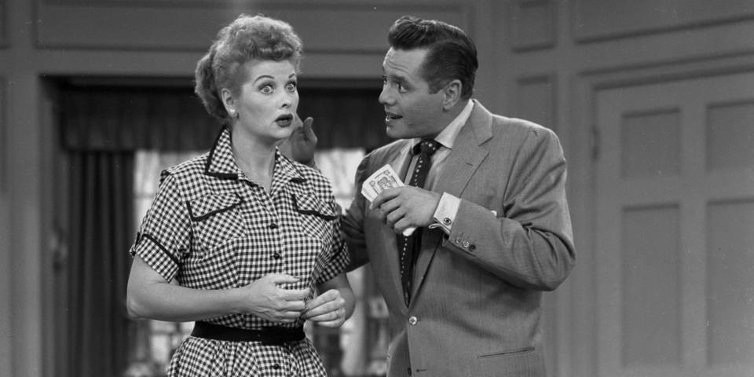
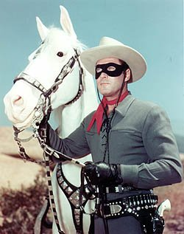
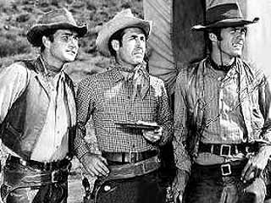
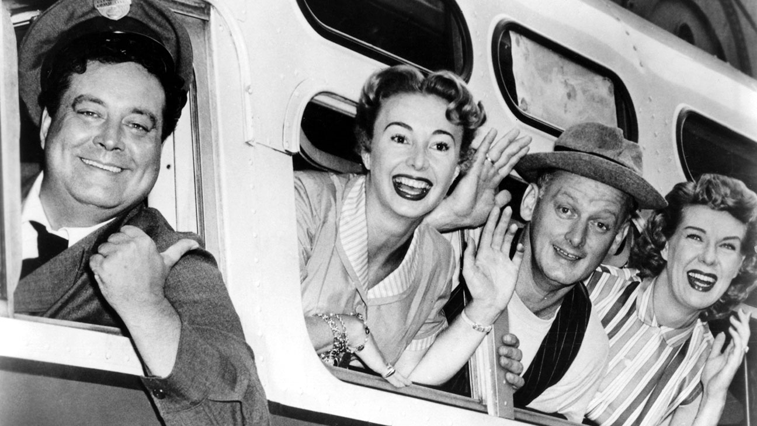

Slide 20
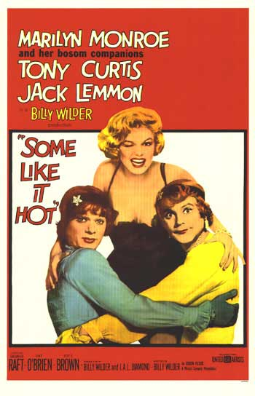
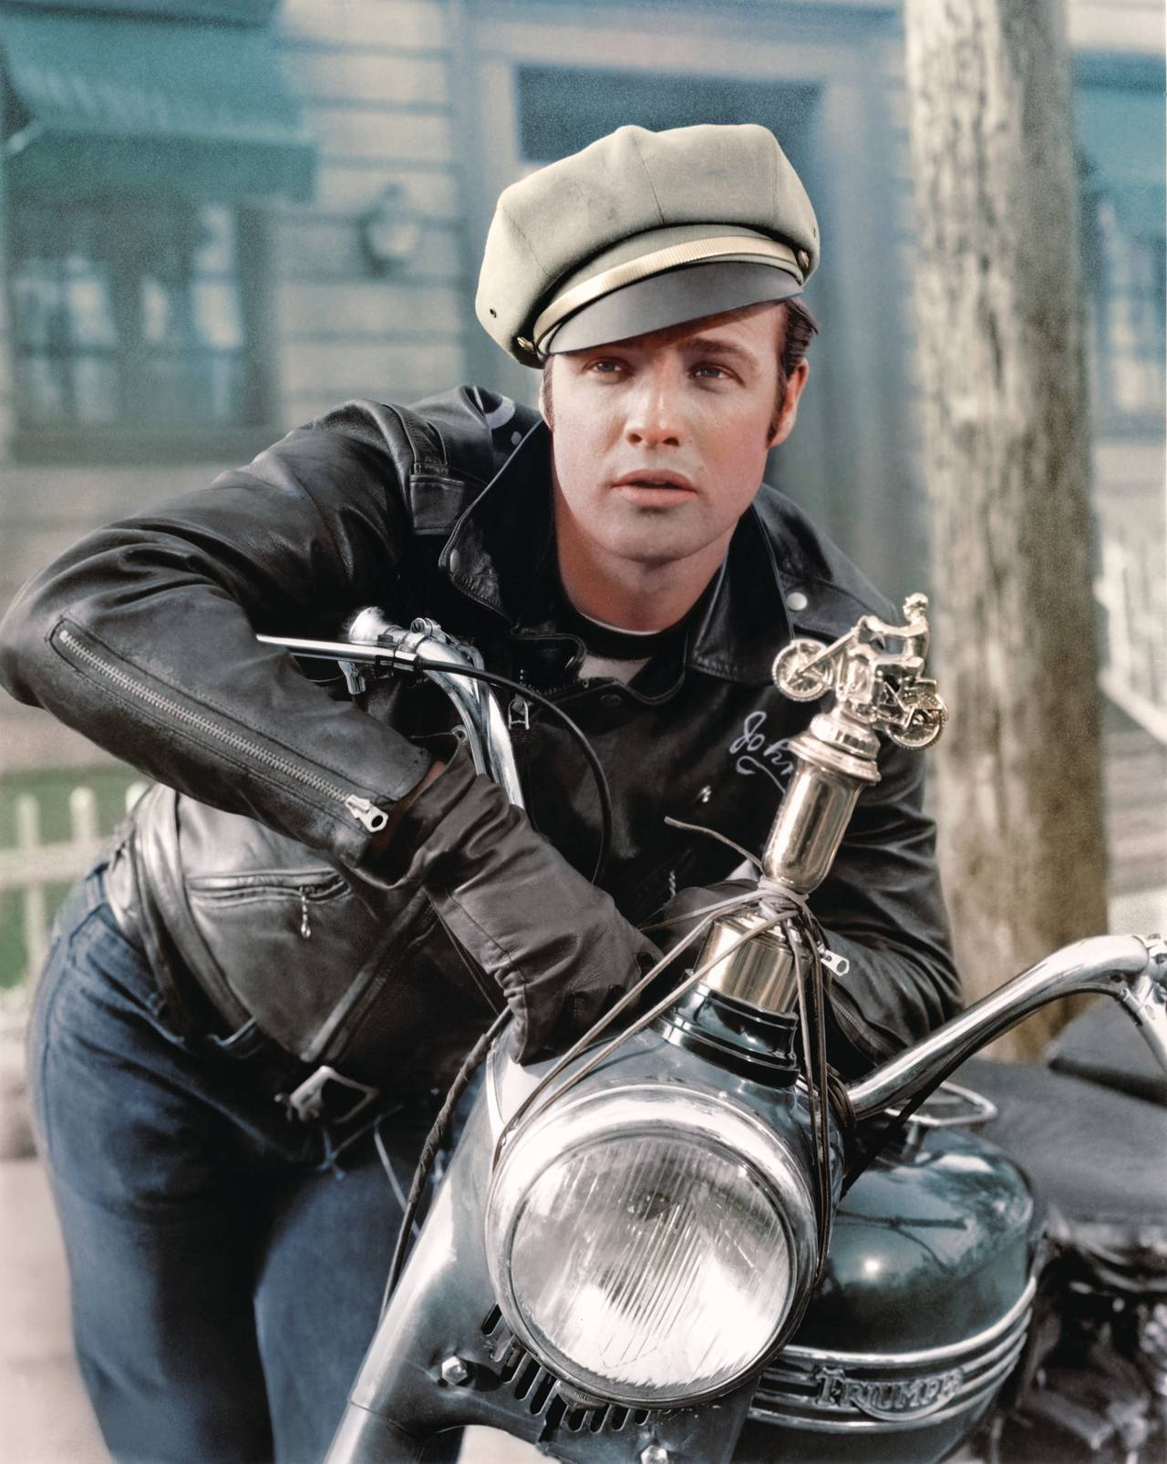
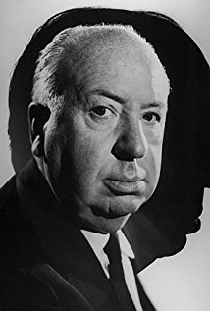
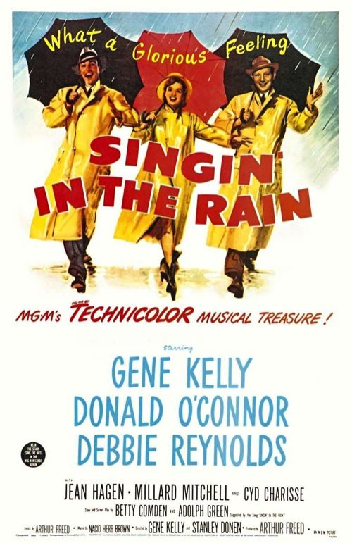
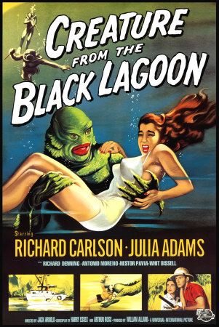
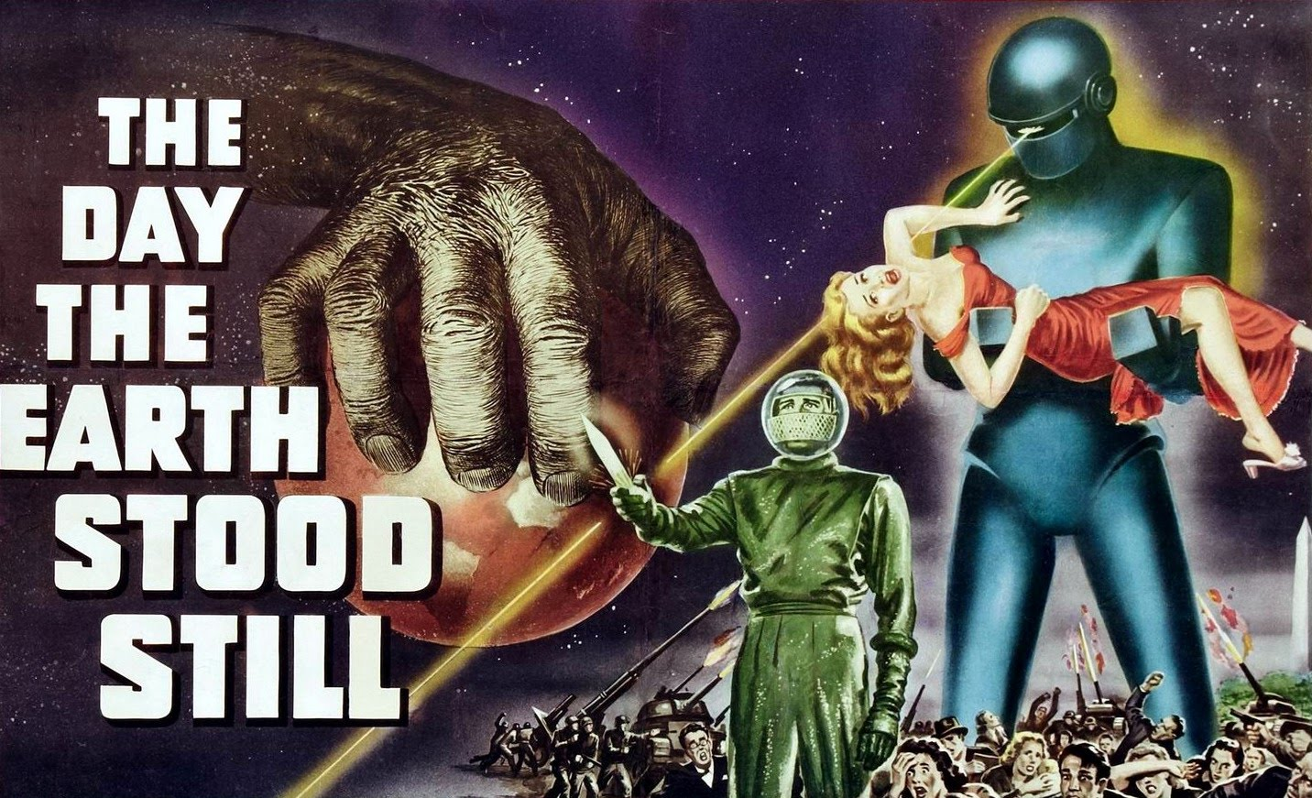
Movies

Slide 21
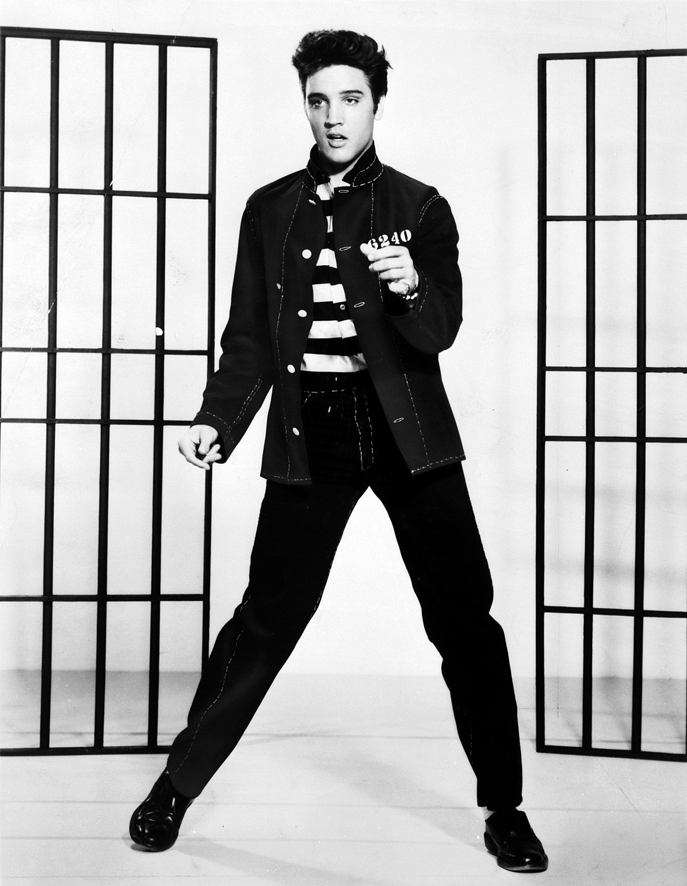
Music
Swing was out, Rock ‘n Roll was in
Roots in blues, R&B, country, & gospel
“Devil’s music”

Slide 22
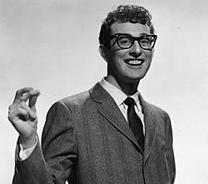
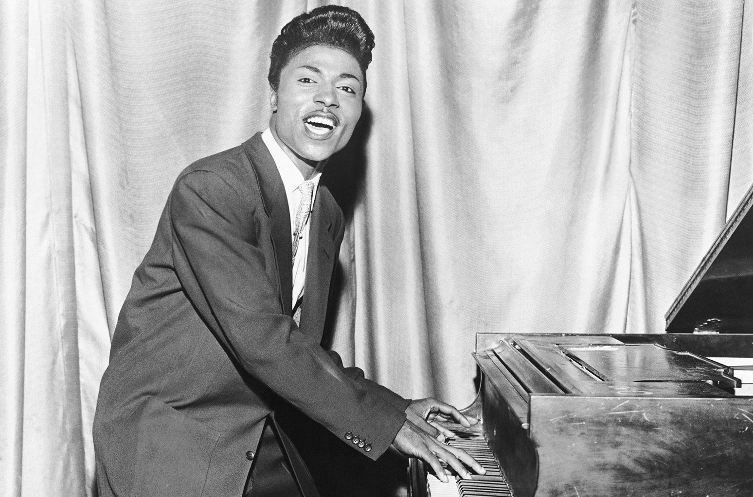
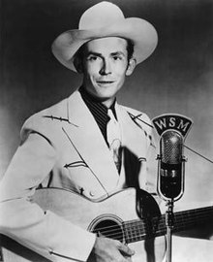
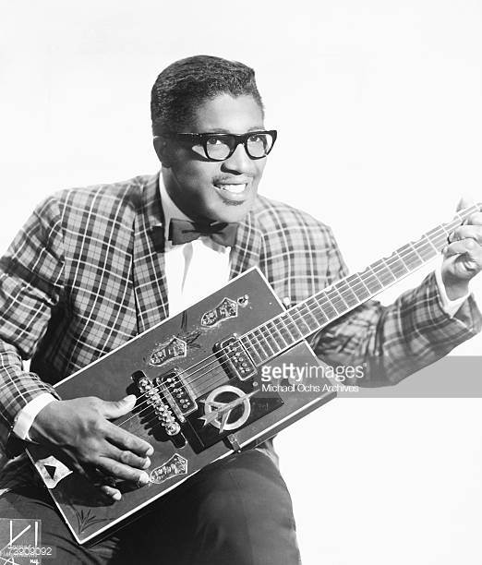
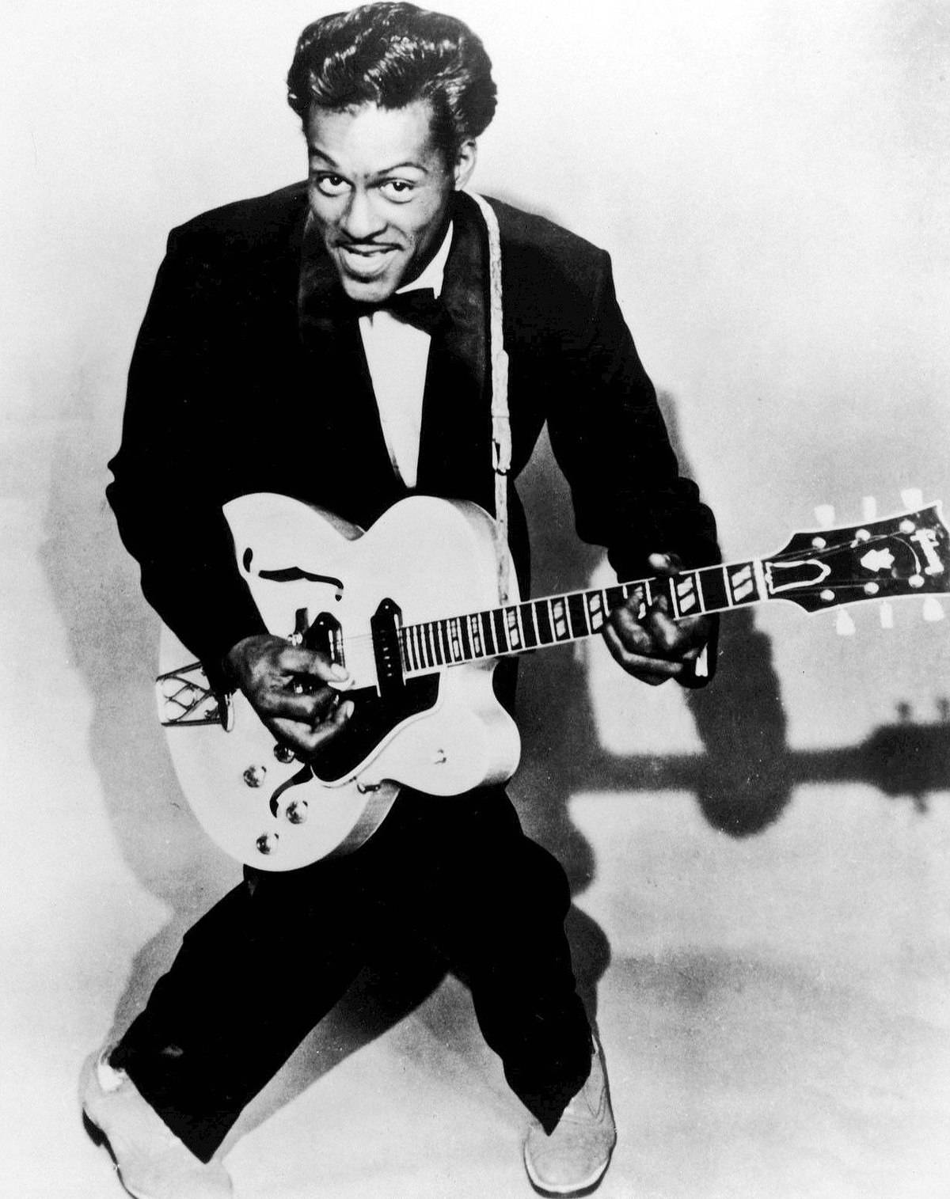
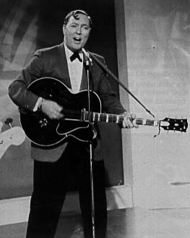
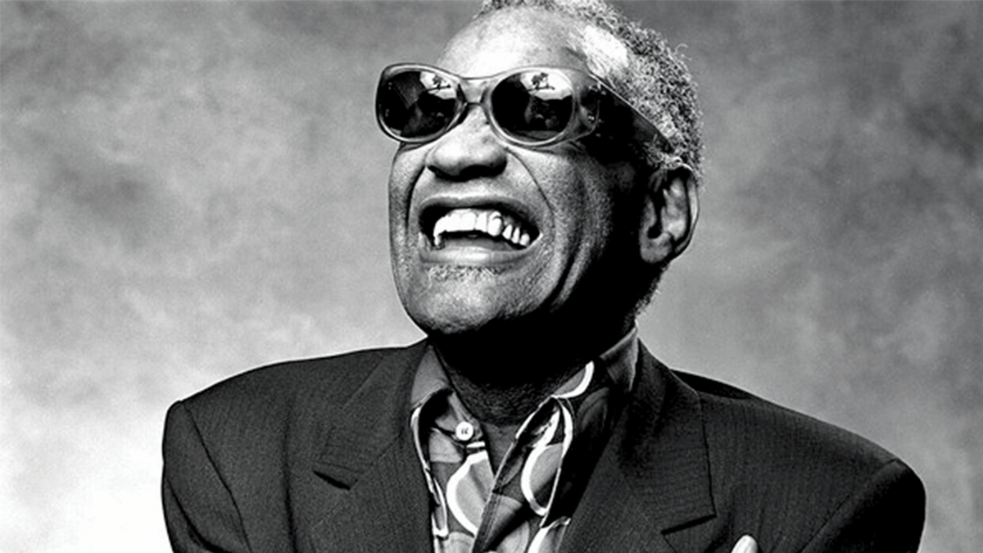

Slide 23
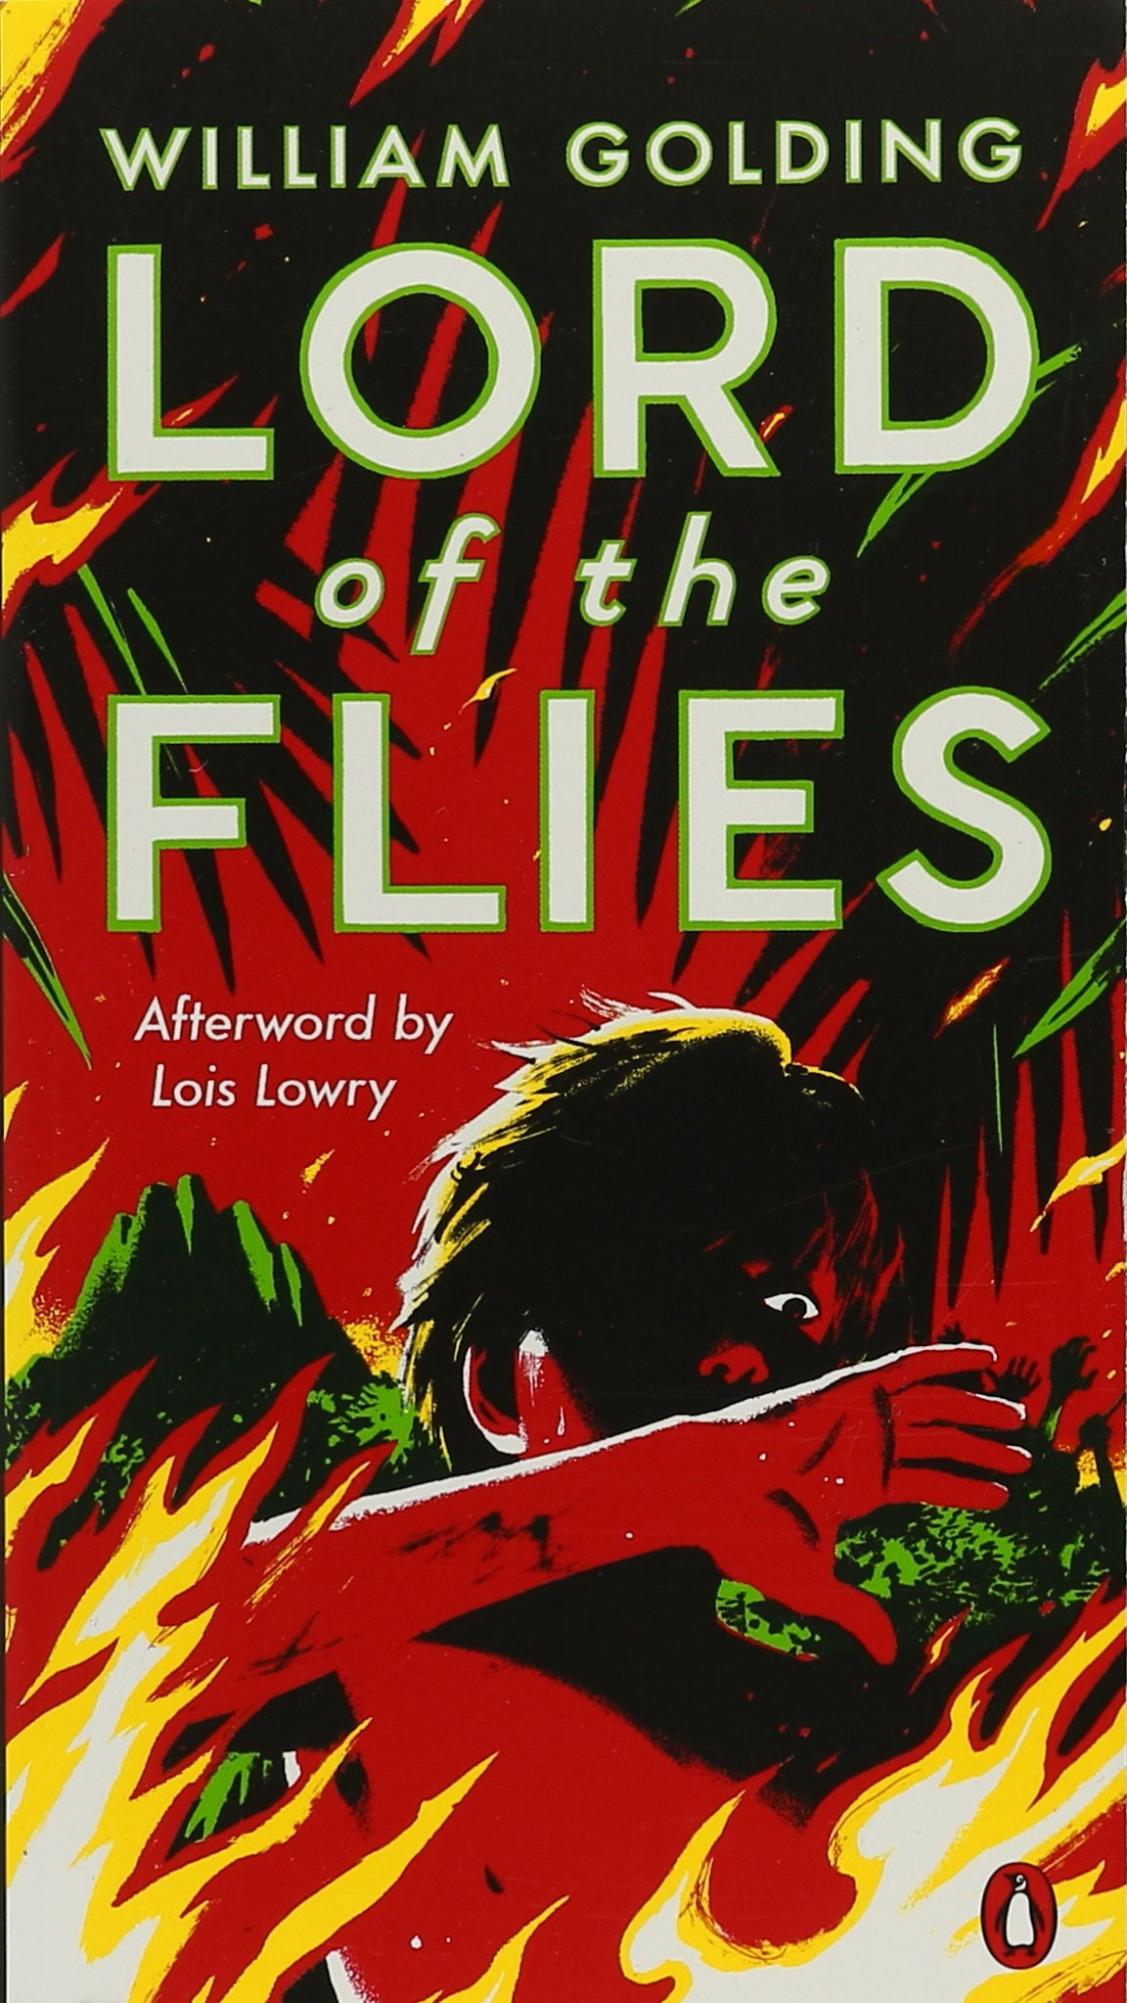
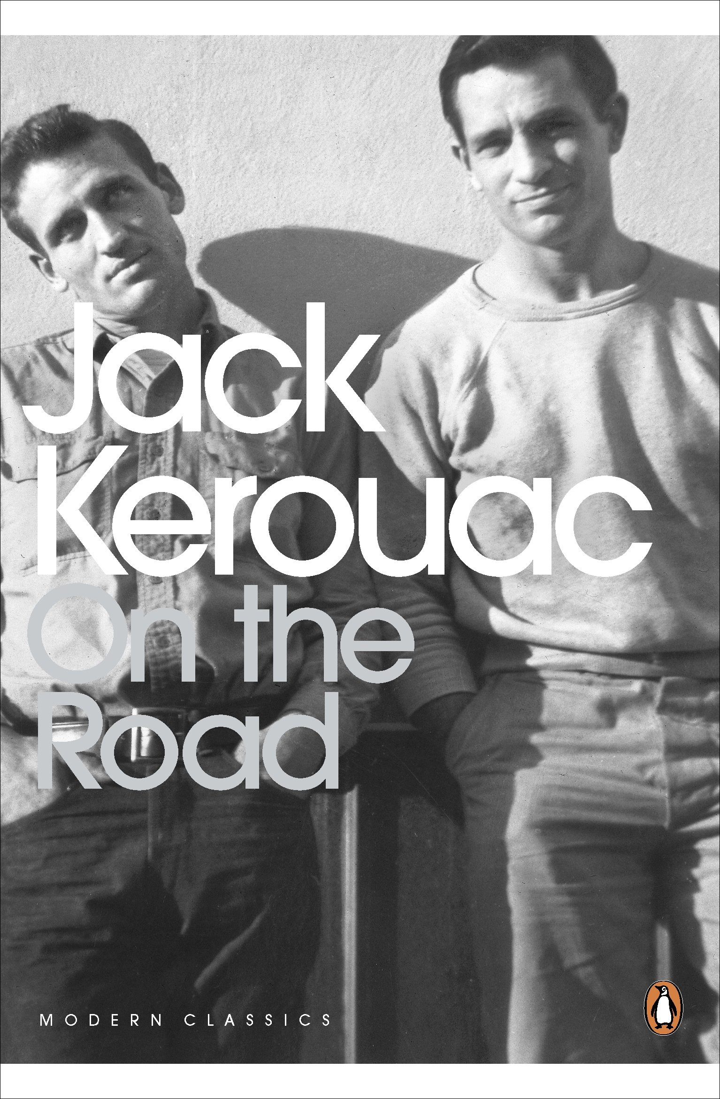
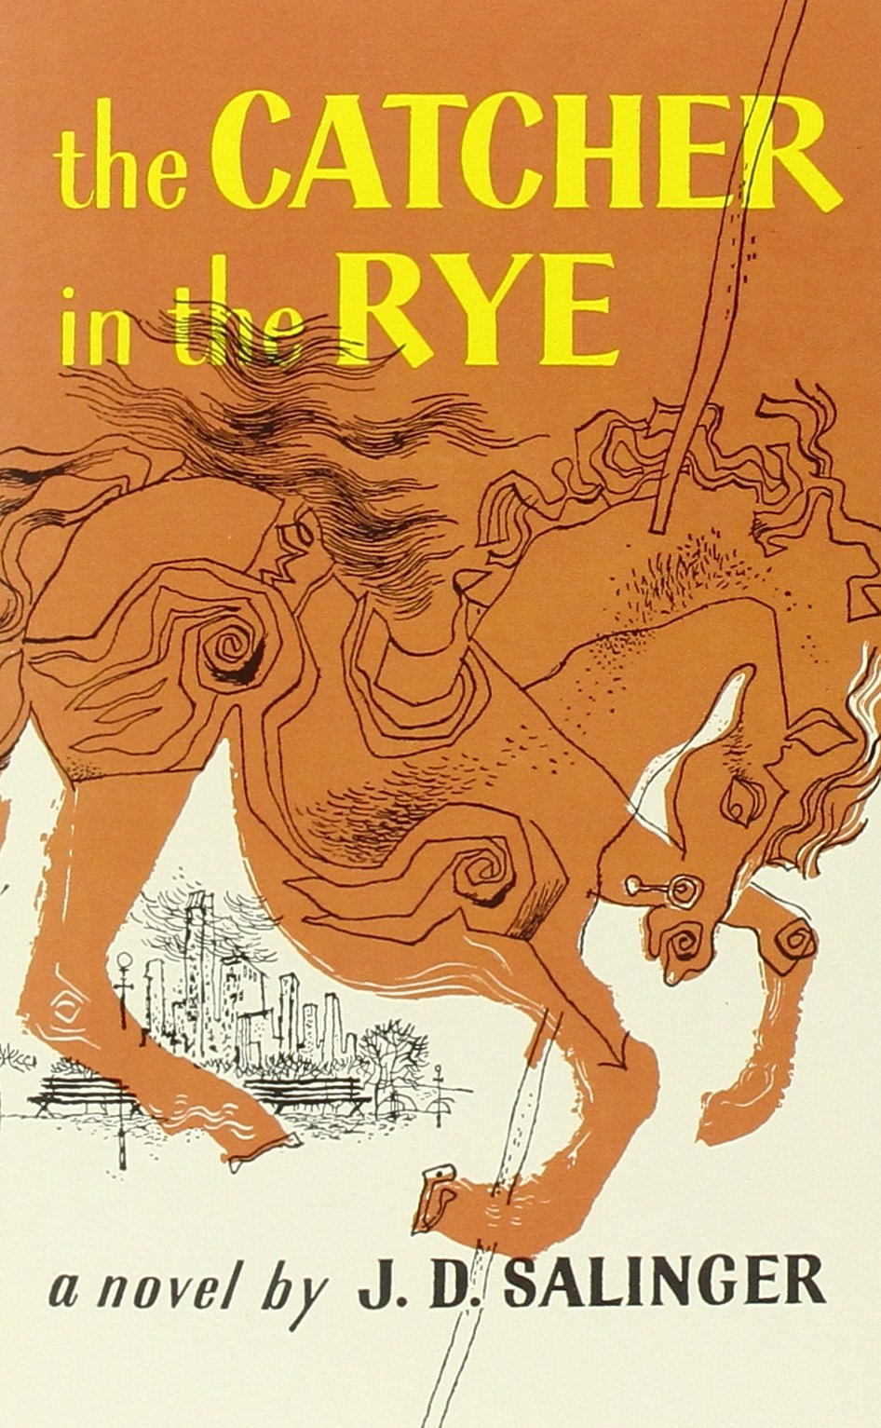
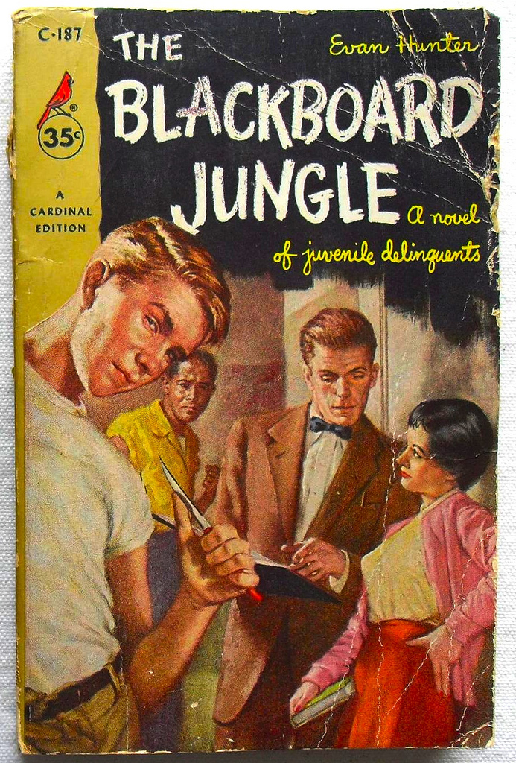
Books
Anti-hero becomes popular
Beatnik Movement
Common themes
Loneliness
Religion
Exploration
Empowerment

Slide 24
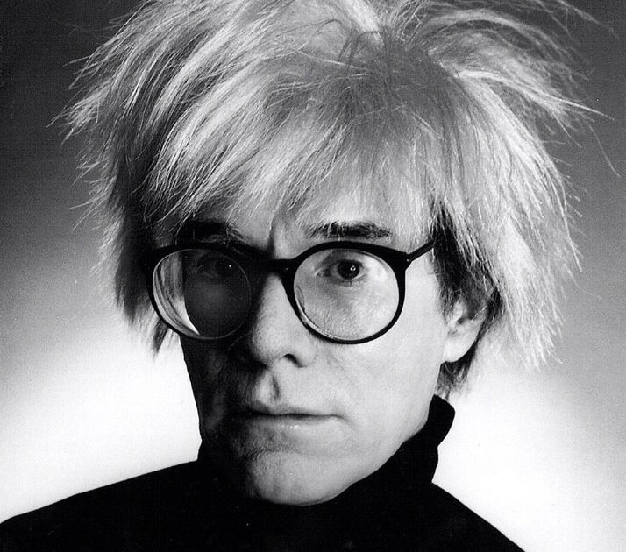
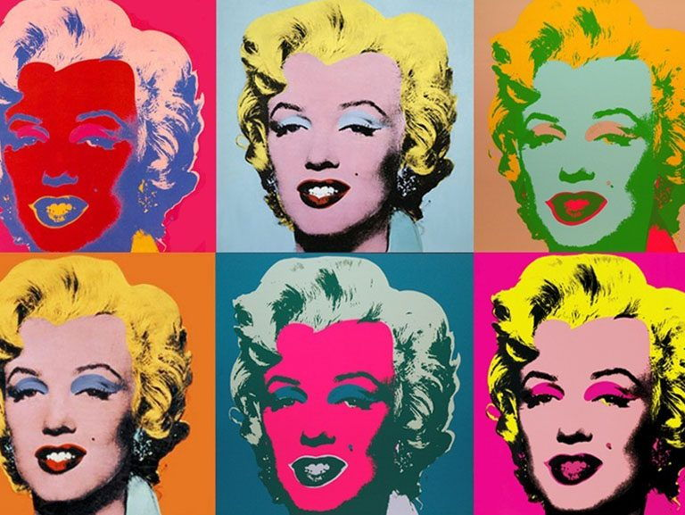
Art
Pop Art
No “high” or “low” art
Embraced the manufacturing and media boom

