Slide 1
Revolutions & the Nation state

Slide 2
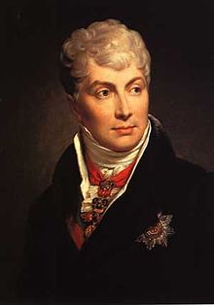
Congress of Vienna
September 1814 – meeting of European leaders after defeat of Napoleon
Prince Klemens von Metternich
Conservatism & Balance of Power
Concert of Europe
Principle of Intervention

Slide 3
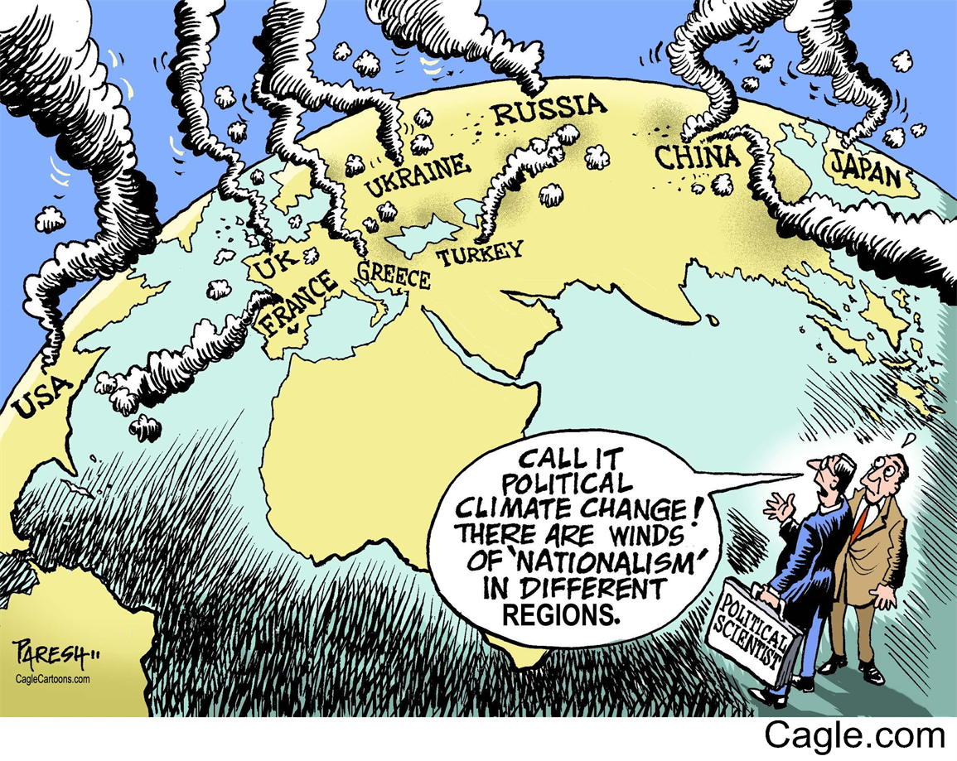
Forces of Change
Liberalism
People should be as free as possible from govt. restraint
Nationalism
Loyalty shifted from monarch to nation
Strong ally in liberalism
Revolutionary Outbursts
Began in 1830

Slide 4
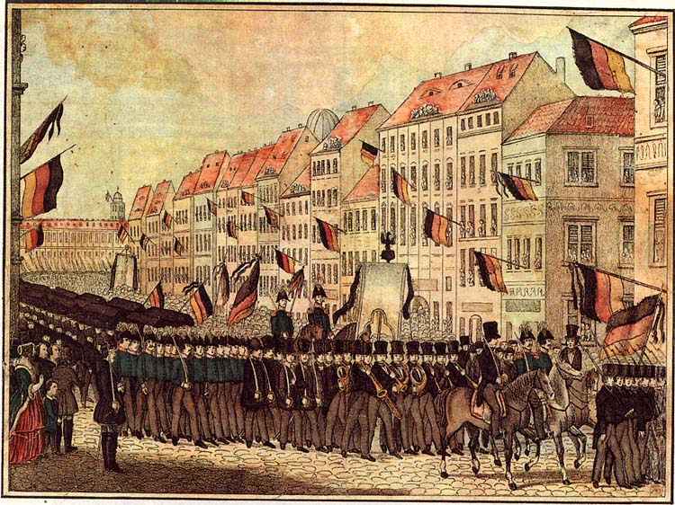
Revolutions of 1848
Another French Revolution
Second Republic established – November 1848
Trouble in the German States
Revolution failed to gain support – unification not achieved
Revolutions in Central Europe
Revolutions fail in Austria
Metternich ousted
Revolts in the Italian States
Austria controlled Northern Italy – put down unification attempts

Slide 5
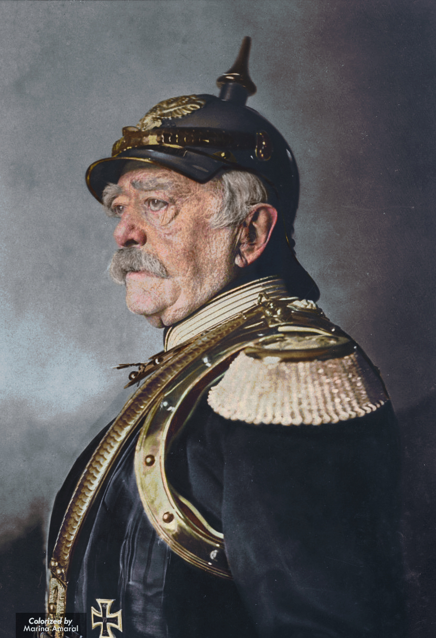
Toward national unification
Breakdown of the Concert of Europe
Crimean War
Italian Unification
1861 – new state of Italy declared
German Unification
Otto von Bismarck
1871 – Second German Empire Declared

Slide 6
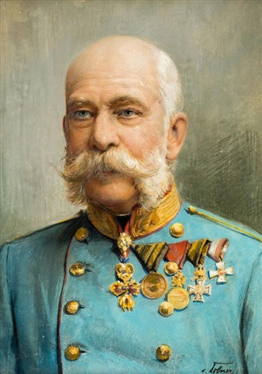
Reform in Europe
Great Britain
Managed to avoid revolutionary upheaval
France
Restores empire
Austria
Compromise of 1867 – becomes Austria-Hungary
Russia
Rural, agricultural, autocratic

