Slide 1
The Age of Imperialism 1870-1914

Slide 2
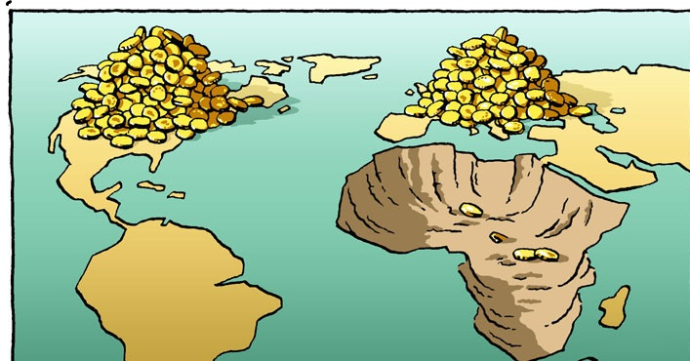
Pre-1800
European interested in Africa had waned
Renewed interest due to need for new markets & more raw materials
Begins a “scramble” to establish colonies in Africa

Slide 3
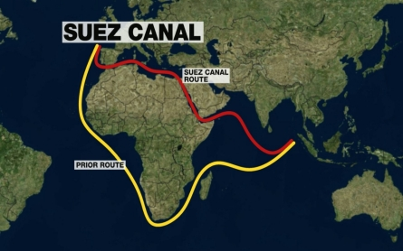
British Holdings
1874 – annex Nigeria & the Gold Coast
1898 – takes control of Sudan
1914 – Egypt becomes a British protectorate
Had taken control of Suez Canal in 1875

Slide 4
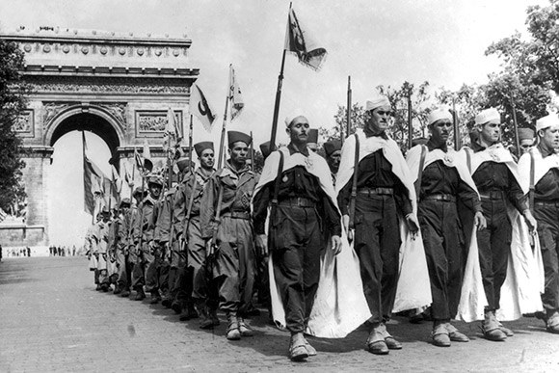
French Holdings
1879 – take Algeria
1881 – gain Tunisia
1900 – control French West Africa
1912 – brings in Morocco

Slide 5
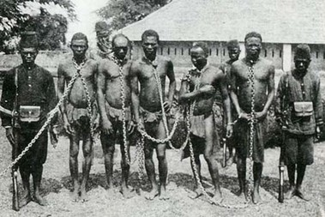
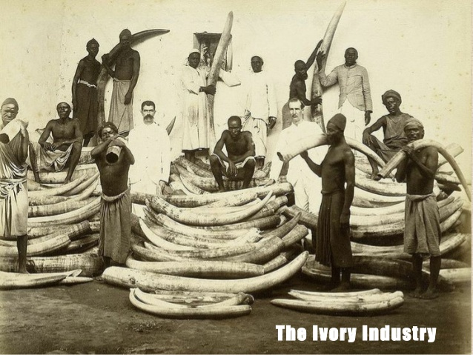
Other Holdings
Germany claimed Togo, Cameroon, German Southwest Africa, & German East Africa
Italy invaded Libya in 1911; had previously tried to take Ethiopia in 1896 but failed
Belgium gets the Congo

Slide 6
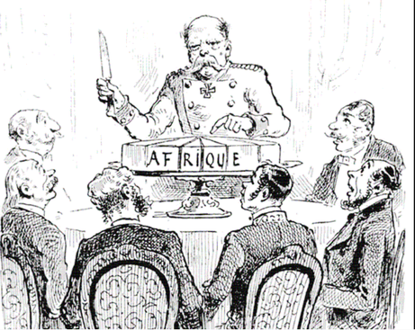
The Berlin Conference
Takes place from 1884 to 1885
Purpose: to stop conflict before it started – Germany had begun launching expeditions that frightened Britain and France
14 countries took part
Austria-Hungary
Belgium
Denmark
France
Germany
Italy
Netherlands
Ottoman Empire
Russia
Portugal
Spain
Sweden
Britain
United States

Slide 7
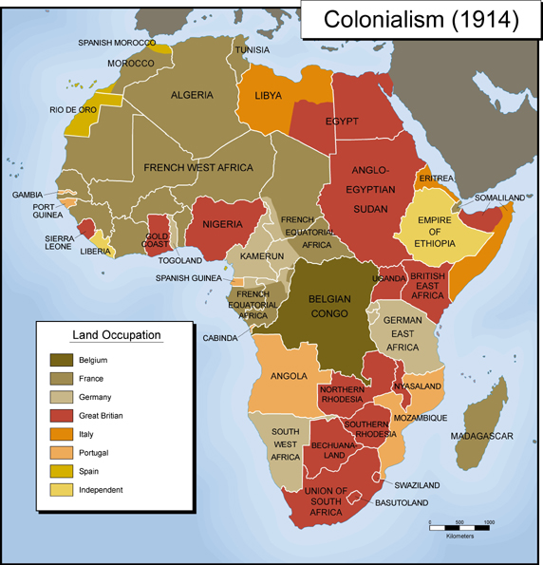
Results of the Conference
Europe agreed to stop the slave trade throughout their perspective spheres
Freed trade through Congo Basin
Niger and Congo rivers were made free for ship traffic
Principle of Effective Occupation
Introduced spheres of influence
Had to notify other powers if you were going to colonize a new area

Slide 8
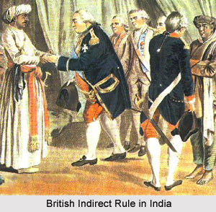
Indirect Rule
Most European nations ruled their colonies indirectly
They exerted influence and power over local rulers to maintain control
Happened for a few reasons
Cheaper to do this
Local rulers got to keep power
Elite class gained advantages
Alternative = resistance; never really went well

Slide 9
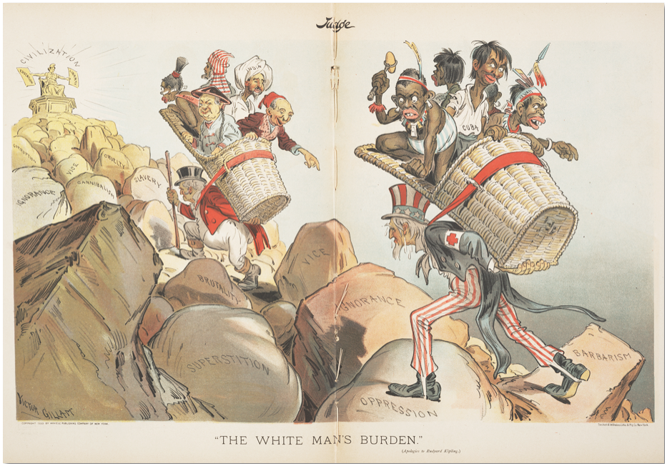
The White man’s Burden
White man has a moral obligation to rule non-white civilizations by encouraging their economic and social progress through colonization
Comes from a poem by Rudyard Kipling about the Philippine-American War

Slide 10
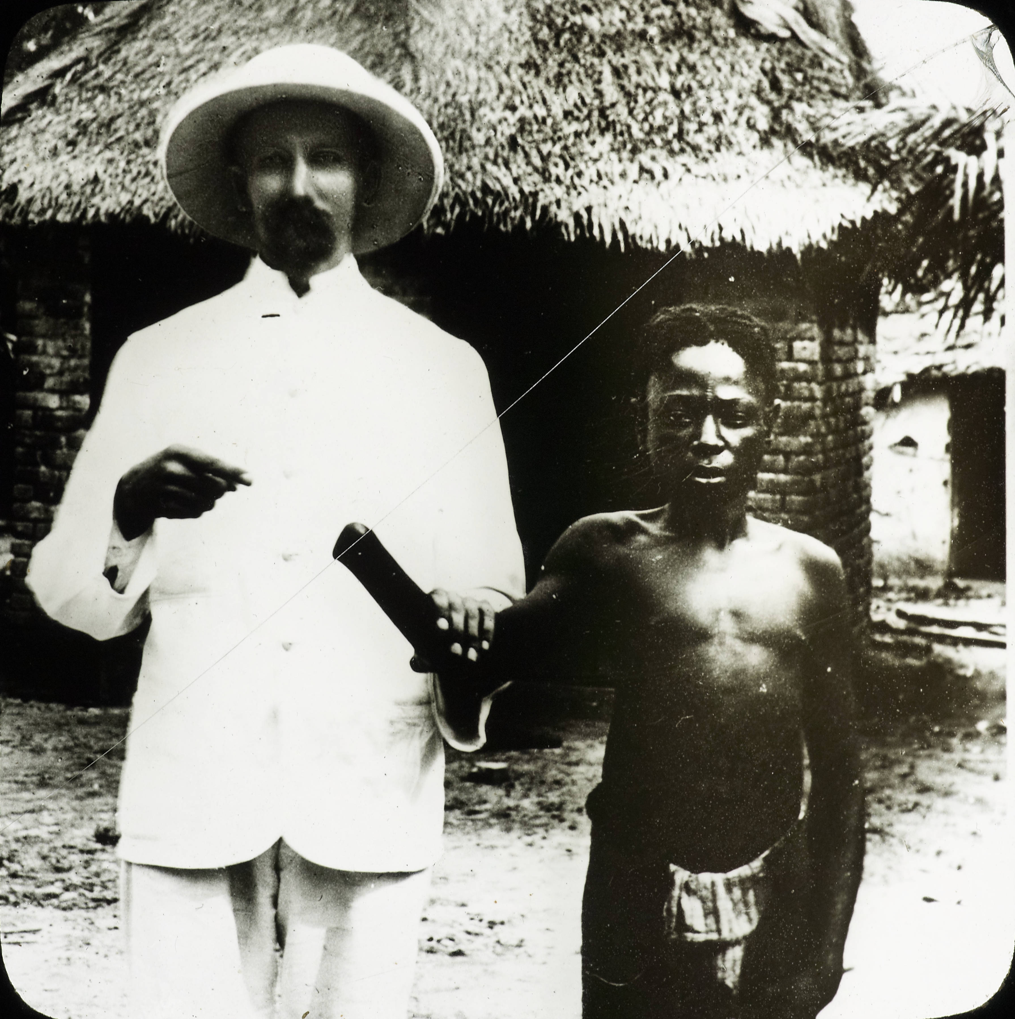
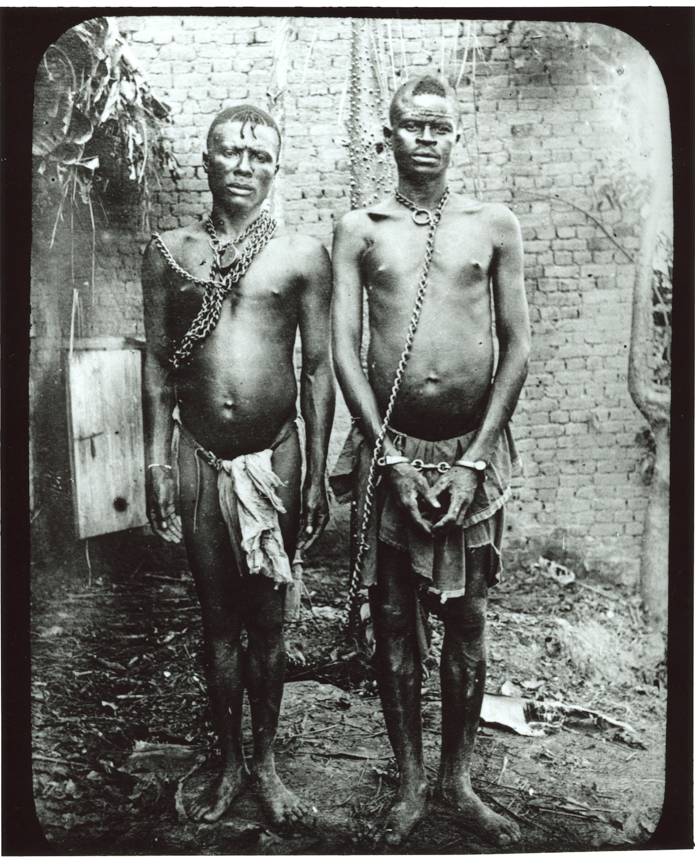
Effects of Imperialism
Gross exploitation of Africa and its people
Sowed seeds for class and tribal tensions
New wave of African nationalism

Slide 11
British Rule in India
British had been there since 1757 – control given to British East India Company – Company Raj
Rule switched to the crown directly in 1858 – British Raj

Slide 12
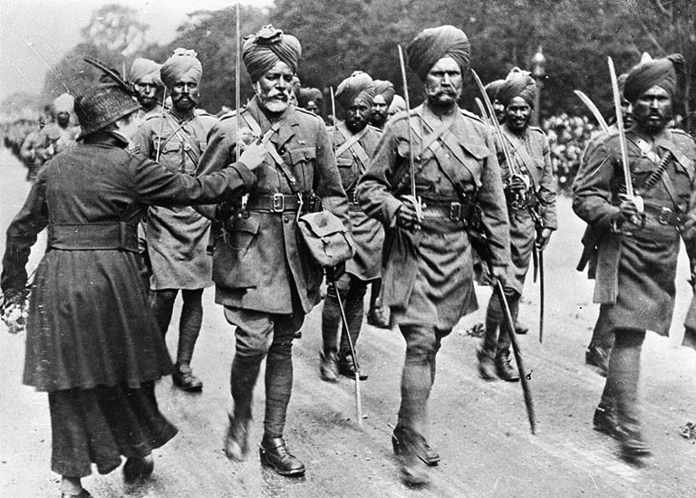
Sepoy mutiny
Sepoys – Indian soldiers hired by the East India Company
1857 – growing Indian distrust leads to revolt
Immediate cause – rifle cartridges greased with pig fat
Long term cause – racial and social tensions
Flashpoint: Meerut
Group of sepoys refused to load rifles, humiliated and punished
Angered other sepoys and groups, rebellion rose, crushed within a year

Slide 13
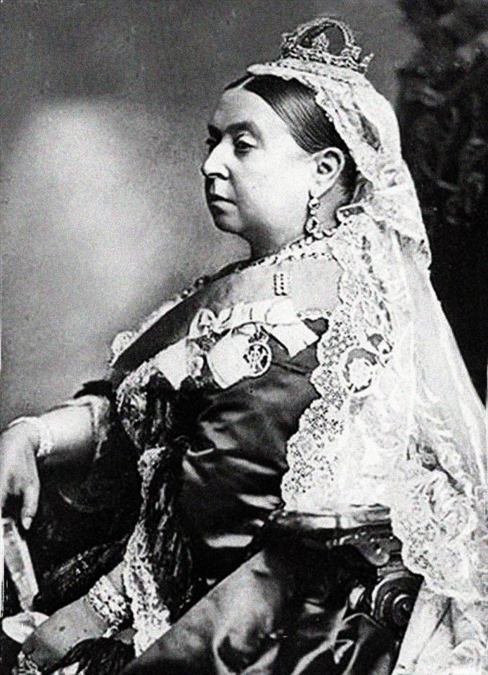
Effects of the Mutiny
Power shifted from EIC to the crown
Rebellion fueled Indian nationalism

Slide 14
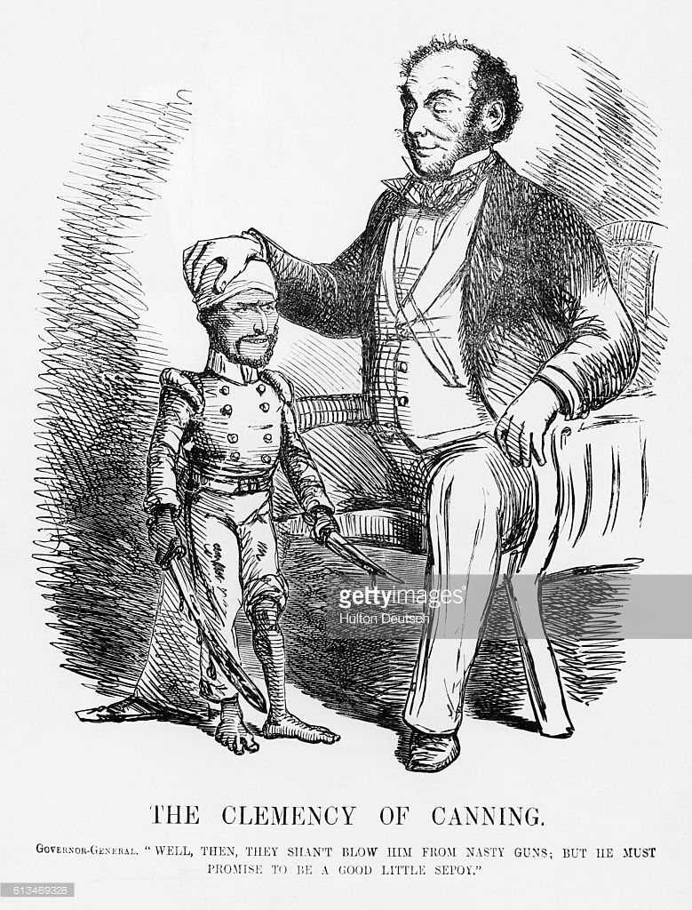
British Colonial Rule: Structure, benefits, & costs
Appointed viceroys to run India
Benefits:
Brought order & stability to a badly divided society
Efficient govt.
New school system
Introduced railroads, telegraph, & postal service
Costs:
Economic – British reaped rewards, brought hardship to masses
Method of tax collection backfired – led to peasant unrest
Drastic fall in food supply
Brits were arrogant – cut Indian pride
Disrespect for local culture & racial attitudes

Slide 15
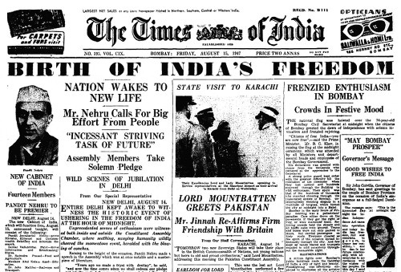
Indian Nationalism
Came from upper-middle class, educated, urban population
Preferred reform to revolution
Learned not to rely on British goodwill
Indian National Congress
Newspapers

Slide 16
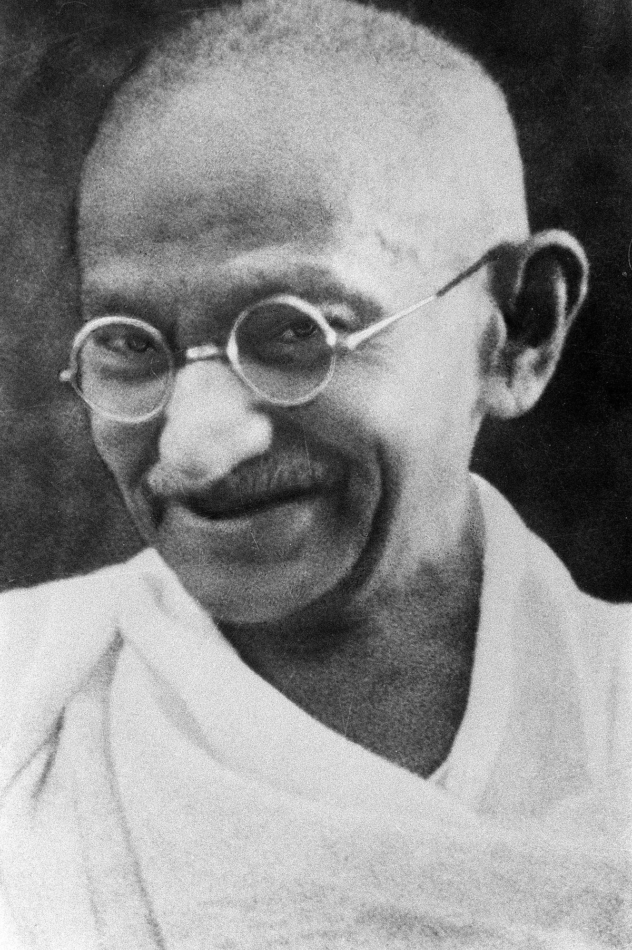
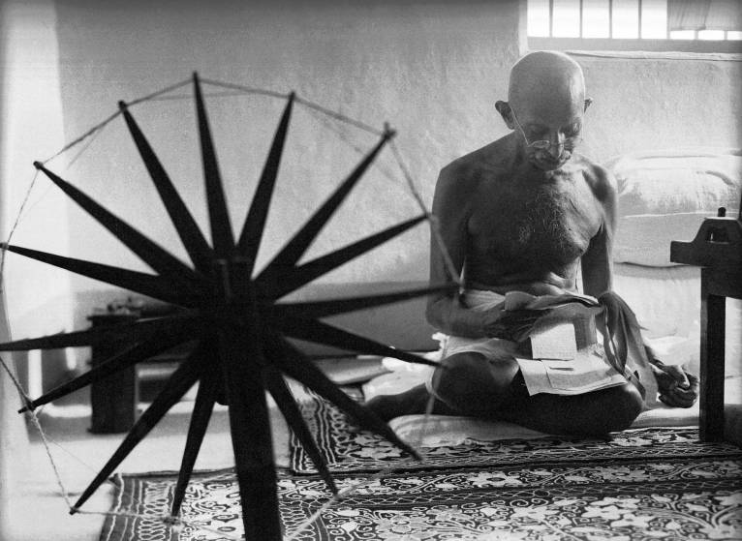
Gandhi
Born in 1869
Father was the chief minister of his province
At 19 went to London to study law
Came back to India in 1891 – set up a practice but failed
Got a job with an Indian law firm and sent to South Africa – lived there for 20 years
Appalled by the discrimination he experienced – began to practice passive resistance
Returned to India in 1914 – began to stage passive resistance demonstrations in 1919
Arrested in 1922, released in 1924, & began a new movement in 1930
Retired from in politics in 1934, but came back during WWII
Assassinated in 1948 by a Hindu extremist

Slide 17
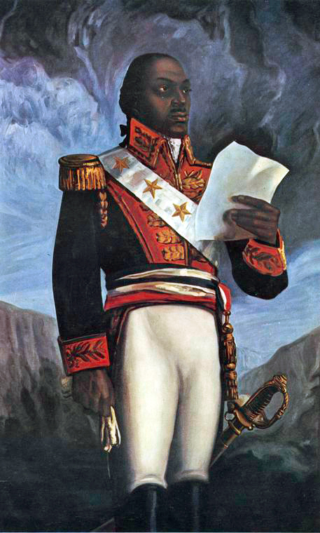
Nation building in Latin America
Nationalist Revolts - revolution ideas came from Europe & NA
1807-1825 – series of revolts allowed for LA independence
1804 – first major revolt – slave revolt led by Francois Toussaint-Louverture

Slide 18
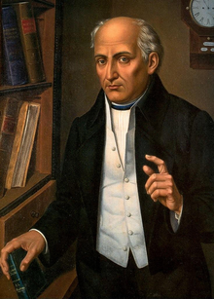
Revolt in Mexico
1810 – Miguel Hidalgo led a revolt against Spanish – failed
Aristocracy feared the masses – decided to overthrow Spanish
1821 – Mexico declares its independence

Slide 19
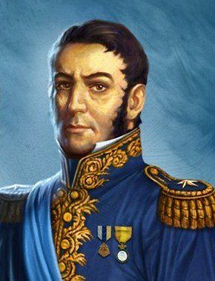
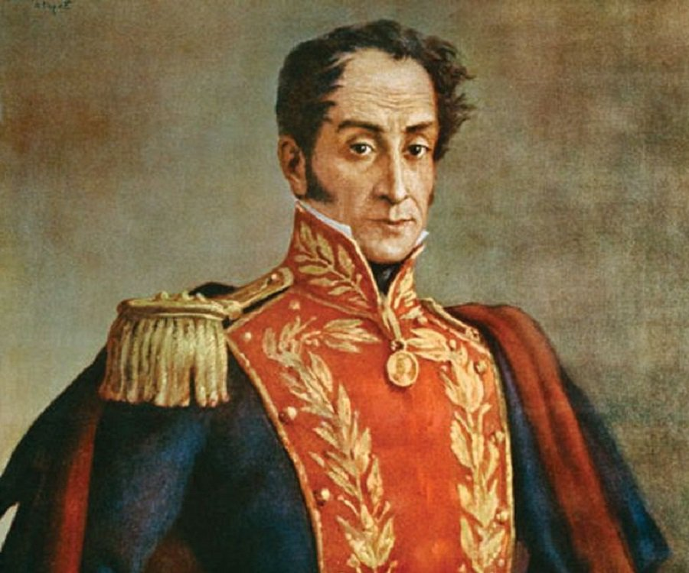
South America
Jose de San Martin & Simon Bolivar – major revolutionary leaders
1810 – Venezuela, Colombia, Ecuador, & Argentina liberated
1817 – Chile gains independence
1822 – Brazil declares independence from Portugal
1824 – Peru liberated by Bolivar

Slide 20
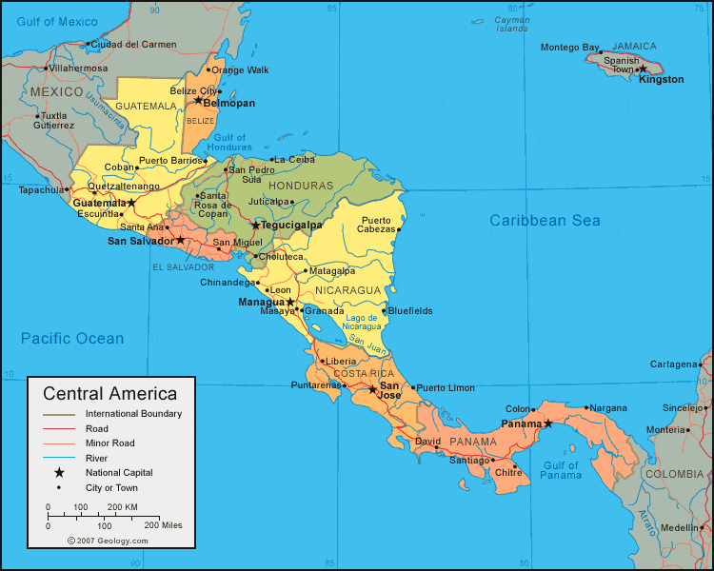
Central America
By 1823 almost all Central America states had gained freedom
5 republics: Guatemala, El Salvador, Honduras, Costa Rica & Nicaragua

Slide 21
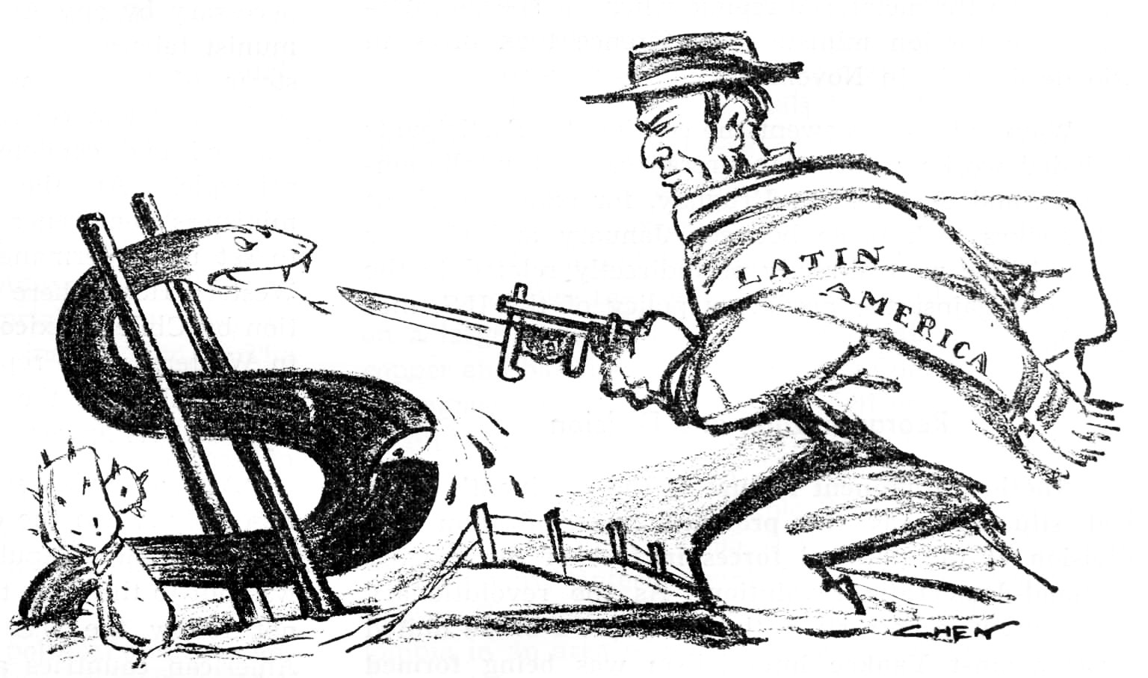
Nation building
Number of problems
Staggering loss of people, property, livestock
Uncertainty in new borders
Poor roads, railroads made communication and unity difficult
During 19th century – LA became economically dependent on West again

Slide 22
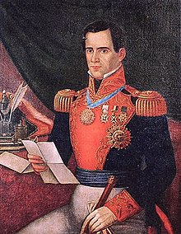
Antonio Lopez de Santa anna
Ruled Mexico from 1833-1855
“Napoleon of the West”
Misused state funds, halted reforms, created chaos
Mexican-American War 1846 – 1848
Period of reform followed – led by Benito Juarez
Caudillos – strong leaders supported by military and landed elite; very popular

Slide 23
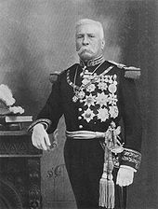
Revolution in Mexico
Porifirio Diaz – ruled from 1877-1911
Workers wages declined
Francisco Madero – forced Diaz from power
Tried to lead revolution, proved to be difficult
Pancho Villa
1910-1920 Mexican Revolution

Slide 24
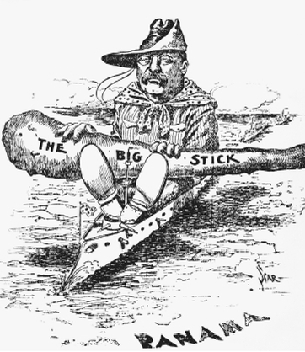
U.S. & Latin America
US dominated LA
Built infrastructure
Economic dependence
Persistent Inequality

Slide 25
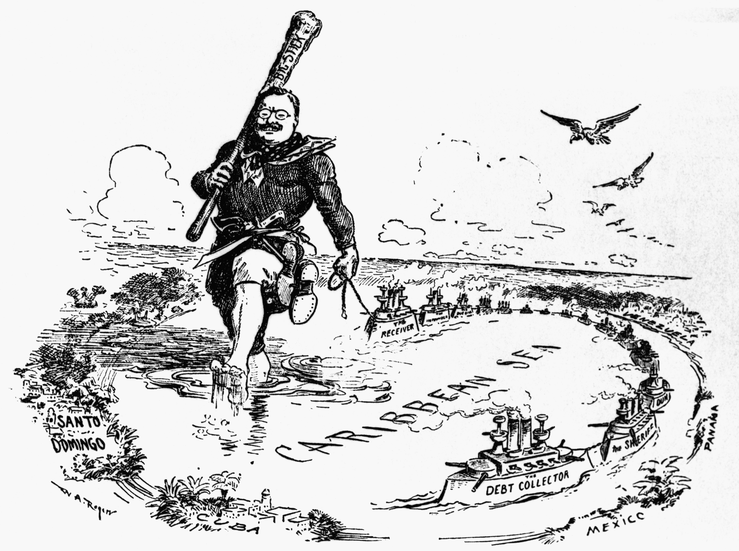
Theodore Roosevelt
Takes office in 1901
1903 – supports Panamanian rebellion against Colombia – gained land for Panama Canal – completed in 1914
Good Neighbor Policy

